Slide 1
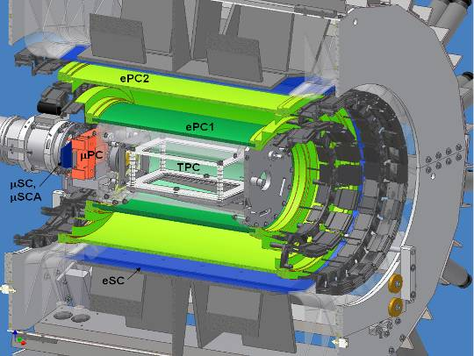
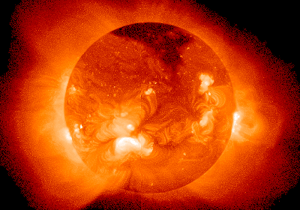
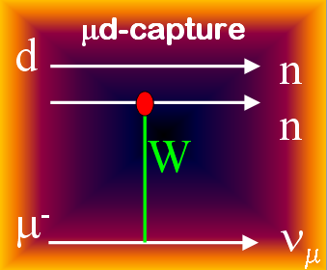
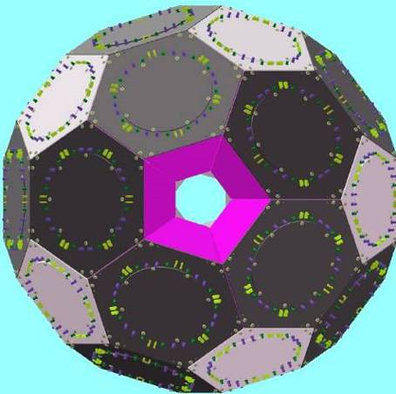
Precision Muon Capture
Peter Kammel
Department of Physics and Center for Experimental Nuclear Physics and Astrophysics,
University of Washington
http://www.npl.washington.edu/muon/
Basic QCD
Symmetries
“Calibrating
the Sun”
MuCap
MuSun
Fundamental
Constants
MuLan
SLAC, April 2013

Slide 2
Outline
Introduction
μ → e ν ν Strength of Weak Interaction
MuLan G_{F}
μ + p → n + ν Basic QCD Symmetries
MuCap g_{P}
μ + d → n + n + ν Weak few nucleon reactions
MuSun and astrophysics

Slide 3
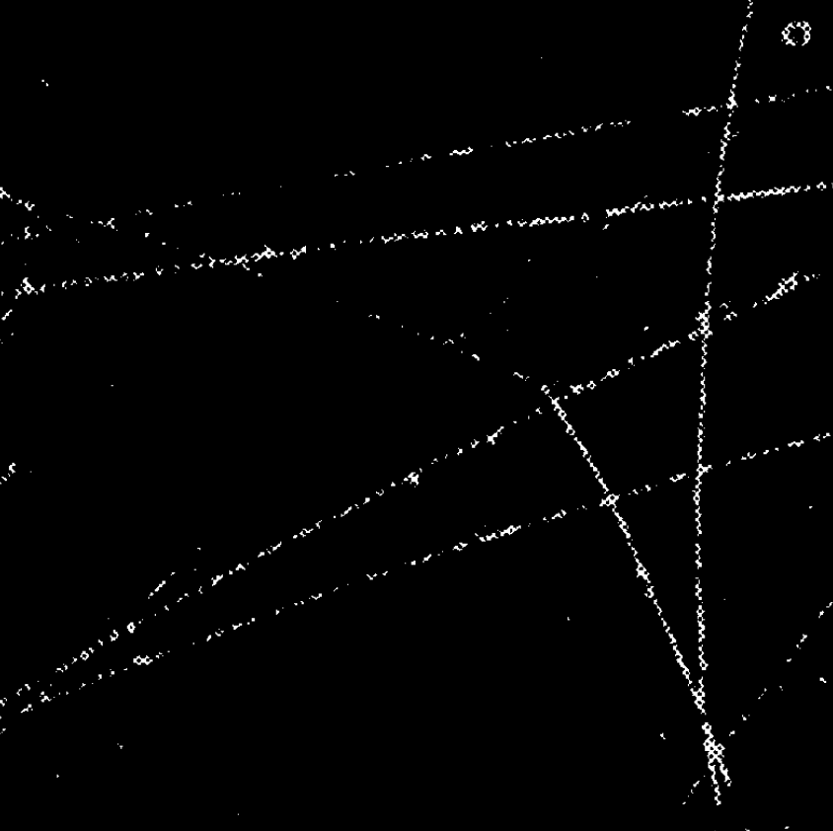
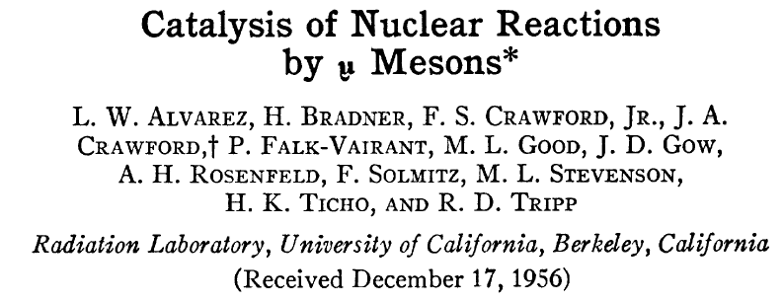
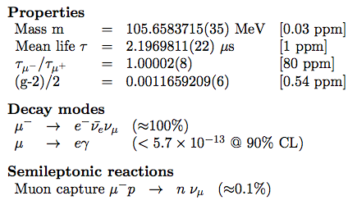
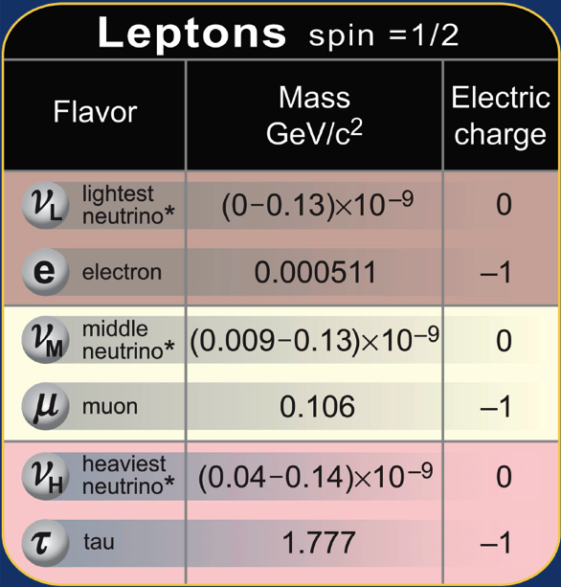
What’s Special about Muons?
Precision physics @ Intensity frontier
Muon decay determines strength and structure of weak interaction
Muon capture probes physics not accessible in 1st lepton generation
  Aside: Muon is heavy electron
e
μ⁻
μ⁻
μ stops
³He
μd atom formed
pdμ formed
pdμ → ³He+μ fusion (5.4 MeV)

Slide 4
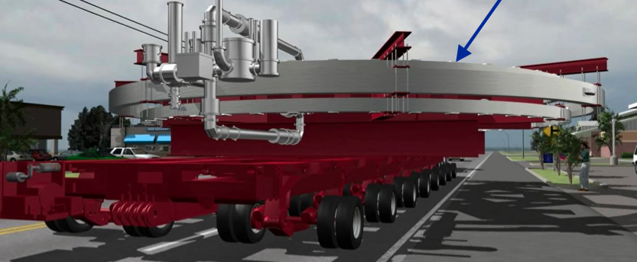
What’s Special about Muons?
Precision physics @ Intensity frontier
Muon decay determines strength and structure of weak interaction
Muon capture probes physics not accessible in 1st lepton generation
  Aside: Muon is heavy electron
Quantum loop sensitivity to
new physics (m_{μ}/m_{e})²
Charged Lepton Flavor violation
Muon collider, MSR, etc
Muon g-2 @ FNAL

Slide 5
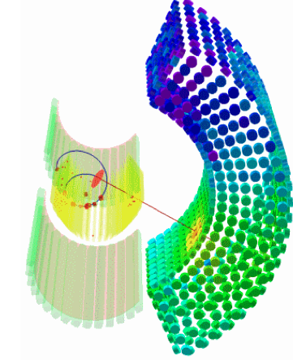
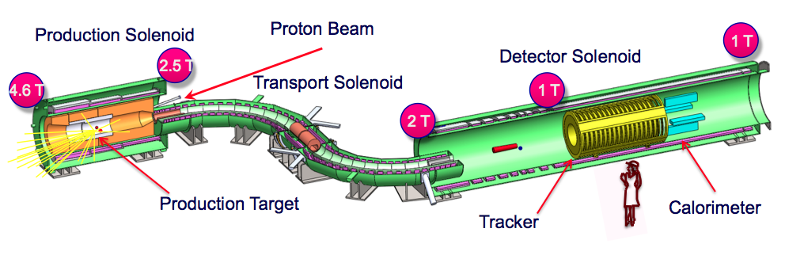
What’s Special about Muons?
Precision physics @ Intensity frontier
Muon decay determines strength and structure of weak interaction
Muon capture probes physics not accessible in 1st lepton generation
  Aside: Muon is heavy electron
Quantum loop sensitivity to new physics (m_{μ}/m_{e})²
Charged Lepton Flavor violation
Muon collider, MSR, etc
MEG@PSI
Mu2e @FNAL

Slide 6
Outline
Introduction
μ → e ν ν Strength of Weak Interaction
MuLan G_{F}
μ + p → n + ν Basic QCD Symmetries
MuCap g_{P}
μ + d → n + n + ν Weak few nucleon reactions
MuSun and astrophysics

Slide 7
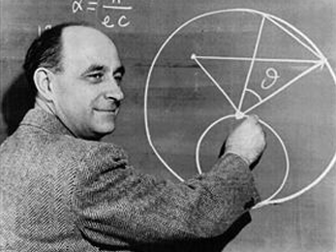
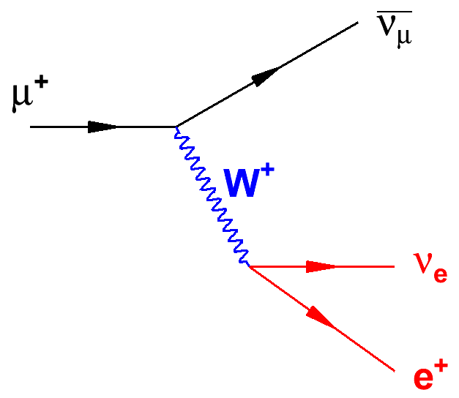
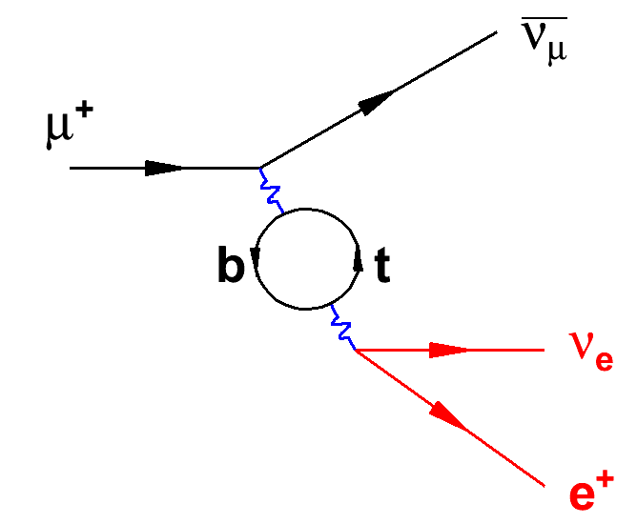
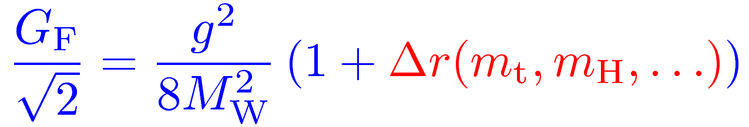

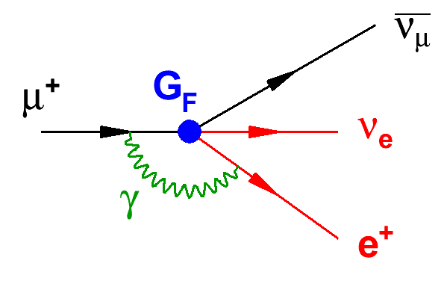
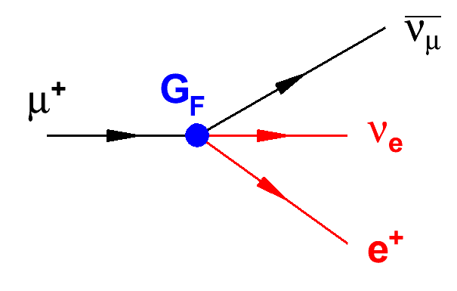
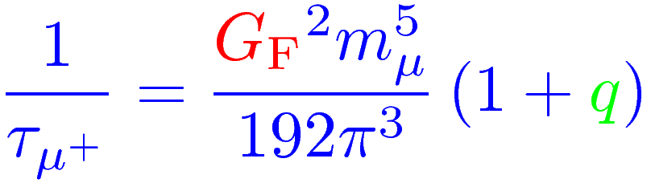
Muon Lifetime
Fundamental electro-weak couplings
Implicit to all EW precision physics
Uniquely defined by muon decay
G_{F} α M_{Z}
9 ppm → 0.5 ppm 0.37 ppb 23 ppm
MuLan Collaboration
PRL 106, 041803 (2011)
Extraction of G_{F} from τ_{μ} : 1999 two-loop calc. reduced error from
15 to ~0.2 ppm
R
QED

Slide 8
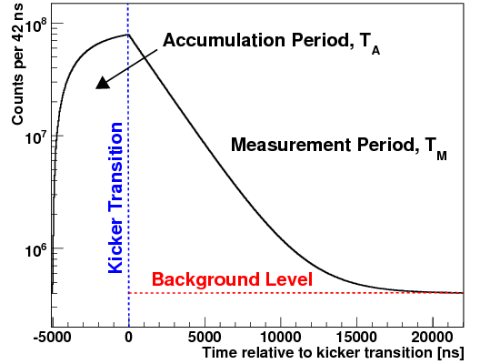
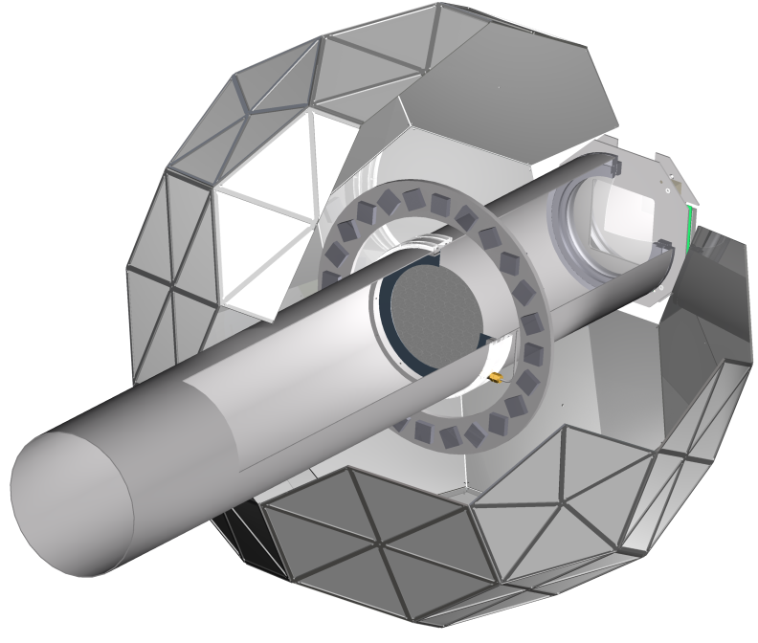

The MuLan experimental concept…
170 Inner/Outer
tile pairs
Real data
Kicker On
450 MHz
WaveForm
Digitization
Measurement Period
Number (log scale)
time
Fill Period
-12.5 kV
12.5 kV
Detector has symmetric design around stops

Slide 9
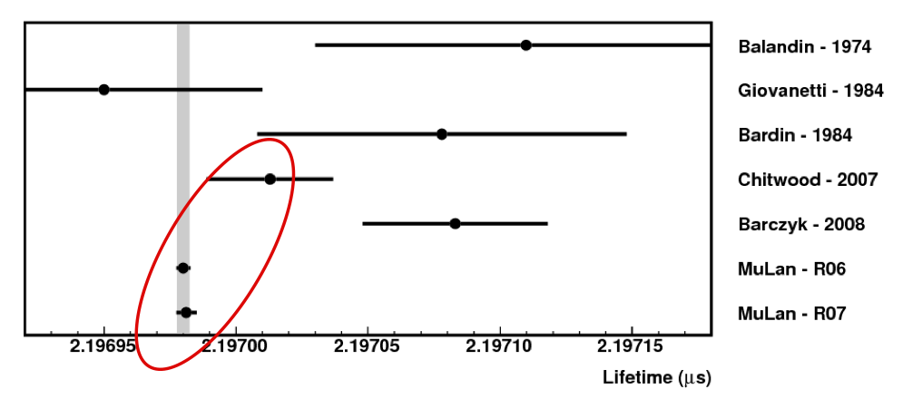
MuLan Final Results
τ(R06) = 2 196 979.9 ± 2.5 ± 0.9 ps
τ(R07) = 2 196 981.2 ± 3.7 ± 0.9 ps
τ(Combined) = 2 196 980.3 ± 2.2 ps (1.0 ppm)
Δτ(R07 – R06) = 1.3 ps
The most precise particle or nuclear or atomic lifetime ever measured
New G_{F} (30x improved since 1999 PDG)
G_{F}(MuLan) = 1.166 378 7(6) x 10⁻⁵ GeV⁻² (0.5 ppm)

Slide 10
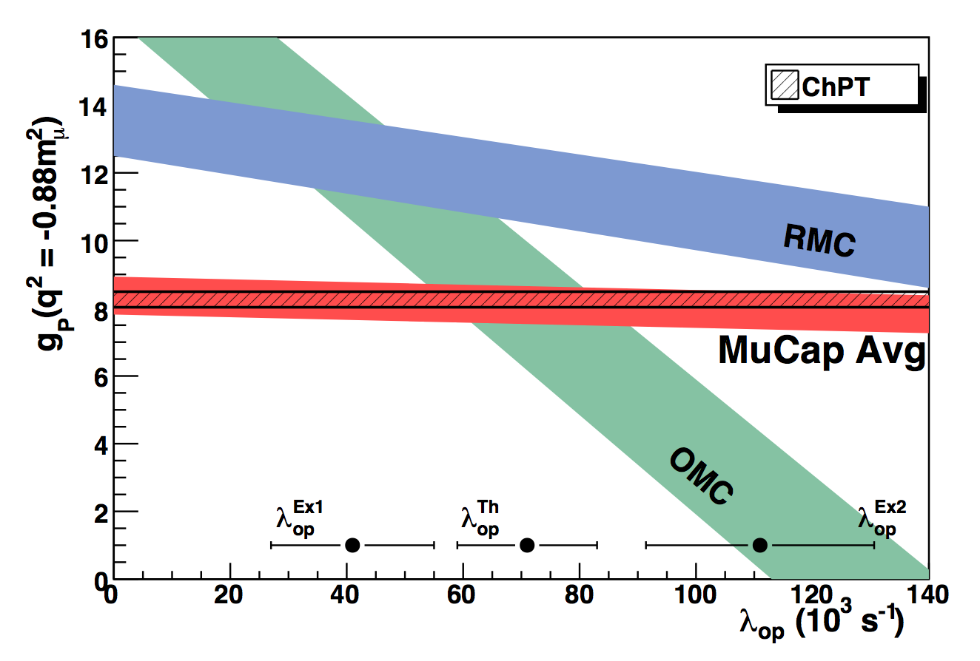
Outline
Introduction
μ → e ν ν Strength of Weak Interaction
MuLan G_{F}
μ + p → n + ν Basic QCD Symmetries
MuCap g_{P}
μ + d → n + n + ν Weak few nucleon reactions
MuSun and astrophysics

Slide 11
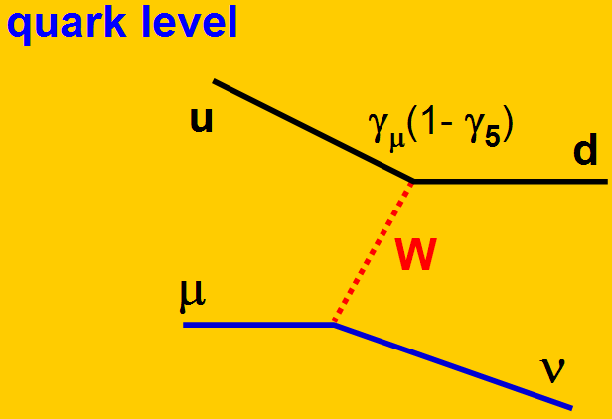
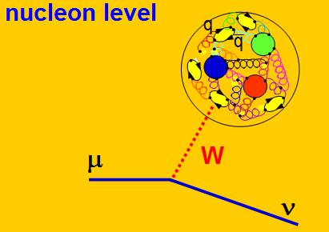
Muon Capture on the Proton
Historical: V-A and μ-e Universality
Today: EW current key probe for
  Understanding hadrons from
  fundamental QCD
  Symmetries of Standard Model
  Basic astrophysics reactions
μ⁻ + p → ν_{μ}+ n
charged current
Precision experiments meet first principle theory

Slide 12
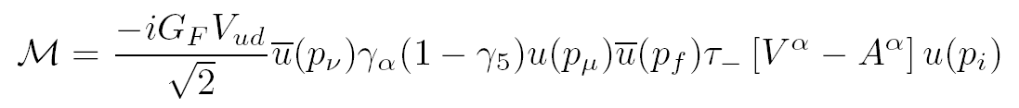
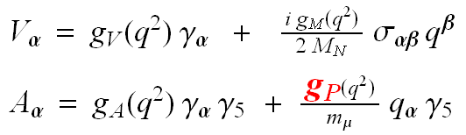
Capture Rate Λ_{S} and Form Factors
Muon Capture
Form factors
μ⁻ + p → ν_{μ}+ n rate Λ_{S} at q²= -0.88 m_{μ}²
+ second class currents
suppressed by isospin symm.
Lorentz, T invariance
All form factors precisely known
from SM symmetries and data.
g_{V}, g_{M} from CVC, e scattering
g_{A} from neutron beta decay
apart from g_{P} = 8.3 ± 50%
0.45 %
9 % pre MuCap

Slide 13
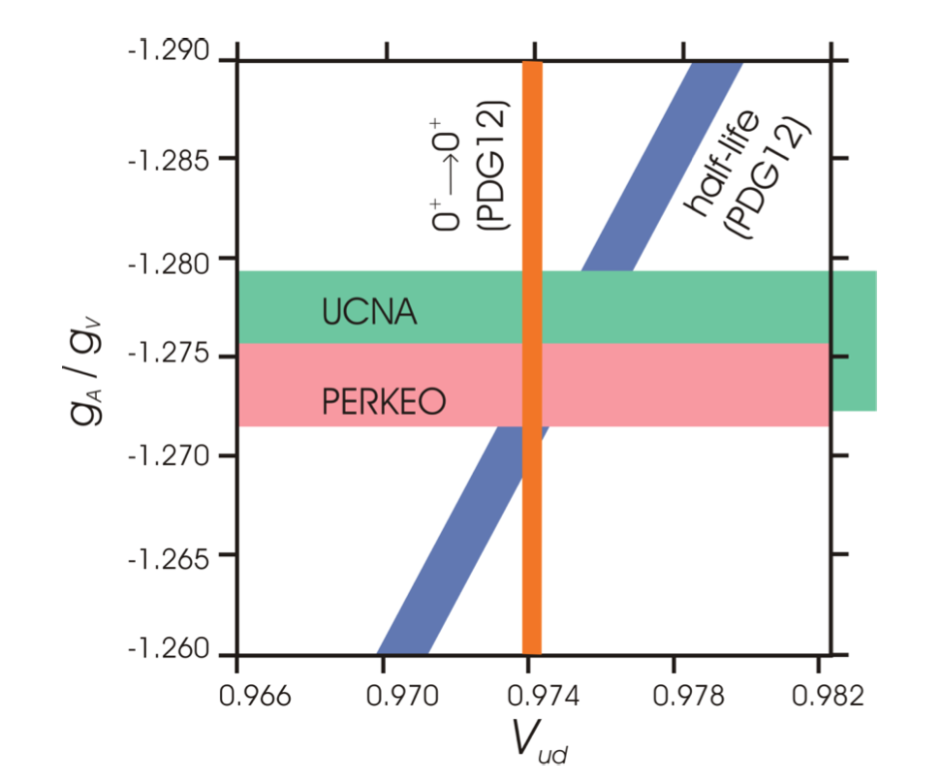

Axial Vector g_{A}
PDG 2008
g_{A}(0)= 1.2695±0.0029
PDG 2012
g_{A}(0)= 1.2701 ±0.0025
Future ?
g_{A}(0)= 1.275
Lattice QCD ?
Axial Mass
Λ_{A}= 1 GeV νp, π electro production
1.35 nuclear targets
PDG12

Slide 14
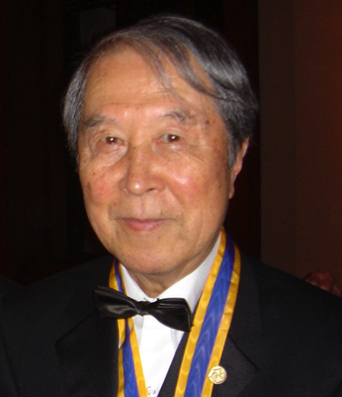
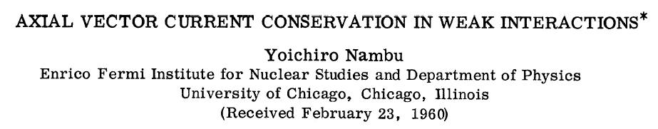
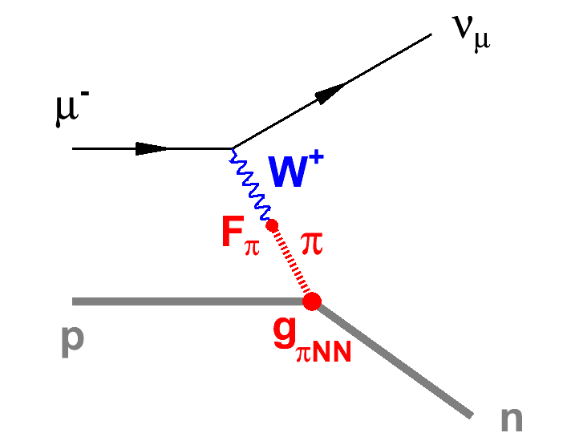
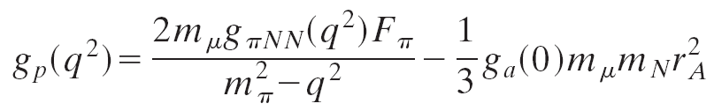
Pseudoscalar Form Factor g_{P}
History
  PCAC
  Spontaneous broken symmetries in subatomic physics, Nambu. Nobel 2008
State-of-the-art
  Precision prediction of ChPT
    Foundations for
    mass generation
    chiral perturbation theory of QCD
g_{P} = (8.74 ± 0.23) – (0.48 ± 0.02) = 8.26 ± 0.23
leading order one loop two-loop <1%
g_{P} experimentally least known nucleon FF
solid QCD based prediction (2-3% level)
basic test of QCD symmetries
recent lattice results
Kammel & Kubodera, Annu. Rev. Nucl. Part. Sci., 60 (2010), 327
Gorringe, Fearing, Rev. Mod. Physics 76 (2004),31

Slide 15
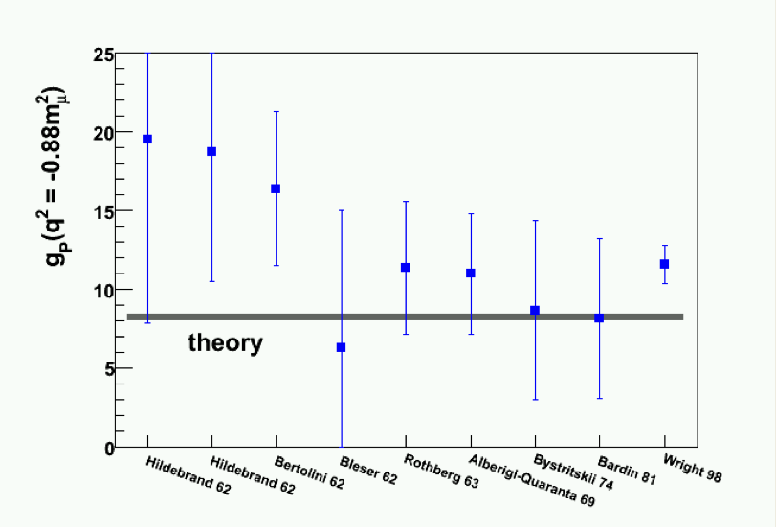
50 years of effort to determine g_{P}
OMC
RMC
μ⁻ + p → n + ν + γ
Kammel&Kubodera
“ Radiative muon capture in hydrogen was carried out only recently with the result
that the derived g_{P} was almost 50% too high. If this result is correct, it would be
a sign of new physics... ’’
— Lincoln Wolfenstein (Ann. Rev. Nucl. Part. Sci. 2003)

Slide 16
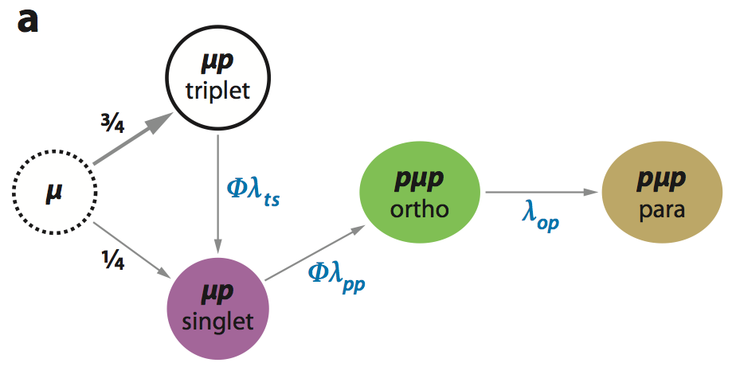
“Rich” Muon Atomic Physics
Makes Interpretation Difficult
Λ_{T} = 12 s⁻¹
Λ_{ortho}=506 s⁻¹
Λ_{para}=200 s⁻¹
Λ_{S}= 710 s⁻¹
Strong sensitivity to hydrogen density φ (rel. to LH₂)
In LH₂ fast ppμ formation, but λ_{op} largely unknown

Slide 17
Precise Theory vs. Controversial Experiments
g_{P}
RMC @ TRIUMF
ChPT
OMC@ Saclay
TRIUMF 2006
exp
theory
λ_{OP} (ms⁻¹)
  no overlap theory & OMC & RMC
  large uncertainty in λ_{OP} → g_{P} ± 50% ?

Slide 18
MuCap Strategy
Precision technique
Clear Interpretation
Clean stops in H₂
Impurities < 10 ppb
Protium D/H < 10 ppb
Muon-On-Request
All requirements simultaneously

Slide 19
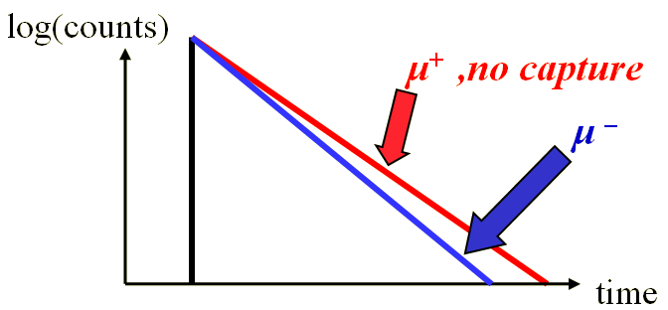
MuCap Strategy
Precision technique
Clear Interpretation
Clean stops in H₂
Impurities < 10 ppb
Protium D/H < 10 ppb
Muon-On-Request
All requirements simultaneously
  μp→nν rare, only 0.16% of μ→eνν
  neutron detection not precise enough
  Lifetime method
Λ_{S} = 1/τ_{μ−} - 1/τ_{μ+}
measure τ_{μ} to 10ppm

Slide 20
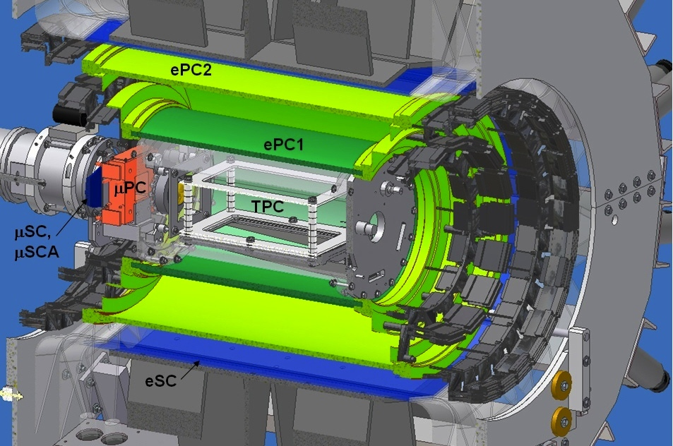
MuCap Technique
e
t
μ
Notes:
Different techniques, plot with more and more results

Slide 21
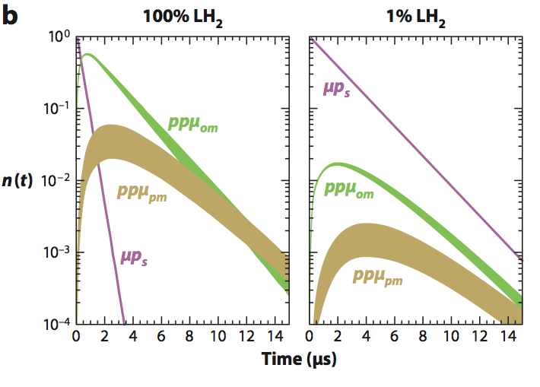
MuCap Strategy
Precision technique
Clear Interpretation
Clean stops in H₂
Impurities < 10 ppb
Protium D/H < 10 ppb
All requirements simultaneously
  At gas density of 1% LH₂ density mostly pμ atoms during muon lifetime

Slide 22
MuCap Strategy
Precision technique
Clear Interpretation
Clean stops in H₂
Impurities < 10 ppb
Protium D/H < 10 ppb
All requirements simultaneously

Slide 23
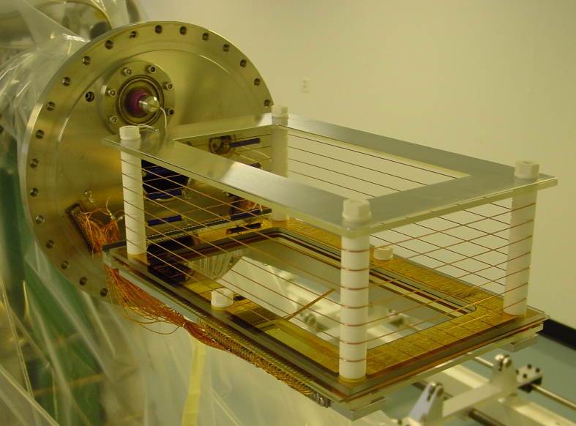
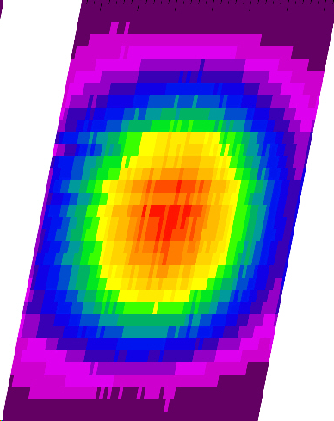
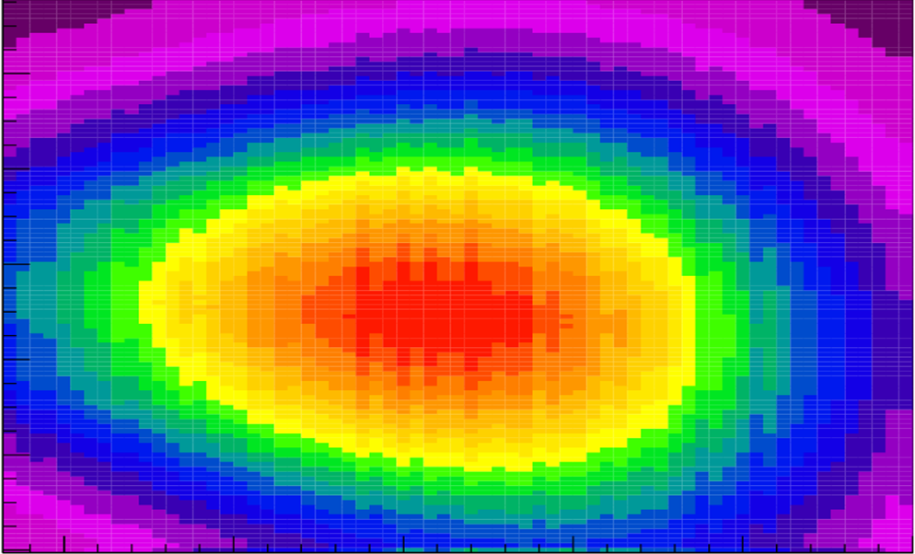
Muons Stop in Active TPC Target
  to prevent muon stops in walls
  (Capture rate scales with ~Z⁴)
10 bar ultra-pure hydrogen, 1.12% LH₂
2.0 kV/cm drift field
~5.4 kV on 3.5 mm anode half gap
bakeable glass/ceramic materials
Observed muon stopping distribution
μ⁻
e⁻
p
E
3D tracking w/o material in fiducial volume

Slide 24
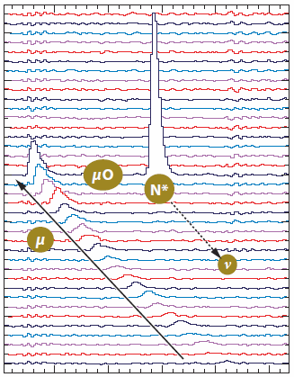
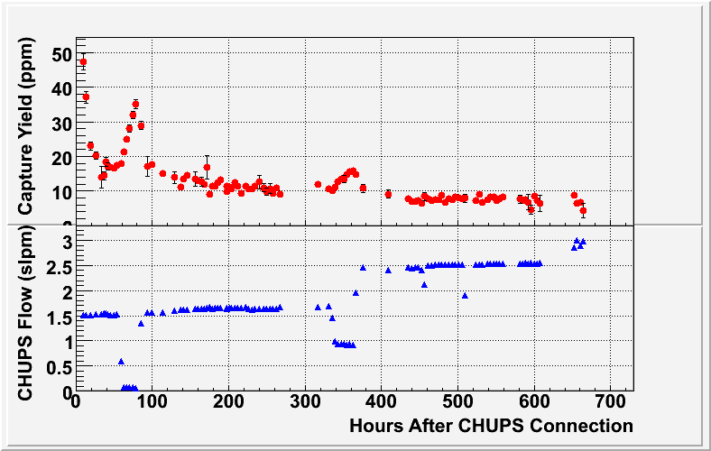
MuCap Strategy
Precision technique
Clear Interpretation
Clean stops in H₂
Impurities < 10 ppb
Protium D/H < 10 ppb
Muon-On-Request
All requirements simultaneously
  Gas continuously
  purified
  TPC monitors
  impurities
  Impurity doping
  calibrates effect
anodes
time
2004: c_{N} < 7 ppb, c_{H2O}~20 ppb
2006 / 2007: c_{N} < 7 ppb, c_{H2O}~9-4ppb

Slide 25
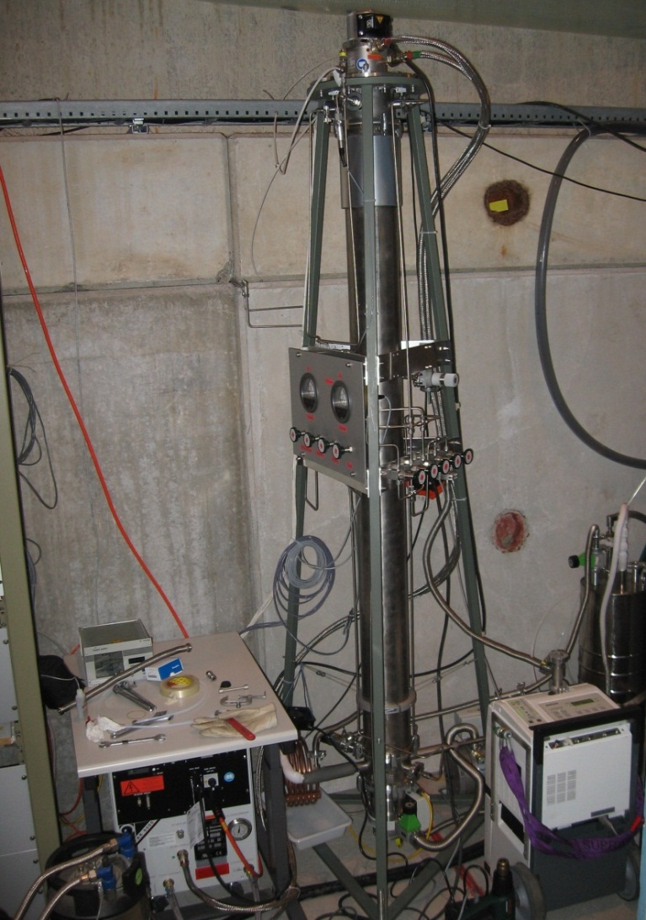
MuCap Strategy
Precision technique
Clear Interpretation
Clean stops in H₂
Impurities < 10 ppb
Protium D/H < 10 ppb
All requirements simultaneously
Cryo distillation column,
purity verified by AMS

Slide 26
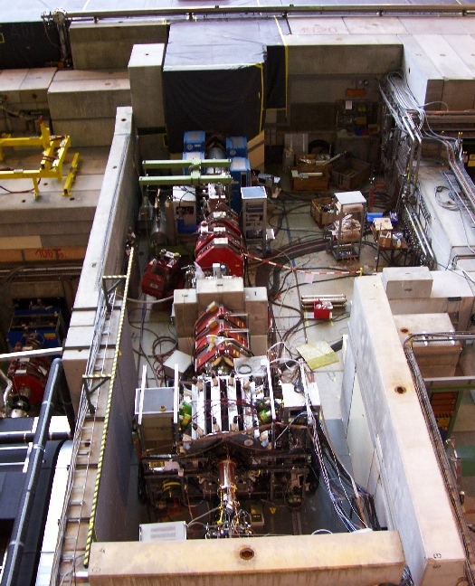
Experiment at PSI
πE3 beamline
Kicker
Muon On Request
Separator
Quadrupoles
Slit
TPC
MuCap detector

Slide 27
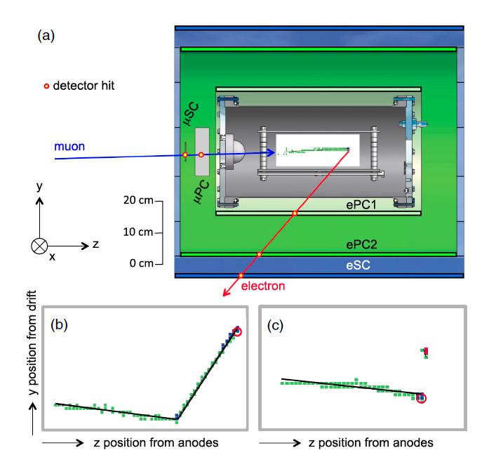
Muon defined by TPC
Signals digitized into pixels with three thresholds (green, blue, red)
TPC side view
10⁻²/μ
~10⁻⁶/μ
b) Large angle μ-p scatter
c) Delayed capture on
impurity μO→Nν

Slide 28
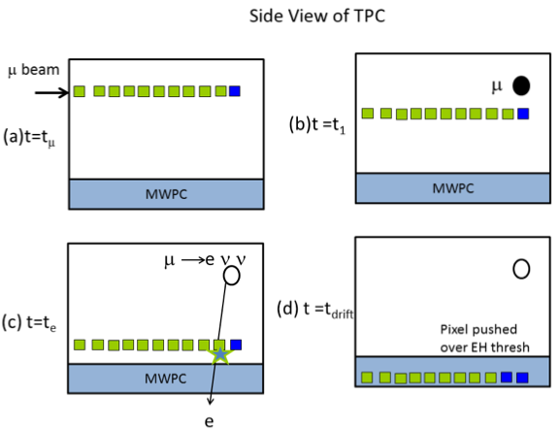
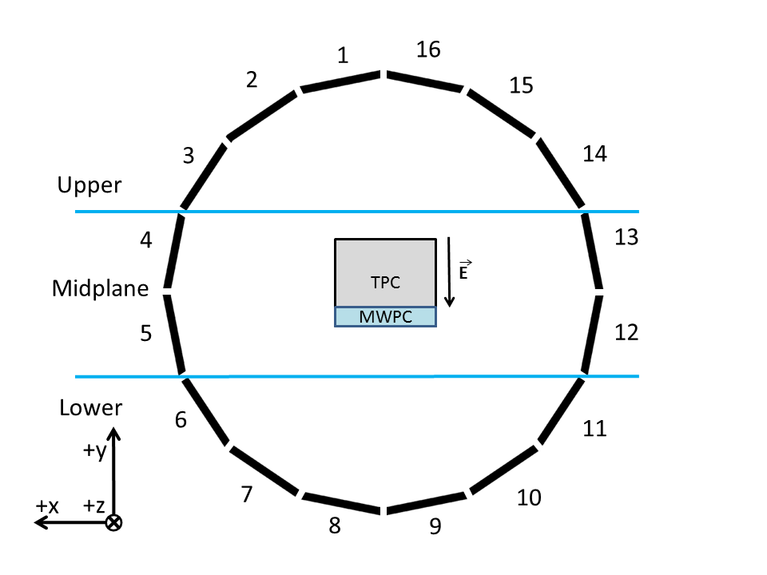
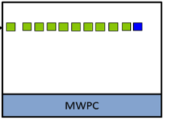
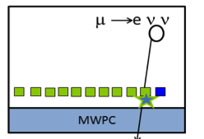
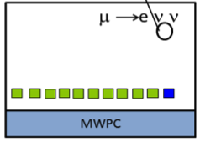
Electron defined by Independent e-Tracker
  Small, but significant
  interference with μ track
  simple, robust track
  reconstruction and
  its verification
  essential

Slide 29
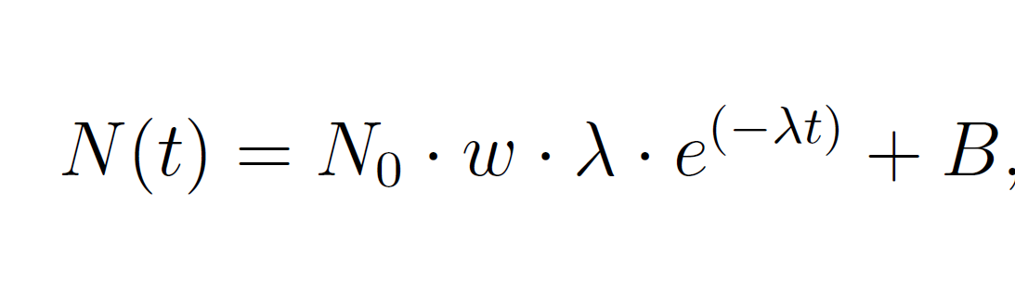




Time Distributions are Consistent
  fitted λ is constant
  No azimuth
  dependence
4/6/2012
29
Run groups
Data run number (~3 minutes per run)

Slide 30

MuCap Results
rates with secret offset, stat. errors only

Slide 31

Disappearance rate λ

Slide 32



Determination of Λ_{S}
molecular formation
MuCap: precision measurement
MuLan
bound state effect

Slide 33


Error Budget

Slide 34

MuCap Results
APS Editor's spotlight
PSI press release
Physics World
Capture Rate
Λ_{S} (MuCap) = 714.9 ± 5.4_{stat} ± 5.1_{syst} s⁻¹
Λ_{S} (theory) = 712.7 ± 3.0_{gA} ± 3.0_{RC} s⁻¹
Pseudoscalar Coupling
g_{P}(MuCap) = 8.06 ± 0.48_{Λs(ex)} ± 0.28_{Λs(th)}
  for g_{A}(0) → -1.275 g_{P}(MuCap) → 8.34
By-product (reverse logic, i.e. assuming ChPT)
CPT τ_{μ+}/τ_{μ-} to 20 ppm (4 fold improvement)
recent calculations
PDG12 updated
Czarnecki, Marciano, Sirlin calculation
711.4 | Pheno | CMS
706.6 | HBChPT | BHM
714.5 | HBChPT | AMK

Slide 35
Precise and Unambiguous MuCap Result
Verifies Basic Prediction of Low Energy QCD
g_{P}(MuCap) = 8.06 ± 0.55
g_{P}(theory) = 8.26 ± 0.23

Slide 36


Outline
Introduction
μ → e ν ν Strength of Weak Interaction
MuLan G_{F}
μ + p → n + ν Basic QCD Symmetries
MuCap g_{P}
μ + d → n + n + ν Weak few nucleon reactions and astrophysics
MuSun

Slide 37

Motivation
μ⁻ + d → ν + n + n measure rate Λ_{d} in μd(↑↓) atom to <1.5%
simplest nuclear weak interaction process with precise th. & exp.
  g_{P} from MuCap, rigorous QCD based calculations: effective field theory
close relation to neutrino/astrophysics
  solar fusion p p → d e⁺ ν
Sudbury: ν_{e} d → p p e⁻ (CC)
ν_{x} d → p n ν_{x} (NC)
model independent connection by single Low Energy Constant

Slide 38
μ + d → ν + n + n Theory
Axial current reaction
Gamow-Teller ³S₁ → ¹S₀
one-body currents well defined
two-body currents not well
constrained by theory
(short distance physics)
Methods
  Potential model + MEC
  hybrid EFT
  Effective field theories (EFT)
Δ
MEC
π
EFT
∧
L_{1A}, d^{R}
Low Energy Constants

Slide 39


Quest for the Unknown LEC
“Calibrate the Sun”
^
Axial current d^{R} (or c_{D})
Extract from axial current reaction in
2-body system
  theoretical clean, natural progression of topical program
  to build nuclear physics from QCD
  experimental information scarce: 100% uncertainty in LEC
  MuSun only realistic option, reduce uncertainty 100% to ~20%
3-body system
  2 LECs and additional complexity enter
  tritium beta decay
  current state of the art
c_{E}
H. Krebs 2012

Slide 40
Precise Experiment Needed

Slide 41


Muon Physics and Interpretation
Precision technique
Clear Interpretation
Clean stops in D₂
Impurities < 1ppb
H/D < 100 ppb
complex, can one extract EW parameters ?
Optimal conditions
Muon-Catalyzed Fusion
Breunlich, Kammel, Cohen, Leon
Ann. Rev. Nucl. Part. Science, 39: 311-356 (1989)

Slide 42

Precise Experiment Possible?
Precision technique
Clear Interpretation
Clean stops in D₂
Impurities < 1ppb
H/D < 100 ppb
Active muon target

Slide 43

MuSun Detector System
Electron Tracker
Liquid Ne
Circulation
CryoTPC
TPC Digitizer
Electronics
Impurity filtering

Slide 44





Fusions in TPC
run2011, prelim
μSC
³He
μ
robust muon tracking algorithm
at 10⁻⁵ level required !
t+p
μSC
2 μs

Slide 45

Status and Plans
Analysis
  analysis run 2011 data
4.8 x 10⁹ good μ- stop
4 x 10⁸ μ+ stop events
  first physics publication
  study detector upgrades
Upgrades
  new beamline at PSI
  cryo preamp
  TPC optimization
  improved purity
  and monitoring
Final runs 2013-14
Commissioning October 2012

Slide 46


μ³He
Reaction
+ ³He → ³H + ν
Updated Results
PSI experiment: 1496±4 /s (0.3%)
Pisa-JLab theory: 1494±21 /s
➔ g_{P}(q²=-0.954m_{μ}²)=8.2±0.7

Slide 47



Summary: Evolution of Precision
= 8.06 ± 0.55 (μp)
= 8.2 ± 0.7 (μ³He exp+EFT theory)
in progress
complete
future
complete

Slide 48



Summary: Hydrogen TPCs
 | MuHe3 | MuCap | MuSun
Year | 1995 | 2003 | 2010
p (bar) | 50-120 | 10 | 8
T (K) | 300 | 300 | 30
Gas | ³He, D₂ | H₂ | D₂
Geometry (cm³) | 15 | 15x12x18 | 12x10x8
Gain | 1 | 10³-10⁴ | 1
E_{d} (kV/cm) | 29 | 2 | 10
Purity (ppb) | 1000 | 10 | 1
rms el. resolution | 25 keV | 5-10 % | 5 keV?
Physics | MCF, μ³He capture | μp capture | μd capture
36.5 eV per ion pair
Other physics ?
  Search tensor current in ⁶He decay
  Heavy ν, γ

Slide 49






Collaborations
MuCap/MuSun
Precision Muon Physics Group at UW
Projects
MuLan
MuCap
MuSun
Muon g-2
Mu2e, AlCap
Petersburg Nuclear Physics Institute (PNPI), Gatchina, Russia
Paul Scherrer Institute (PSI), Villigen, Switzerland
University of California, Berkeley (UCB and LBNL), USA
University of Illinois at Urbana-Champaign, Urbana, USA
University of Washington, Seattle, USA
Université Catholique de Louvain, Belgium
University of Kentucky, Lexington, USA
Boston University, USA
Regis University, Denver, USA
University of South Carolina, USA
Subset of collaboration
Supported by NSF, DOE, Teragrid, PSI and Russian Academy Science

