Slide 1
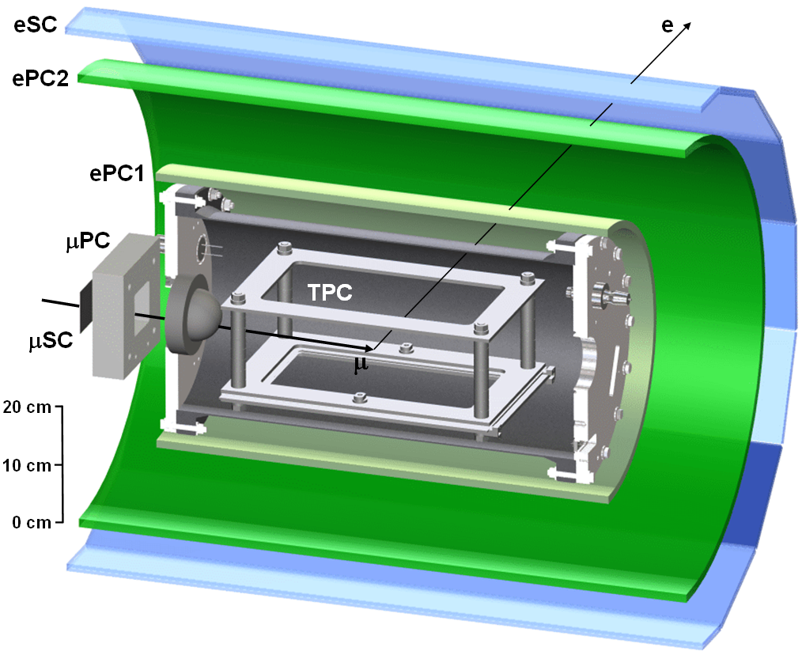
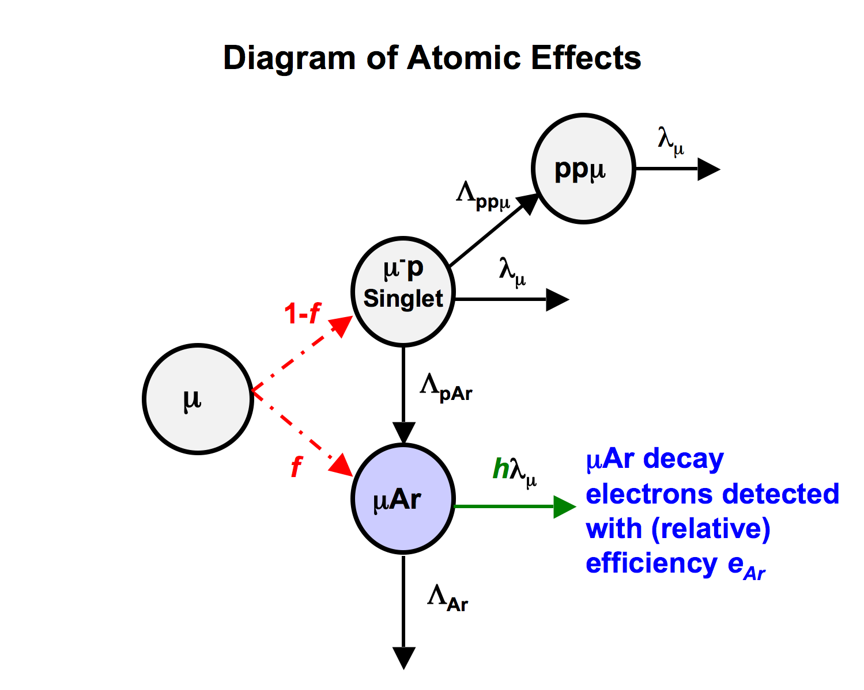

A determination of the formation rate of muonic hydrogen molecules from the MuCap experiment
Sara Anita Knaack
sknaack@illinois.edu
Final Exam
June 25th, 2012

Slide 2
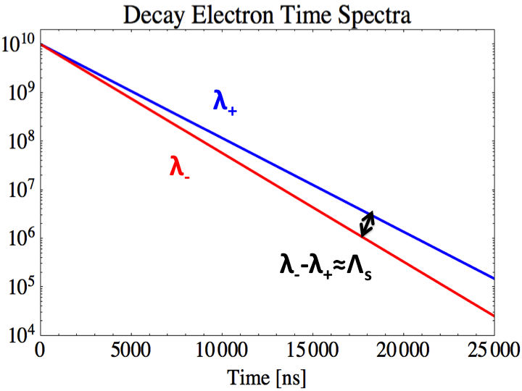
Outline
The MuCap experiment
Motivation for the measurement of Λ_{S}
Muon kinetics
Molecular (ppμ) state
A measurement of the molecular formation rate, λ_{ppμ}
The experiment
Event selection
Analysis of the decay electron time spectrum
Systematic effects
Results
Fit stability
Analysis of the capture neutron time spectrum
Consistency check
Conclusions
Notes:
Be efficient

Slide 3
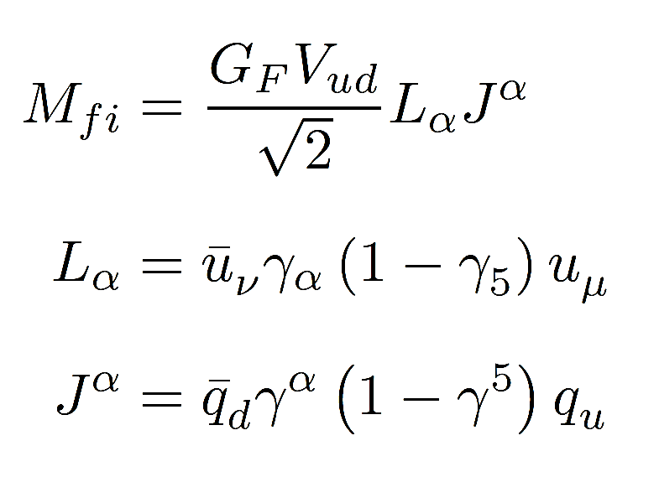
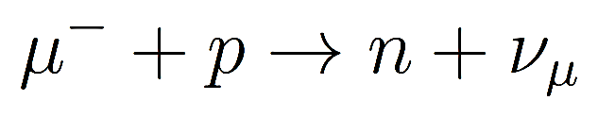
Muon capture in the Standard Model
Weak force interaction
Sensitive to the hadronic environment
spectator quarks
Described in field theories
χPT
p
n
Notes:
1.Weak interaction of negative muon with constituent u quark
2.Hadronic environment
3.

Slide 4
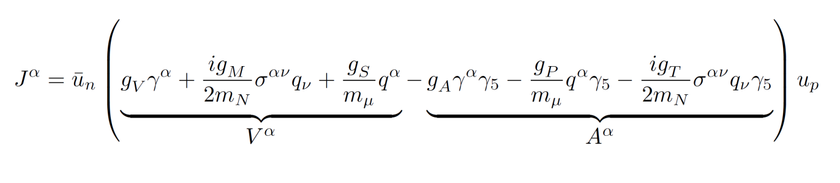
The hadronic form factors
Theory ⇒ g_{S}(q²) , g_{T}(q²) ≈ 0
Experiment ⇒ g_{V}(q²), g_{M}(q²), g_{A}(q²)
G_{F} and V_{ud} also known
Leaves g_{P}(q²=-0.88m_{μ}² ) less well determined experimentally
Muon capture on the proton
g_{P}(q²=-0.88m_{μ}²)=8.36(23) from χPT to NLO
Notes:
The form factors parameterize the most general expression of the hadronic current
Most of the form factors are well known from either theory or experiment
Theroeticallly predicted by chiral perturbation theory
Leaved gP less well understood the best experimental probe for gP is measure the rate of muon capture from the singlet mp state

Slide 5
A measurement of the singlet μp state capture rate, Λ_{S,} determines the pseudoscalar form factor g_{P}
First MuCap result
Notes:
The knowledge of the other form factors, Gf and Vud and the theoretical prediction for gP leads to a prediction for the singlet capture rate.
That is due to the relation between the singlet capture rate and gP
An experimental determination of the singlet capture leads to a determinatoin of gP by these relations here .

Slide 6
The lifetime method – the MuCap experiment
Muon decay
μ⁻ → e⁻ ν_{μ}ν_{e}
BR=O(1)
Capture
μ⁻+p → n+ν
BR=O(1.5x10⁻³)
Molecular state effects
μp+H₂→[(ppμ)pe]⁺+e⁻
λ₊ → 1 ppm relative precision –
MuLan - Phys. Rev. Lett. 106, 041803 (2011)
Λ_{S} → 1% relative precision
λ₋ → 10 ppm relative precision
λ₋ = λ₊ + Λ_{S} - Δ_{ppμ}
Notes:
1. MuCap measures the negative muon disappearance rate in hydrogen.
2. From an atomic weak interaction decay is the dominant disappearance mode of muon
3. Capture proceeds with a smaller probability.
4. Cite plot
5. The positive muon lifetime decay rate is well measured to 1 ppm relative precision by the MuLan experiment
6. A measurement of the singlet capture rate to 1% relative precision requires a measurement of the negative muon disappearance rate to 10 ppm
7. The reason I’m here today is that in addition to muon decay and capture from the mup singlet satate, there are additoinal effects associated with ppmu molecular states, which lead to a necessary correction in the extraction of lambda_S.

Slide 7
A muon stopping in hydrogen
Λ_{T}=12 s⁻¹
μp
Triplet
Enters the n≈14 quantum state
Prompt (≈10 ns) cascade into singlet state
Radiative transitions, Coulomb de-excitation, and Auger interactions
3/4
μ
1/4
μp
Singlet
λ_{μ}=455170.2(5) s⁻¹
Λ_{S}=711.5 s⁻¹
Irreversibly de-excites to the singlet state under thermal conditions.
Notes:
1. The muon slows via electro magnetic interaations
2. Cascades to the lowest energy states via radiative transitions, Coulombic de-excitation and Auger Interactions
3. Forms a tightly bound, small, neutral mup atom
4. Under thermal conditions the triplet state will depopulate irreversibly to the singlet state through
5. Important because the rate of capture from the triplet state is significantly slower than from the singlet state

Slide 8
The ppμ molecular state
Collisional process - Λ_{ppμ}=φλ_{ppμ}
Dominant mode of formation
Electric dipole transition
J=1 “ortho” state
Normalized rate of λ_{ppμ}=1.8 (9) x 10⁶ s⁻¹
J=0 “para” state formation is suppressed
λ_{pf}=7.5 x 10³ s⁻¹
J=1
J=0
Notes:
Collisional interaction – which means the rate of it is depended on the gas density
Exists in two orbilar angular momentum states. This is a contrast to ordinary hydrogen molecules which have a complex spectrum vibrational and rotational quantum states in thermal conditions
Proceeds predominantly via a dipole transition to the J=1 ortho molecular state, which has a binding energy of 100 eV
Theoretical prediction
The direct formation of the J=0 para molecular state is a supressed monopole transition
A de-excitation from the ortho to the para molecular state also proceeds with a rate lambda_op

Slide 9
Molecular state kinetics
λ_{μ}
Λ_{O}=541.5 s⁻¹
μp
Triplet
λ_{μ}
3/4
λ_{op}=
6.6(3.4) x10⁴ s⁻¹
Λ_{ppμ}=φλ_{ppμ}
ppμ
Ortho
μ
1/4
μp
Singlet
ppμ
Para
Λ_{pf}=φλ_{pf}
λ_{μ}=455170.2(5) s⁻¹
Λ_{S}=711.5 s⁻¹
Λ_{P}=213.6 s⁻¹

Slide 10
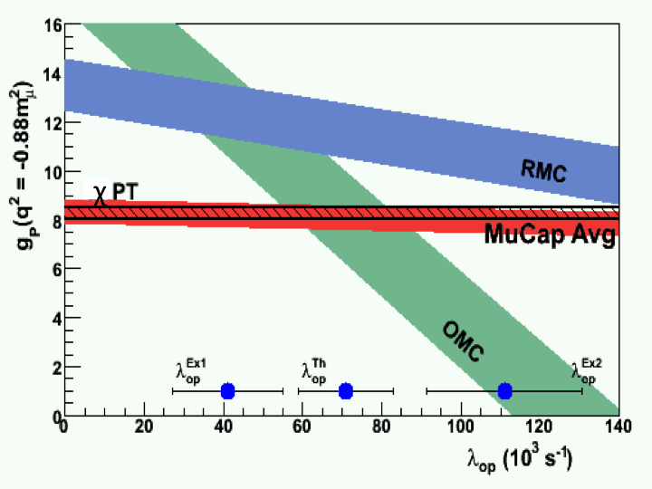
Ambiguity of Λ_{S} Interpretation due to the molecular state kinetics
Measurements of g_{P}
liquid hydrogen target
Sensitive to λ_{op}
The MuCap result is less sensitive to this knowledge
Gaseous hydrogen at 10 bar
Notes:
1.Liquid hydrogen experiments
2. Enhanced sensitivity to knowledge of the population of the molecular states –shown here is the sensitivity to the ortho and para transition rate which is not well understood
3. The MuCap experiment is less sensitive to molecular state effects because of the target condition of a hydrogen gas

Slide 11
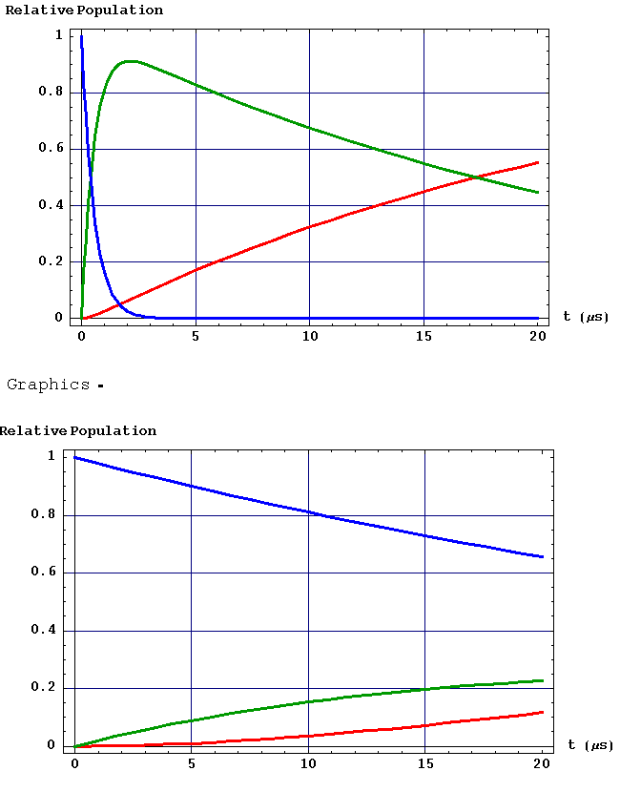
Placing the hydrogen gas under 10 bar at room temperature minimizes the formation of molecular states and their effect on the Λ_{S} extraction
φ = 1 (Liquid)
φ = 0.01 (~10 bar gas)
Rel. Population
Rel. Population
Time after μp Formation
Time after μp Formation
Relative population of μp, ppμ-o and ppμ-p states vs. time (0-20000 ns)
Systematic error for the MuCap measurement
Source of uncertainty | First MuCap result | Final
λ₋ Statistical error | 12.5 s⁻¹ | 5.4 s⁻¹
λ₋ Systematic error | 8.4 s⁻¹ | 5.0 s⁻¹
Correction for Δ_{ppμ} (<λ_{ppμ}>=2.3(5) x10⁶ s⁻¹) (λ_{op}) | 23.5 ± 4.3 ± 3.9 s⁻¹ | < 2 s⁻¹
The improved precision of the final MuCap result requires an improved determination of λ_{ppμ}
Notes:
Hydrogen gas density relative to density of liquid hydrogen.

Slide 12
The current uncertainty of λ_{ppμ}
Historical variation of results and conditions
Systematic < 2 s⁻¹ → < 10 % relative precision
<λ_{ppμ}>=2.3(5) x 10⁶ s⁻¹
Solid
Gas
Liquid
Bystritskii et al. Soviet Physics 43(4), 606 (1976)
Hydrogen gas doped to 30 ppm (atomic) with Xe
Impurity elements introduce competing processes involving the muon

Slide 13
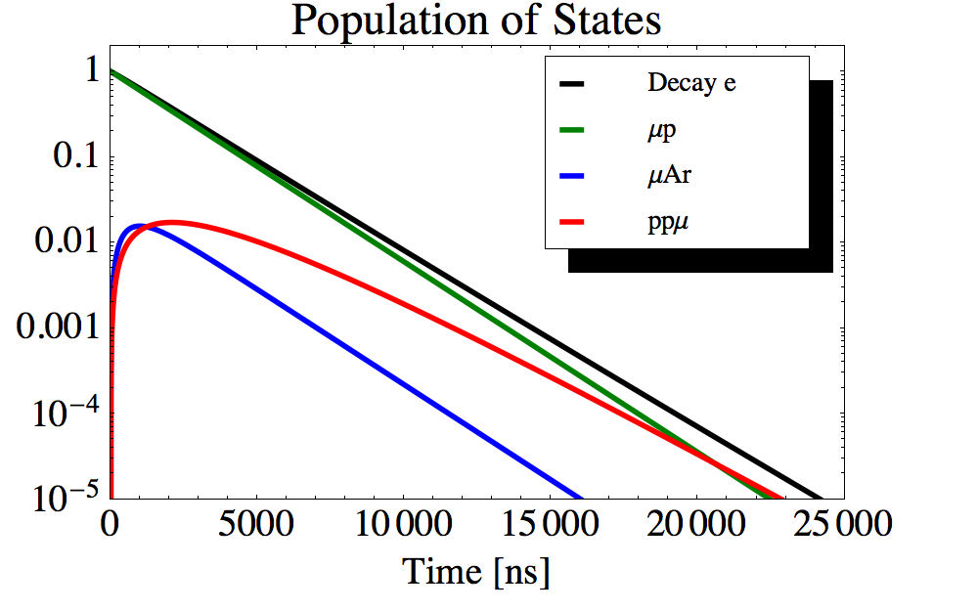
Muon kinetics in an argon-doped hydrogen gas
λ_{μ}
Λ_{ppμ}=φλ_{ppμ}
≈2.2 x10⁴ s⁻¹
ppμ
Λ_{pAr}=φc_{Ar}λ_{pAr}
≈4.5 x10⁴ s⁻¹
≈20 ppm (atomic)
μp
Singlet
λ_{μ}
μAr
n_{μA}r(t), n_{μp}(t) and n_{ppμ}(t)
λ_{μ}=0.455170 x10⁶ s⁻¹
Λ_{Ar}≈1.3 x10⁶ s⁻¹
Notes:
----- Meeting Notes (6/23/12 19:24) -----
This experiment utilizes an argon-dop hydrogen under identical conditions as the pure hydrogen experiment.
Stepping back from the full molecular kinetics already presented, the kinetics of the argon-doped gas are describable as relating to three kintics states
mup singlet
an effective single ppmu state
and the muAr atomic state
The molecular formation process proceese at hte same rate as under the pure hydrogen conditions
while the added argon transfer process perturbs the diappearance rate of the singlet mup state by ~10%
One in the mu argon state the capture rate of the muon dominates muon decay from that state, and

Slide 14
Muon kinetics with Z>1 elements
Muon Transfer – collisional process
Scales approximately Z²
Muon Capture
Remnant (Z-1) nucleus remains.
The rate Λ_{Z} scales with Z_{eff}⁴
# of protons
Wavefunction overlap

Slide 15
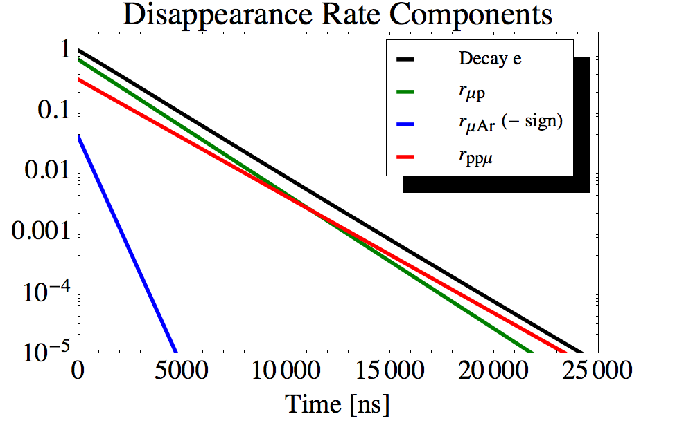
The decay electron time spectrum analysis
Four kinetic rates dominate
λ_{μ}, Λ_{ppμ}, Λ_{pAr} and Λ_{Ar}
C_{ppμ}= Λ_{ppμ}/(Λ_{ppμ}+Λ_{pAr})
C_{μp}= Λ_{pAr} Λ_{Ar} /((Λ_{ppμ}+Λ_{pAr})(Λ_{ppμ}+ Λ_{pAr}- Λ_{Ar}))
C_{μAr}= Λ_{pAr}/(Λ_{ppμ}+Λ_{pAr}- Λ_{Ar})
r_{ppμ}≈ λ_{μ}
r_{μp}≈ λ_{μ}+ Λ_{ppμ}+Λ_{pAr}
r_{μAr}≈ λ_{μ}+Λ_{Ar}
O(10⁸) events
Known muon decay rate λ_{μ}
Determine Λ_{ppμ}, Λ_{pAr} and Λ_{Ar}
to %-level precision.

Slide 16
Capture neutron time spectrum
Dominated by capture form μAr state
7% of all muon stop events
Can obtain O(10⁶) events
Extract r_{μp} and r_{μAr}
Internal consistency check

Slide 17
The MuCap experimental setup
Muon beam
Entrance detectors, μSC
Muon timing, t_{μ}
Time projection chamber (TPC)
Decay electron detectors
ePC chambers (tracking)
eSC hodoscope (t_{e} - timing)
Eight liquid scintillator neutron detectors
Neutron timing, t_{n}

Slide 18
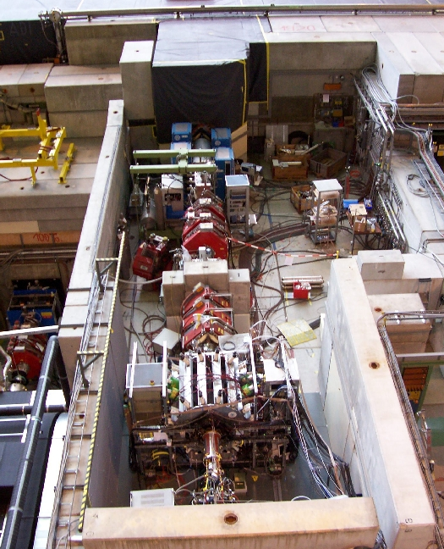

Muon beam
πE3 beamline
Kicker
Delivers 7x10⁴ muon/s
p≈32.6 MeV/c
≈5 MeV
Electrostatic kicker
Reduces beam rate by 100
With μSC implements a single muon event structure
Pileup protection
Separator
Quadrupoles
Slit
TPC
MuCap detector

Slide 19
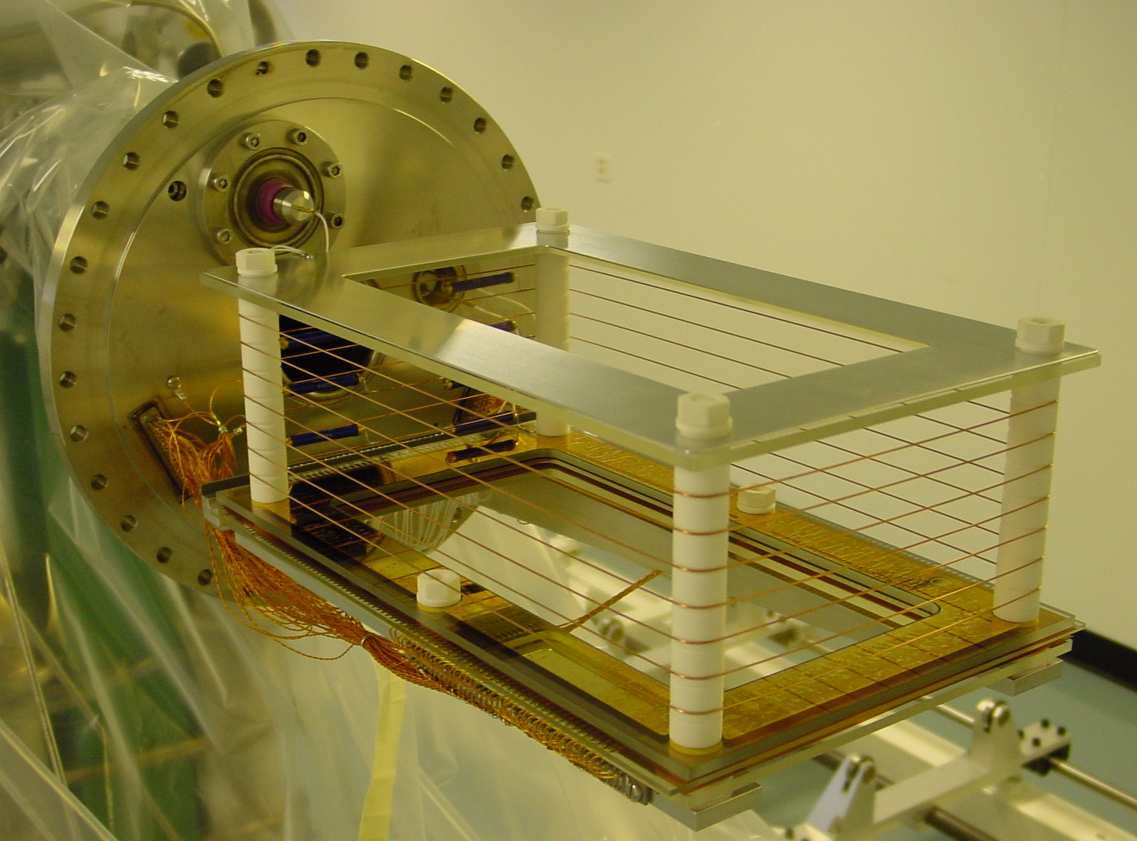
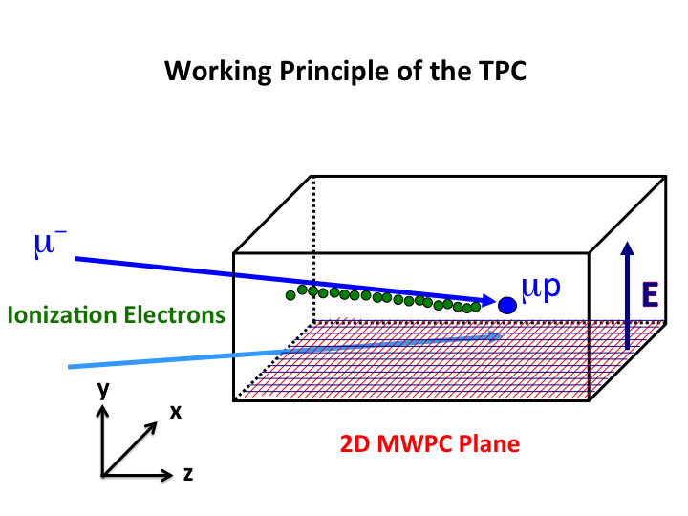
The time projection chamber target
2.0 kV/cm drift field
V_{drift} of 5.5 mm/μs
The hydrogen gas is both a target and an active detection volume
80 anode wires, z axis
35 strips cathode strips, x axis
Time to digital converter readout
2-D unit → pixel
EL, EH, EVH thresholds
Notes:
5.1 kV on 2 mm half-gap

Slide 20
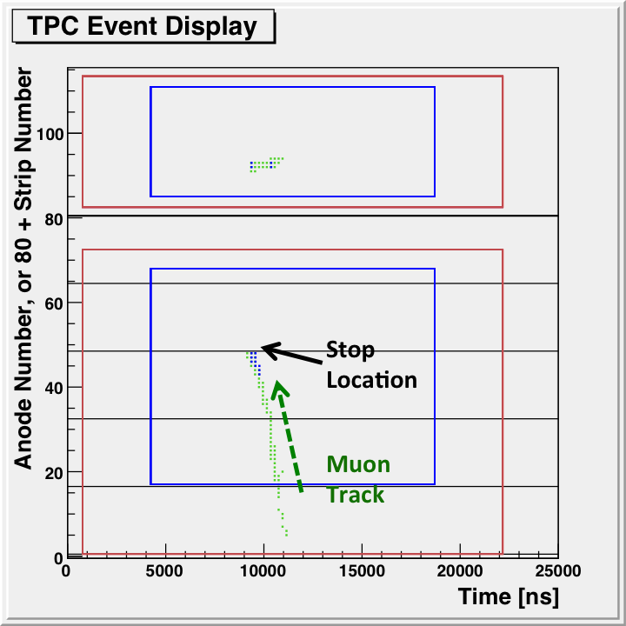
Selecting a muon decay event
Stop Location
EH and EL pixels
Fiducial volume criteria
Particle track criteria
Straight-line fits
χ², total length l
Time coincident electron information
Decay time: t_{decay}=t_{e}-t_{μ}
Same criteria used for the main analysis
Documented extensively
x
y
z
y
Time relative to muon entrance, t_{μ}

Slide 21
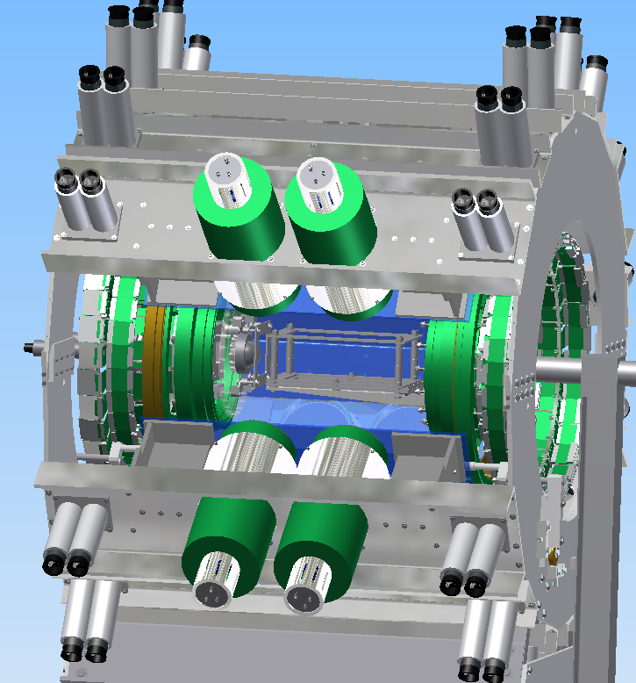
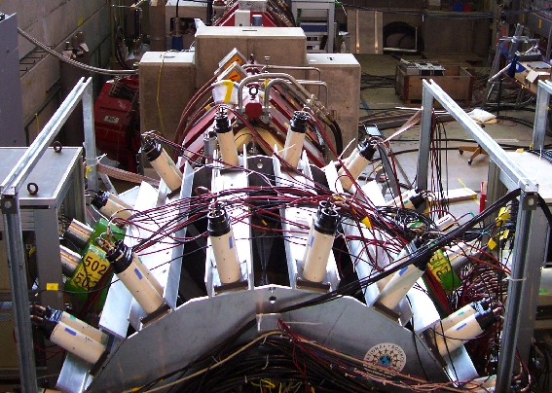
Neutron detectors
Liquid organic scintillator detectors
FADC (analog) readout of pulses
Sensitive to fast neutrons (MeV-scale energy)
Gamma rays and electrons
Different pulse shapes from neutron and gamma ray hits
pulse shape discrimination, PSD.
Determines time of the neutron t_{n}

Slide 22
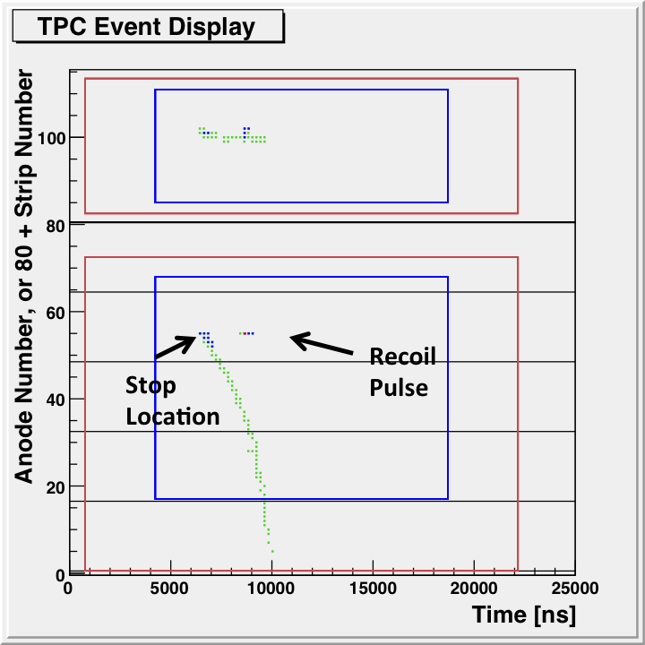
Selection of capture neutron events
Typical capture event in the TPC
Requires a good muon stop
a coincident neutron hit (±35000 ns)
t_{capture}=t_{n}-t_{μ}
Electron veto:
coincident electron hits
within 0 - 20000 ns of muon entrance
Charge deposition in the capture process
x
y
z
y
Another observable for muon capture

Slide 23
Summary of data taken with the argon-doped hydrogen gas
Decay electron time spectrum
4.9x10⁸ analysis-selected events.
40 ns binning
Capture neutron time spectrum
1x10⁶ analysis-selected events
60 ns binning
Capture recoil time spectrum
200 ns binning
Not presented further

Slide 24
Atomic systematic effects
Prompt formation of the μAr state
Direct stops
Excited-state transfer - μp cascade
f=4.95(99)x10⁻⁴
Bound μAr state decay rate effect
Relativistic orbit - time dilation
Phase-space suppressed
h=0.985(3)
Relative efficiency
Nuclear charge
e_{Ar}=0.9956(25)
λ_{μ}
ppμ
Λ_{ppμ}
μp
Singlet
λ_{μ}
1-f
μ
Λ_{pAr}
f
hλ_{μ}
μAr
μAr, μp, free
μAr decay electrons detected with (relative) efficiency e_{Ar}
Λ_{Ar}
Notes:
Three atomic effects are introduced in the argon-doped hydrogen gas

Slide 25
Full kinetics model
λ_{μ}
ppμ
Ortho
Λ_{O}
λ_{μ}
Λ_{ppμ}
λ_{op}
μp
Singlet
ppμ
Para
λ_{μ}
1-f
Λ_{pf}
μ
Λ_{pAr}
Λ_{P}
Λ_{S}
f
hλ_{μ}
μAr
efficiency e_{Ar}
Λ_{Ar}
Notes:
1. Full model includes both atomic, and the remaining systematic effects related to hydrogen chemistry
2. Including the transition to and formation of the para molecular state
3. Capture from the mup singlet and molecualr states
4. Again, we’re emphasizing a determination of the molecular formation rate, the argon transfer rate and the capture rate of the muon onto argon

Slide 26
Description of the time spectrum
Differential equations, initial conditions, full time spectrum.
Atomic physics parameters f, h, and e_{Ar}
relative contribution of μAr state decays
The hydrogen kinetic rates, λ_{μ}, Λ_{S}, λ_{op}, Λ_{pf}, Λ_{O}, and Λ_{P}
Directly affect the time distribution of events
The fit function is A n_{e}(t)+B
Notes:
1. Full description of the time spectrum of decay electrons has three components.

Slide 27
Fit to the decay electron time spectrum
Basic fit results
Λ_{ppμ}=2.208(65) x 10⁴ s⁻¹
Λ_{pAr}=4.529(15) x 10⁴ s⁻¹
Λ_{Ar}=1.302(14) x 10⁶ s⁻¹
χ2/Ndf=0.983(64)
One external systematic correction

Slide 28
Summary of results
Statistics limited results
Scrutiny of fit procedure
Correlated and non-linear features
Disappearance rate results
r_{μp}=0.52350(80) x 10⁶ s⁻¹ where r_{μp}=λ_{μ}+Λ_{ppμ}+Λ_{pAr}+Λ_{S}+Λ_{pf}
r_{μAr}=1.750(16) x 10⁶ s⁻¹ where r_{μAr}=hλ_{μ}+Λ_{Ar}
Notes:
The italicized values for corrections (Δ) applied in the fit function
change in the fit results when each effect is included or excluded
The errors (σ) are the change in the fit results when each fixed parameter is varied by its known uncertainty.

Slide 29
χ² Map of the Λ_{ppμ}, Λ_{pAr,} and Λ_{Ar} parameter space
Variation of the χ² relative to the minimum value
The Δχ²=1 contour is consistent with the ±1 σ of the fit results
Reflects the correlation of these parameters
The χ² variation is controlled and smoothly varying

Slide 30
Fit reproducibility
10⁴ pseudo data histograms
Fit function result
Same statistics as data
Reliability of the central values
As well as the reported fit errors

Slide 31
Capture Neutron Kinetics
λ_{μ}
Relative efficiency, e_{H}, of 5.2 MeV neutrons
e_{H}=1.833(80)
≈ 1-3 MeV neutrons
ppμ
Ortho
λ_{op}
λ_{μ}
Λ_{ppμ}
μp
Singlet
1-f
Λ_{O}
μ
Λ_{pAr}
Λ_{S}
f
hλ_{μ}
μAr
n_{n}(t)=e_{H}(Λ_{S}n_{μp}(t)+Λ_{O}n_{Ortho}(t))+ Λ_{Ar}n_{μAr}(t)
r_{μp}= λ_{μ}+Λ_{ppμ}+ Λ_{pAr}+Λ_{S}+ Λ_{pf}
r_{μAr}= hλ_{μ}+ Λ_{Ar}
Λ_{Ar}

Slide 32
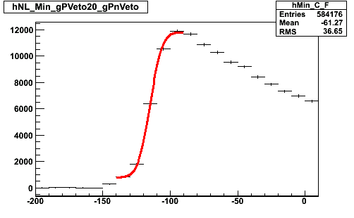
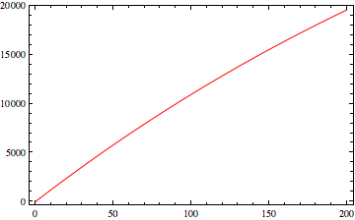
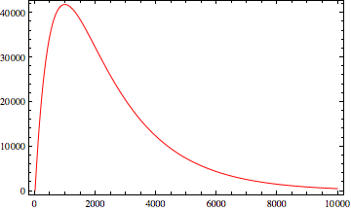
Timing calibration
5.2 MeV neutron -> time-of-flight of ≈18 ns
The time-of-arrival, t_{H}, and the spread s_{H}
Extracted from the pure hydrogen data
t_{H} to ±2 ns precision
s_{H}=15.5(5.9) ns
Neutron Time Spectrum
566 mm
-100
100
t_{n}-t_{μ} [ns]
1-3 MeV neutrons from capture onto argon
Arrive ≈11 ns (2 MeV) later than t_{H}
Time window of ±8 ns
No sharp transition feature
Physical energy distribution not well understood
t_{Ar}=t_{H}+11±8 ns
s_{Ar}=15.5(10.9) ns
Neutron Time Spectrum
0
10000
200
t_{n}-t_{μ} [ns]
Notes:
(upper limit taken from fit to the data)

Slide 33
Fit start-time scan and sensitivity to systematics
Change in fit results: t_{Ar} is varied by ±8 and ±4 ns
r_{μAr} dominates in the first 1500 ns
Early time window data determines rate
r_{μAr} and r_{μp} are correlated
variation in both rates with start-time
The start-time of 600 ns minimizes sensitivity
Allowed 1 σ limit of variation
Stable result
Notes:
The timing calibration information is implemented in the fit function (example)
Chi-square consistent with one.

Slide 34
Neutron time spectrum results
Timing calibration
systematic uncertainties
The r_{μAr} result is “systematics limited”
Well-understood corrections
Prompt μAr formation
Capture from hydrogen states
Relative efficiency of 5.2 MeV neutrons
Comparable precision for r_{μp}

Slide 35
Comparison of results
1 and 2 σ contours of the electron and neutron time spectrum analysis results
1 σ agreement for r_{μp}
0.5 σ agreement for r_{μAr}
Consistent with statistics
The neutron time spectrum - large systematic effects
Timing calibration
Background
Others
The more precise results of the electron time spectrum are the main results of this work.

Slide 36
Normalized molecular formation rate result, λ_{ppμ}
Solid
Gas
Liquid
Known gas density φ=0.0115(1)
≈3% relative precision
Agrees well with theory
Faifman: 1.8(9) x 10⁶ s⁻¹
Differs from Bystritskii et al. at 2.3 σ
Only comparable gaseous target

Slide 37
Final MuCap result
Identical conditions as the λ₋measurement
Exceeds 10% benchmark
< 2 s⁻¹ uncertainty to Δ_{ppμ}
Clear interpretation of correction

Slide 38
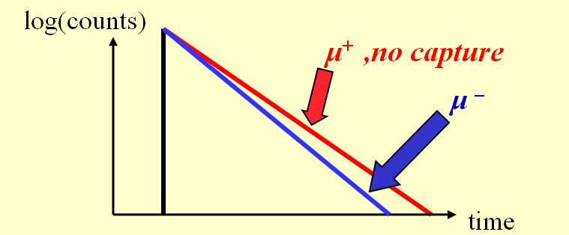

A precision determination of Λ_{s} also determines the pseudoscalar coupling constant g_{p}.
μ⁻ + p → n + ν
Most precise experimental determination of g_{p}
Test of chiral symmetries and low energy QCD
The electron time spectrum is described with a single lifetime; reduced due to capture.
MuCap measures Λ_{S} by comparing the μ⁻ decay rate in hydrogen to the muon lifetime.
Recently measured to 1 ppm precision
μ⁻
ν
q² = -0.88m_{μ}²
p
n
In leading order:
Phys. Rev. Lett. 99, 032002 (2007) and Phys. Rev. Lett. 106, 041803 (2011)

Slide 39
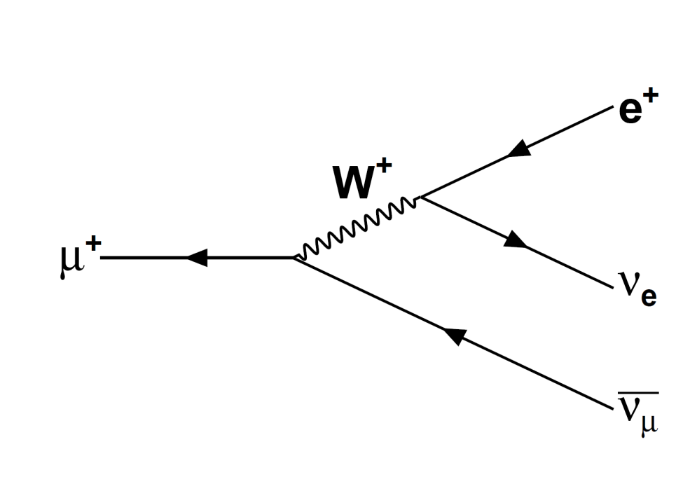
Muons and the Weak Force
Fundamental particle
m_{μ}=105.7 MeV/c²
Decays through the weak interaction
lifetime of τ_{μ}≈2.2 μs
decay rate λ_{μ}.
Measured to 1 ppm relative precision by the MuLan collaboration
λ_{μ}=455170.2(5) s⁻¹
Also a significant update to the knowledge of the Fermi Constant G_{F}
Notes:
One of three charged leptons (e and τ)
Appears in nature as a μ⁻ or μ⁺

Slide 40
The Hadronic Form Factors
G-Parity ⇒ g_{S}(q²) , g_{T}(q²) ≈ 0.
CVC + Electron scattering ⇒
g_{V}(q²=-0.88m_{m}) = 0.976 ± 0.001
g_{M}(q²=-0.88m_{m}) = 3.583 ± 0.003
Neutron beta decay ⇒
g_{A}(q²=-0.88m_{m} ) = 1.247 ± 0.004
Leaves g_{P}(q²=-0.88m_{μ} ) ill determined experimentally.
Muon Capture on the proton
g_{P}(q²=-0.88m_{μ} )=8.36(23) from χPT to NLO

Slide 41
Decay Electron Event Selection
3-D tracking from ePC1 and ePC2
Timing t_{e}, from eSC hodoscope
16 segments
two 0.5 mm thick layers
Four photo multiplier tubes (PMTs
“Paired” - fourfold coincidence (±25 ns)
t_{decay}=t_{e}-t_{μ}
Impact Parameter b
b ≤ 120 mm
Electron and muon stop data processed separately at the raw stage of the analysis.
Bulk data processing at NCSA

Slide 42
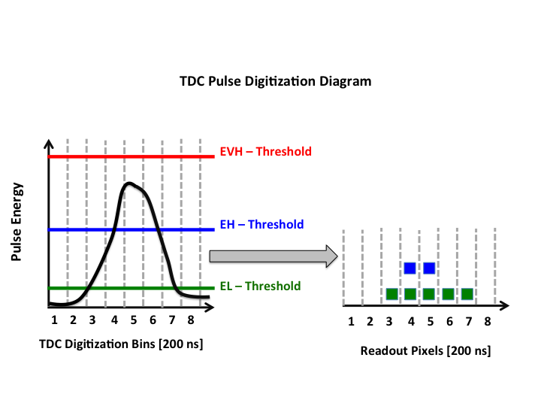
TDC Electronics: threshold discrimination
EL “low” threshold
Muon track
0.014 MeV
EH “high” threshold
0.060 MeV
Increased dE/dX as the μ⁻ slows
Signature of a stop
EVH “very high” threshold
0.290 MeV
Recoiled pulse in muon capture onto a Z>1 nucleus
Digitization applied at the clock boundary of 200 ns sampling bins.
2-D coordinate for the TPC,
anode wire : time of a sample bin
pixel
The cathode strips are read out in a similar way.

Slide 43
Selecting a muon decay event
Stop Location
Down-stream most anode at EH: z
The time of first EH pixel, t_{Stop}, y
via y=(t_{Stop}-t_{μ})/v_{drift}
Coincident cathode strip pixels, x
Fiducial volume criteria
Stop location and all EH – pixels
“MuStop” fiducial volume.
All EL (or higher) pixels
“Track” fiducial volume.
Particle track criteria
Straight-line fit to EL pixels
χ², total length l
Decay time: t_{decay}=t_{e}-t_{μ}
MuCap criteria
Documented extensively
x
y
z
y
Time relative to muon entrance, t_{μ}

Slide 44
Oxygen Impurity Correction
Induce muon transfer and capture.
C_{O}=0.23 ppm and C_{N}=0.23 ppm
Two sets of simulated time spectra
varying C_{O} and C_{N}
Known N and O transfer and capture rates
x10⁵ more statistics than in the data
Linear coefficient of variation, k
Correction Δ=k C_{O}
C_{O} =0.12(11) ppm
Applied to Λ_{ppμ} and Λ_{pAr}

Slide 45
Fit start-time scan
A sub-set of the data is chosen with start-time
moved back from 120 ns
Fit stop-time fixed at 20000 ns
Amplitude and background fixed
From “free” 120 – 20000 ns result
Allowed 1 σ limit of variation

Slide 46
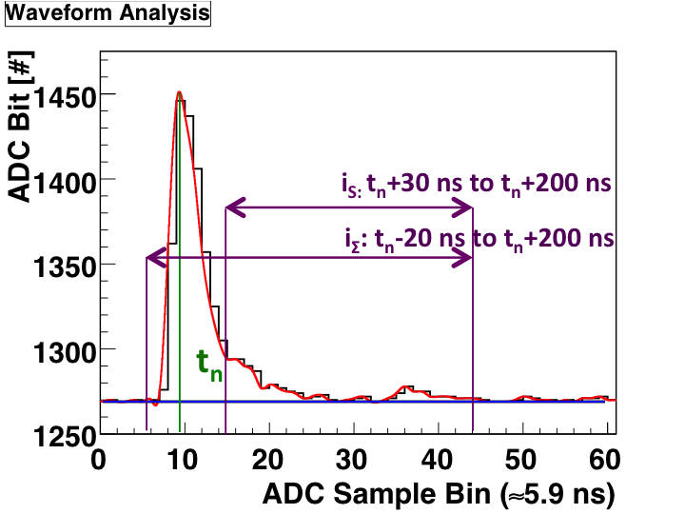
Pulse Waveform Analysis
Resampling from 5.9 ns to 0.3 ns
Interpolation fit to rate data
Peak time determines t_{n}
Slow, i_{S}, and total, i_{Σ}, integrals
Discriminant r_{PSD}=i_{S}/i_{Σ}
Upper and lower limits
Vary with the total Integral
l = c + k/i_{Σ}
Specific to each detector
A final 400 ADC bit ≤ i_{Σ}≤ 5000 ADC bit
0.5 MeV - 5.0 MeV energy cut

Slide 47
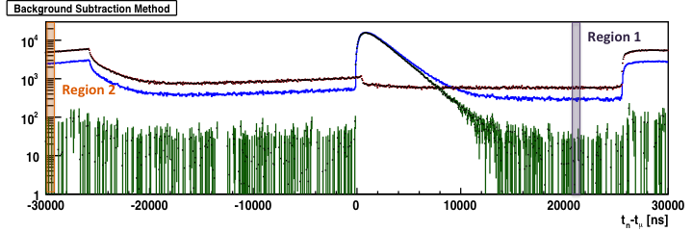
Neutron Background
Paired eSC hit and neutron coincident to same muon stop
Prompt -150<t_{e}-t_{n}<50 ns
“misidentified” electron hits
Separation of beam-correlated background

Slide 48
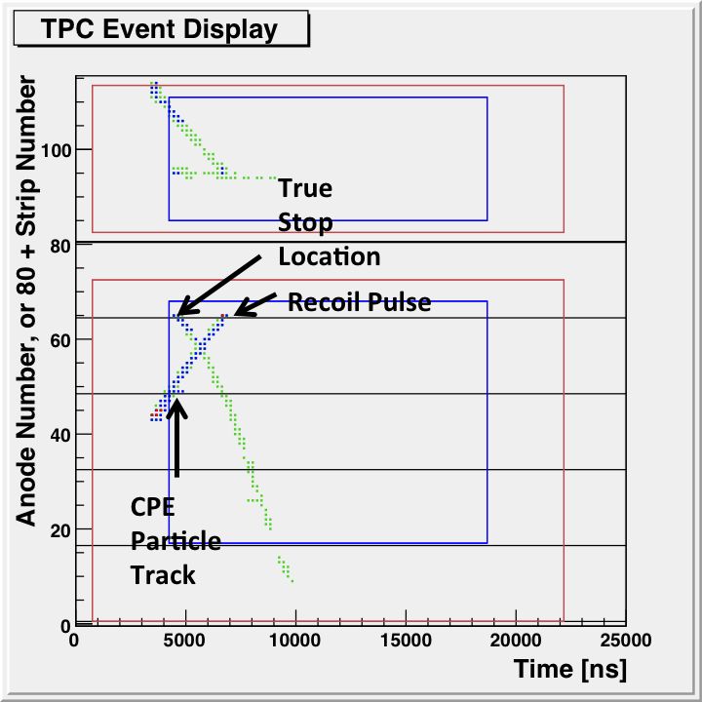
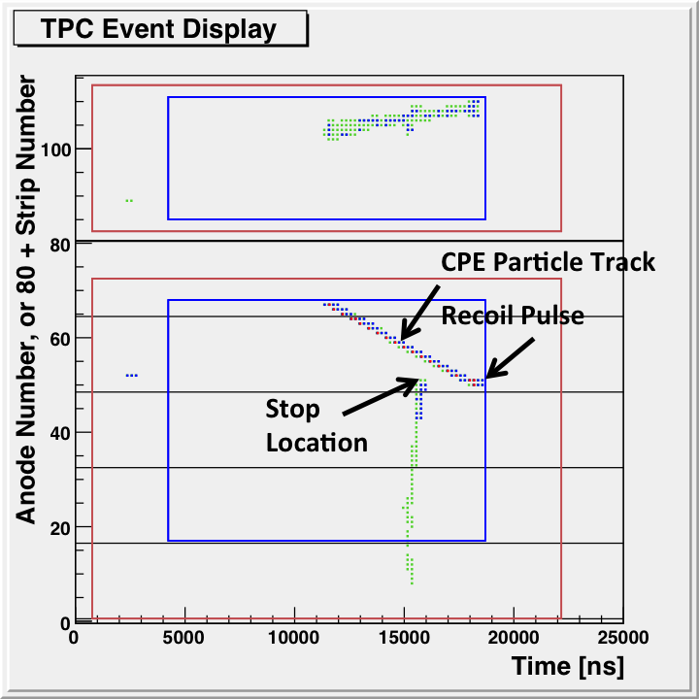
CPE Interference
Connected
Disconnected
Fiducial volume conditions unstable
Early times, before 1000 ns
Rejected from the analysis
p_{C}=60.8(7.0)%
Disconnected events, predominant after 2000
p_{D}=15.1(3.7)%
CPE -> particle track in the analysis
p_{T}=35.7(6.2)%
Correction applied using the time spectrum of the disconnected “track” events
f_{CPE}=(p_{D}-p_{C})/p_{T}=1.28(31)
Systematic errors
3.1 x 10² s⁻¹ for r_{μp}
1.42 x 10⁴ s⁻¹ for r_{μAr}

Slide 49
Fit start-time scan and sensitivity to systematics
No systematic correction
Prompt μAr formation
μp state capture events
Relative efficiency of μp state capture events
Full result – correction for capture from the ortho-molecular sate
Including the relative efficiency
A start-time of 600 ns minimizes sensitivity to these systematics as well.

Slide 50
The capture neutron time spectrum
n_{n}(t)=e_{H}(Λ_{S}n_{μp}(t)+Λ_{O}n_{Ortho}(t))+ Λ_{Ar}n_{μAr}(t)
n_{μp}’(t) = -r_{μp} n_{μp}(t)
n_{μAr}’(t) = Λ_{pAr} n_{μp}(t) -r_{μAr} n_{Ar}’(t)
n_{Ortho}’(t)= Λ_{ppμ}n_{μp}(t)-(λ_{μ}+ Λ_{O}+ λ_{op})N_{Ortho}(t)
Where n_{μp}(0)=1-f and n_{μAr}(0)= f,
r_{μp}= λ_{μ}+Λ_{ppμ}+ Λ_{pAr}+Λ_{S}+ Λ_{pf}
r_{μAr}= h λ_{μ}+ Λ_{Ar}
Results for r_{μp} and r_{μAr} respectively.
Capture from the para-molecular state is neglected.
Fit function: A n_{n}(t) +B

Slide 51
Oxygen Impurity Correction
Linear coefficient of variation, k
each of the kinetic rates
Correction for each rate, Δ
Δ=k C_{O}
C_{O} =0.12(11) ppm
Δ=191(175) s⁻¹ is applied to Λ_{ppμ}
Δ=27(24) s⁻¹ is applied to Λ_{pAr}
Induce muon transfer and capture.
C_{O}=0.23 ppm and C_{N}=0.23 ppm
Two sets of simulated time spectra
varying C_{O} and C_{N}
λ_{pN}=0.34 x 10¹¹ s⁻¹ and Λ_{N}=0.069 x 10⁶ s⁻¹
λ_{pO}= 1.7 x 10¹¹ s⁻¹ and Λ_{O}=0.102 x 10⁶ s⁻¹
x10⁵ more statistics than in the data

