Slide 1
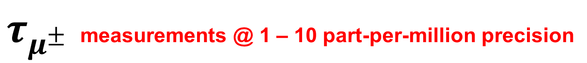
Final MuLan and MuCap determinations of the Fermi constant and the nucleon’s weak-induced pseudoscalar coupling
David Hertzog
University of Washington
$τ_{μ^{±}}$ measurements @ 1 – 10 part-per-million precision
Motivation
MuLan: $τ_{μ^{+}}$
MuLan: 𝜏_(𝜇^+ )
MuCap: μ⁻p capture
Results & Summary
CIPANP 2012

Slide 2
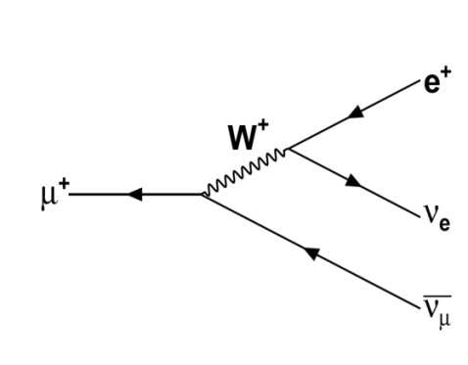
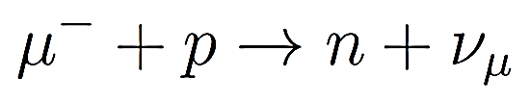
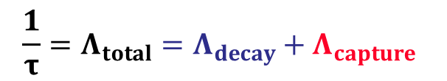
Positive and Negative Muon Lifetimes
Free muon decay is a pure weak process …
determines G_{μ}, often called G_{F}
Muons stopped in matter:
Positive muons decay “as if” free, or form atomic-bound muonium … with a lifetime shift expected at the ~ ppb level
→ most precise Fermi Constant
e⁻
μ⁺
Negative muons form “1-electron-like” muonic atoms and either decay or, undergo nuclear capture.
The decay and capture rates add; lifetime is “shorter”
μ⁻
Z
$$\frac{1}{τ}=Λ_{total}=Λ_{decay}+Λ_{capture}$$
Extract physics here

Slide 3
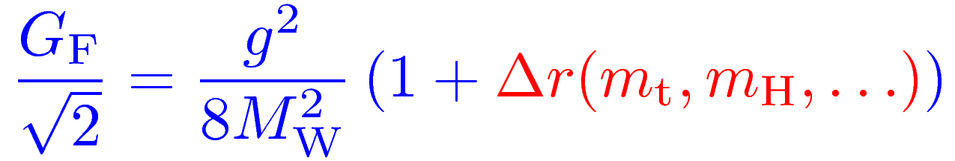
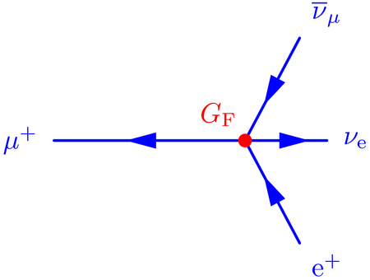
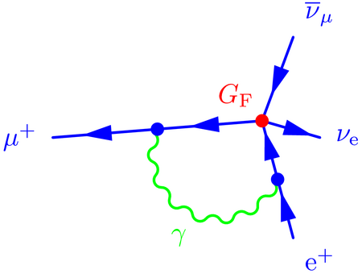
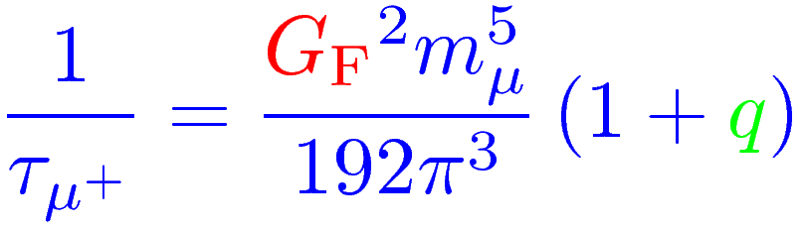
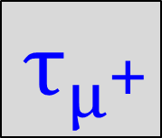
The Fermi constant is related to the electroweak gauge coupling g by
$${ τ}_{μ^{+}}$$
Contains all weak interaction loop corrections
In the Fermi theory, muon decay is a contact interaction where Δq is phase space and both QED and hadronic and radiative corrections
Δq
In 1999, van Ritbergen and Stuart completed full 2-loop QED corrections reducing the uncertainty in G_{F} from theory to < 0.3 ppm (it was the dominant error before)

Slide 4
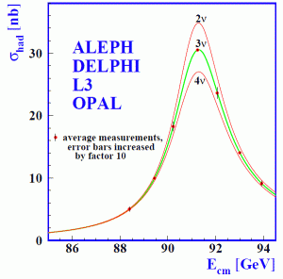
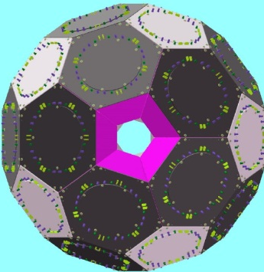
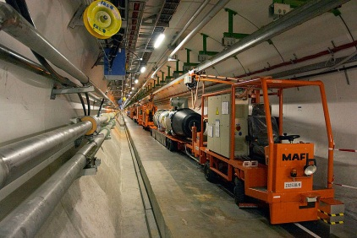
Positive muon lifetime motivation: Predictive power of the SM depends on well-measured input parameters
$${ τ}_{μ^{+}}$$
G_{F} α M_{Z}
9 ppm 0.37 ppb 23 ppm
0.6 ppm
Hanneke, Fogwell, Gabrielse PRL 100, 120801 (2008)
Phys.Rept.427:257-454,2006
MuLan Collaboration
PRL 106, 041803 (2011)
This work
G_{F} = 1.166 378 8(7) x 10⁻⁵ GeV⁻²
α⁻¹ = 137.035 999 084 ± 0.000 000 051
M_{Z} = 91.1875 ± 0.0021 GeV

Slide 5
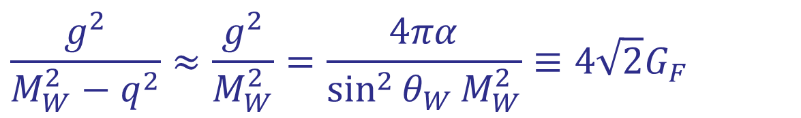


Example: connection from τ_{μ} to sin² θ_{W}
$${ τ}_{μ^{+}}$$
Momentum transfer q² = (p_{μ} − p_{νμ})² = (p_{e} + p_{νe})² < m_{μ}² much smaller than M_{W}²
Thus, W propagator shrinks to a point and can be well approximated through a local four-fermion interaction,
MuLan: G_{F} = (1.166 378 8 ± 0.000 000 7) · 10⁻⁵ GeV⁻² .
(there are further quantum corrections here not included)

Slide 6
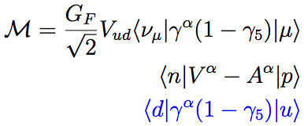
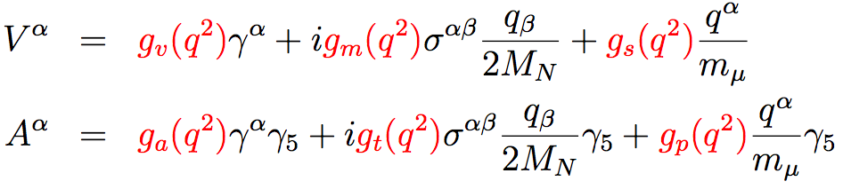
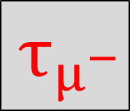
Negative muon lifetime motivation: Muon capture → Elusive hadronic properties
$${ τ}_{μ^{−}}$$
quark level
nucleon level
μ⁻
ν
u
γ_{μ}(1- γ₅)
d
q² = -0.88m_{μ}²
W
μ
ν
p
n
CVC
EM
FF’s
= 0
n-decay
G-parity
6
Notes:
the Feynman diagram for this process in the modern notation, where the W boson converts one of the up quarks in the proton to a down quark.
To determine the rate of this process, we use the usual current algebra, writing the leptonic and hadronic terms separately. At the quark level, each of these currents demonstrate the left-chiral projection operators that are characteristic of the weak interaction.
Of course, the diagram shows that there are other quarks in the nucleon’s and this must be considered.

Slide 7

The observable is the Capture Rate Λ_{S} …
$${ τ}_{μ^{−}}$$
… which depends on the form factors g_{V}, g_{M}, g_{A}, g_{P}.
Well known terms contribute ~0.45% uncertainty to Λ_{S}^{theory}
g_{P}. is by far the least well known
typically ~ 50% prior to this work
Measure Obtain:
Therefore:
Notes:
The quarks involved in muon capture are embedded in a nucleon, so the hadronic current must be modified to reflect this. This is the general form of the hadronic charged-current interaction.
Most of these form factors (denoted by little gs) have already been determined from other measurements or from symmetries.
G_S and G_T are generally considered to be 0 by g-parity (the product of charge conjugation and an isospin rotation).
G_V and G_M can be related via electroweak theory to the electromagnetic form factors (GE and GM). The charged current weak interactions and the neutral current Electromagnetic interaction are believed to form an isospin triplet of conserved vector currents. Electron – proton scattering experiments then precisely determine these form factors.
GA is also well determined by the weak-interaction process of neutron beta decay.
This leaves only gp undetermined, and prior to mucap, experimental efforts to determine gp had a rather large uncertainty of approximately 50%.
“Within the standard model the vector piece of the weak charged-current interaction and the isovector piece of the electromagnetic current are just different isospin components of a common isovector current.”
CVC → E&M + weak interaction form a doublet; rotation from E&M allows us use those form factors

Slide 8

Pseudoscalar form factor g_{P}
$${ τ}_{μ^{−}}$$
μ
ν
2m_{N}m_{μ}g_{A}(0)
2m_{N}m_{¹}g_{A}(0)
1
f_{π}
g_{P}(q²) = -
g_{P}(q²) = - - g_{A}(0)m_{N}m_{μ}r_{A}²
q²-m_{π}²
q²-m_{¼}²
3
π
PCAC pole term
(Adler, Dothan, Wolfenstein)
NLO (ChPT)
Bernard, Kaiser, Meissner PR D50, 6899 (1994)
g_{πNN}
p
n
g_{P} = 8.26 ± 0.23
Λ_{S} = 711.5 ± 4.6 s⁻¹(0.65%)
ChPT based on the spontaneous symmetry breaking
QCD prediction via ChPT @ 2-3% precision level
Basic test of chiral symmetries and low-energy QCD
Recent review: Kammel, P. and Kubodera, K., Annu. Rev. Nucl. Part. Sci. 60 (2010), 327
Notes:
Historically, gp was calculated by relating the divergence of the axial field to pion field.
In the limit of massless pions, this would represent a Conserved Axial current, analogous to CVC.
However, the pions are massive, and the field is only “partially conserved” which is the PCAC hypothesis. The physics is then encapsulated in the pion-weak and pion-strong nucleon couplings.
This is in contrast to theory, which makes precise predictions for gp.
Similarly, the modern approach makes use of ChPT, which uses pions and nucleons as the effective fields.
ChPT encapsulates the higher energy physics into constants and is valid in the regime of small momentum transfer, with respect to the chiral scale of ~ 1 GeV.
This expansion allows for precise calculations, and in leading order, directly reproduces the calculations of PCAC, where g and f are the pion strong and weak nuclear couplings.
It also has the benefit that higher orders are directly calculable. ChPT precisely predicts gP to be 8.26 pm 0.23, which can the be used with the other form factors to determine the capture rate.
An experimental comparison of this rate then directly probes our understanding of the the low-energy physics and symmetries of QCD encapsulated in chiral perturbation theory.
Divergence of axial component ⇔ pion field Consider PK comment: V-A allows axial coupling 0^- → 0^+

Slide 9
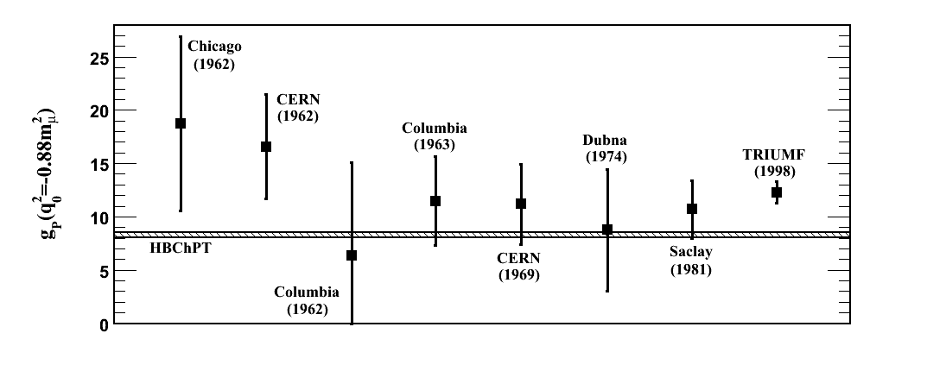
$${ τ}_{μ^{−}}$$
The experimental determinations of g_{P} prior to MuCap were far less precise
Ordinary Muon Capture (OMC)
Radiative
LH₂
LH₂
LH₂
LH₂
GH₂
GH₂
LH₂
LH₂
Liquid H₂ target
Gas (low density) H₂ target

Slide 10

Our method: Take difference between τ_{μ+} and τ_{μ−} in hydrogen to infer singlet capture rate Λ_{S}
$${ τ}_{μ^{+}}$$
$${ τ}_{μ^{−}}$$
1.0 ppm MuLan
~15 ppm MuCap
log(counts)
μ –
μ⁺
time
Notes:
10
Get new numbers from Brendan

Slide 11
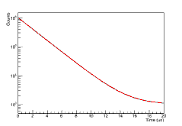

The Experiments
Generic design considerations
MuLan
MuCap
$${ τ}_{μ^{+}}$$
$${ τ}_{μ^{−}}$$

Slide 12
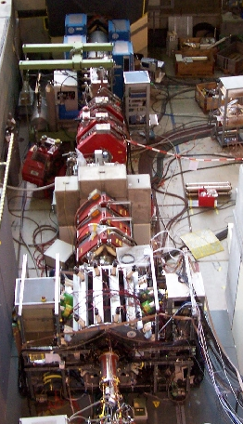
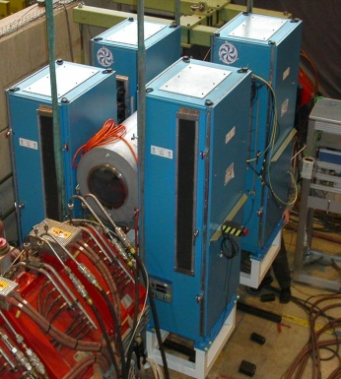
Design Considerations counts and systematic control
$${ τ}_{μ^{+}}$$
$${ τ}_{μ^{−}}$$
Need: 10¹² μ⁺ decays (1 ppm) & 10¹⁰ μ⁻ decays (10 ppm)
PSI:
2.2 mA protons @ 590 MeV
πE3 low-energy muon beamline
Time structured custom Kicker
MuLan:
~10⁷ μ+ /s
Beam-on / Beam-off periodic cycles
Multiple decays per cycle
MuCap:
~10⁵ μ⁻ /s
Muon-on-demand
1 measurement at a time

Slide 13
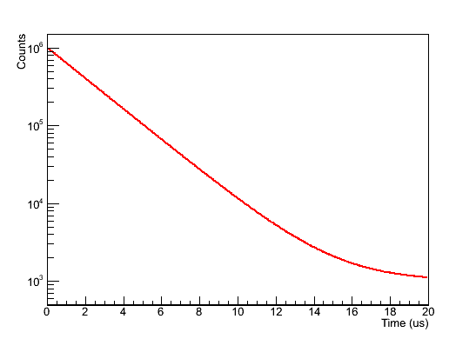
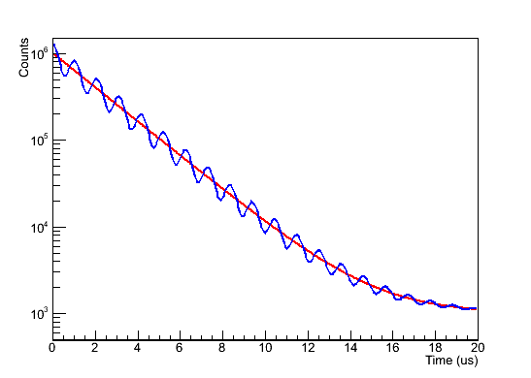

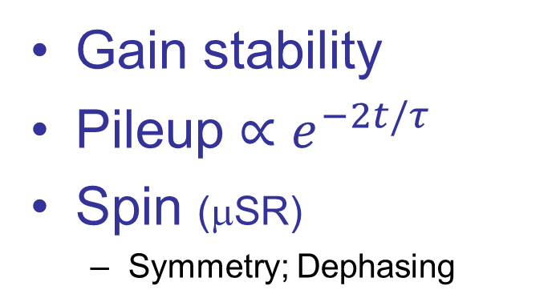




Generic Design Considerations counts and systematic control
Stability of Detector
“early-to-late”
Gain stability
Pileup $∝e^{−2t/τ}$
Spin (μSR)
Symmetry; Dephasing
Minimize precession amplitude
Maximize precession frequency
$${ τ}_{μ^{+}}$$
Background: small and constant
Avoid impurities
Fiducial volume
Interference of μ & e tracks
Capture rate $∝Z^{4}$ → must stop in target
$${ τ}_{μ^{−}}$$
a TPC specific effect
$$μ^{−}$$
$$e^{−}$$

Slide 14
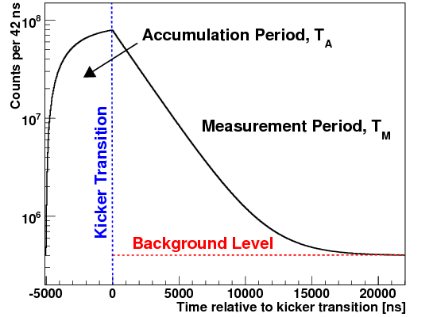
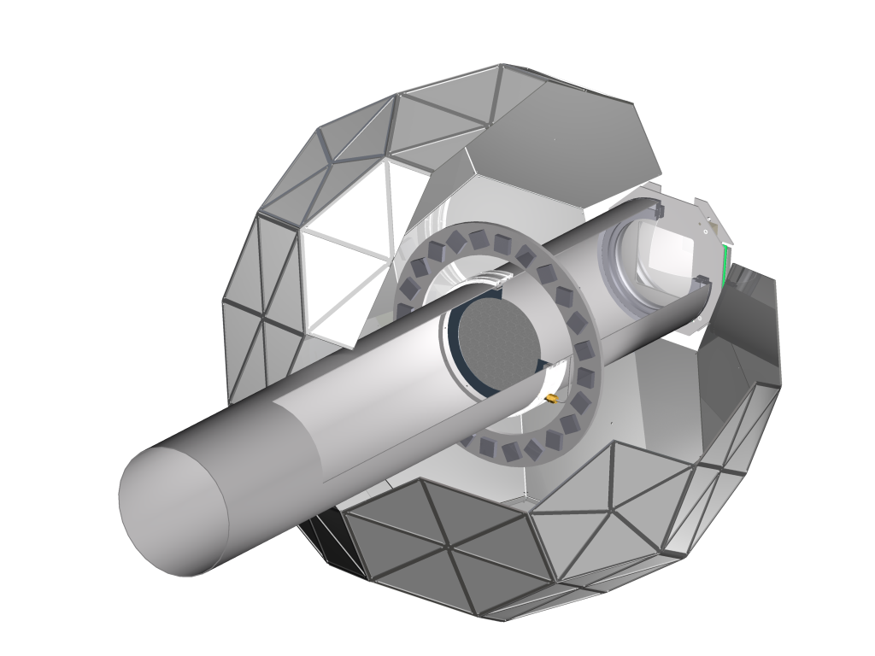
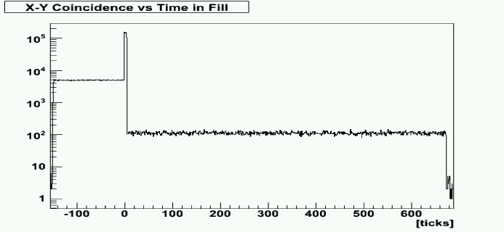
$${ τ}_{μ^{+}}$$
The MuLan experimental concept…
170 Inner/Outer
tile pairs
Real data
Kicker On
450 MHz
WaveForm
Digitization
Measurement Period
Number (log scale)
time
Fill Period
-12.5 kV
Extinction ~ 1000
12.5 kV
Accumulation
Measuring Period
Detector has symmetric design around stops

Slide 15
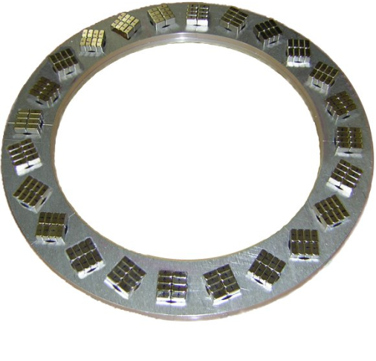
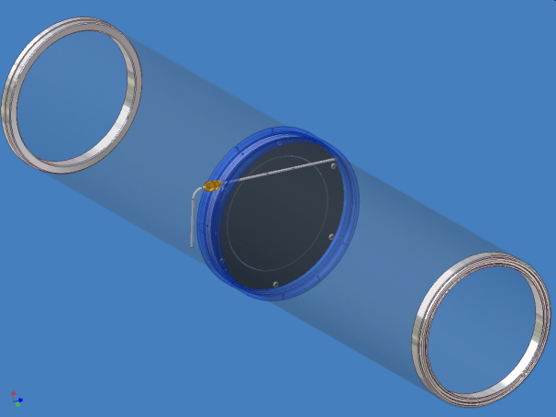
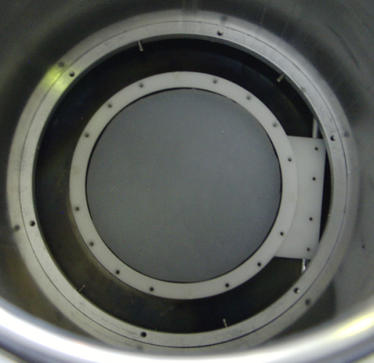
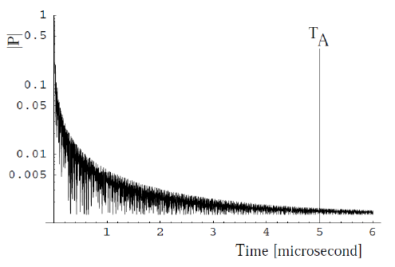

Stopping targets selected to control spin
$${ τ}_{μ^{+}}$$
AK-3 Internal B ~ 0.5 T
Quartz
Halbach Array
+
Quartz
AK-3*
Internal 0.5 T transverse field
Precess rapidly
Dephase owing to different arrival times
Quartz
Form muonium 90%
Precession period few ns
Control 10% free muon spins by symmetry of detector
$$\left\langle \vec{P}\right\rangle ≈0$$
Start Accumulation
Start Measurement
*Arnokrome-3 (~28% chromium, ~8% cobalt, ~64% iron)

Slide 16
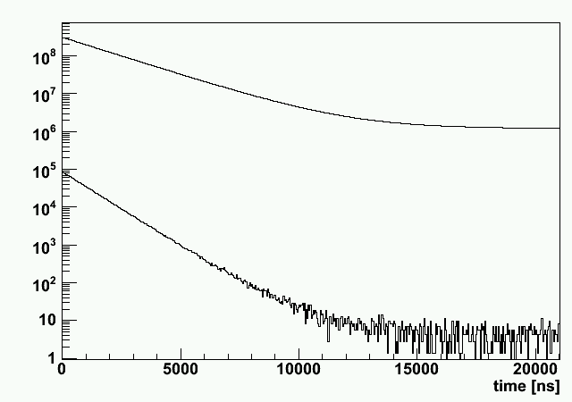
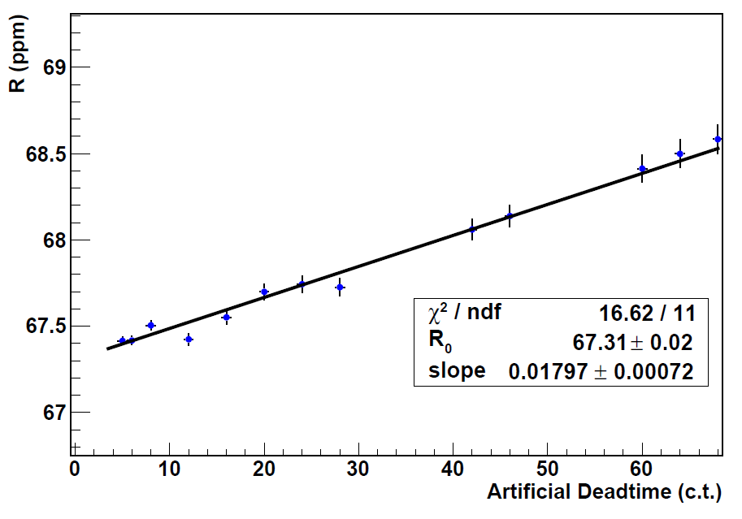
Leading order pileup is a ~5x10⁻⁴ effect, yet …
$${ τ}_{μ^{+}}$$
Statistically reconstruct
pileup time distribution
Fit corrected distribution
Fill i
Fill i+1
Final deadtime corrected lifetime
Normal Time
Distribution
A slope exists due to a pileup undercorrection
1/τ – 2/τ
1 ppm
2/τ
Pileup Time
Distribution
150 ns deadtime range
Extrapolation to 0 deadtime is correct answer

Slide 17
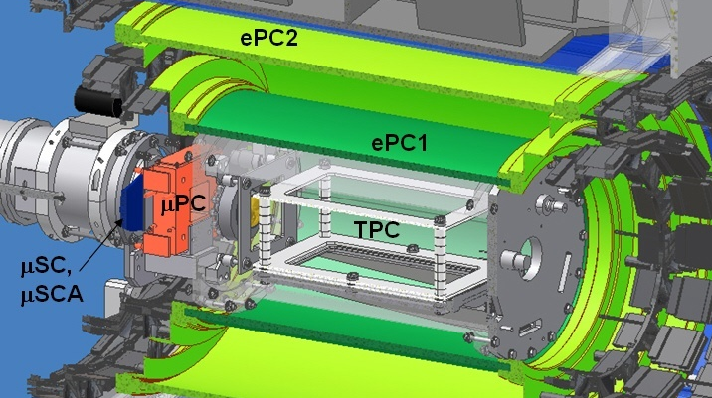
The MuCap Experimental Concept
$${ τ}_{μ^{−}}$$
Stop in pure hydrogen (gas)
Gas impurities < 10 ppb
Isotopic impurity < 6 ppb
Image muon stop with TPC
Measure the disappearance rate (effective lifetime)
μ⁻
E
e⁻
μ⁻p

Slide 18
Muon kinetics
$${ τ}_{μ^{−}}$$
φ: Hydrogen density, (LH₂: φ=1)
Λ_{T} ~ 12s⁻¹
pμ↑↑
ppμ
Λ_{OM} ~ ¾ Λ_{S}
μ-
p
< 100ns
φλ_{OF}
ortho (J=1)
pμ↑↓
λ_{OP}
φλ_{PF}
Λ_{S} ~ 700s⁻¹
ppμ
Λ_{PM} ~ ¼ Λ_{S}
para (J=0)
Notes:
Different techniques, plot with more and more results

Slide 19
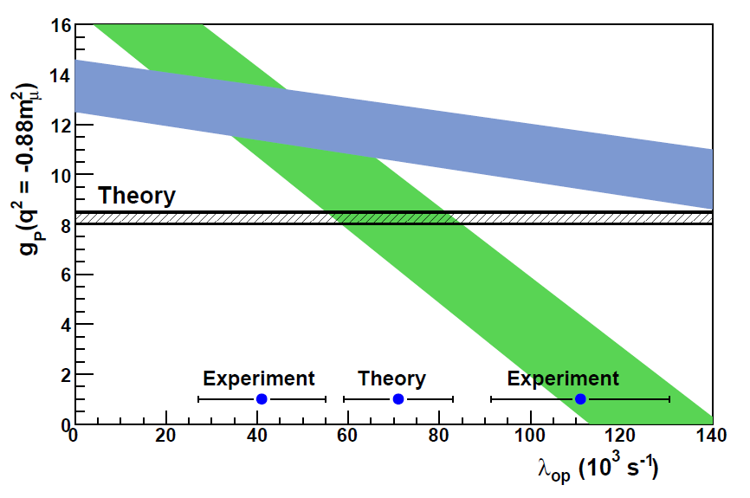
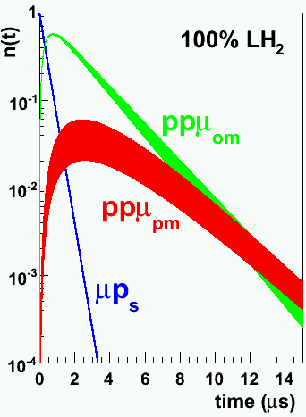
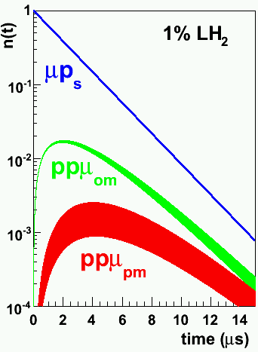
Capture from μp singlet is in competition with capture from ppμ molecular states: depends on density and time
$${ τ}_{μ^{−}}$$
ppμ
φλ_{OF}
Λ_{OM} ~ 540 s⁻¹
ortho (J=1)
RMC
pμ↑↓
λ_{OP}
OMC
Λ_{S} ~ 700s⁻¹
φλ_{PF}
Λ_{PM} ~ 210 s⁻¹
Liquid hydrogen experiments
Molecular-states dominate
ppμ
MuCap conditions
Singlet-state dominates
para (J=0)
Notes:
Different techniques, plot with more and more results

Slide 20
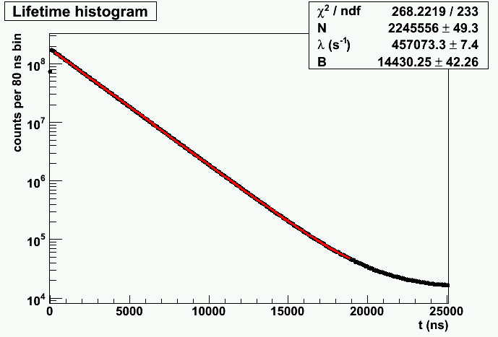




Analysis & Results
?
$${ τ}_{μ^{−}}$$
$${ τ}_{μ^{+}}$$
$$τ_{μ^{+}}→ G_{F}$$
MuLan
MuCap
$${τ_{μ^{−}}→Λ}_{s} → g_{P}$$

Slide 21
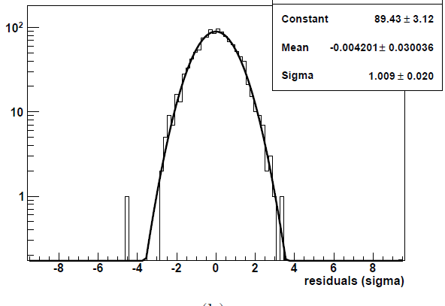
MuLan fit of 30,000 AK-3 pileup-corrected runs
$${ τ}_{μ^{+}}$$
ppm τ_{μ} + Δ_{secret}
22 μs
Relative τ (ppm)
tau vs fit start time
Red band is the set-subset allowed variance
0 9 μs

Slide 22
Quartz data fits well as a simple sum, exploiting the symmetry of the detector. The μSR remnants vanish.
$${ τ}_{μ^{+}}$$
Start-time scan

Slide 23
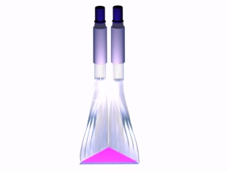
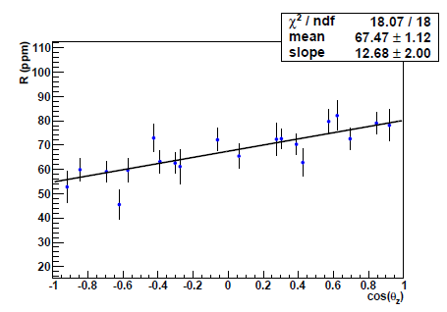
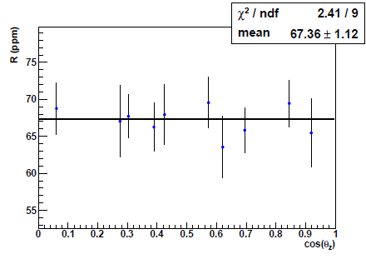
$${ τ}_{μ^{+}}$$
A small asymmetry exists front / back owing to residual longitudinal polarization
85 Opposite Pairs
All 170 Detectors
μ
Lifetime
Opposite pairs summed
Front
Back
“front-back folded”

Slide 24
MuLan Final Errors and Numbers
$${ τ}_{μ^{+}}$$
ppm units
τ(R06) = 2 196 979.9 ± 2.5 ± 0.9 ps
τ(R07) = 2 196 981.2 ± 3.7 ± 0.9 ps
τ(Combined) = 2 196 980.3 ± 2.2 ps (1.0 ppm)
Δτ(R07 – R06) = 1.3 ps
New G_{F}
G_{F}(MuLan) = 1.166 378 8(7) x 10⁻⁵ GeV⁻² (0.6 ppm)

Slide 25
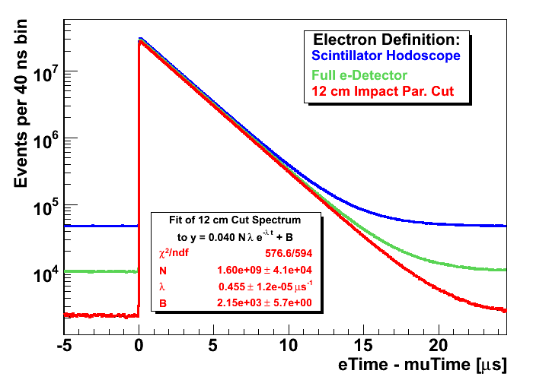
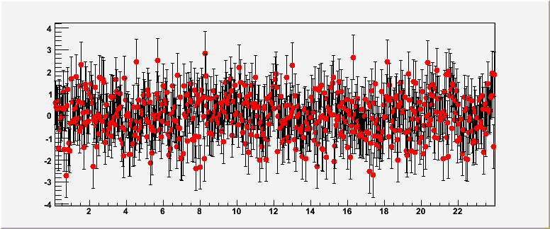
MuCap Negative Muon Lifetime Spectra
$${ τ}_{μ^{−}}$$
Typical fit
normalized
residuals
Notes:
Different techniques, plot with more and more results

Slide 26
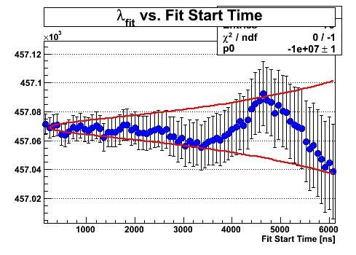
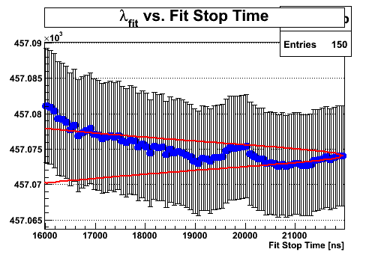
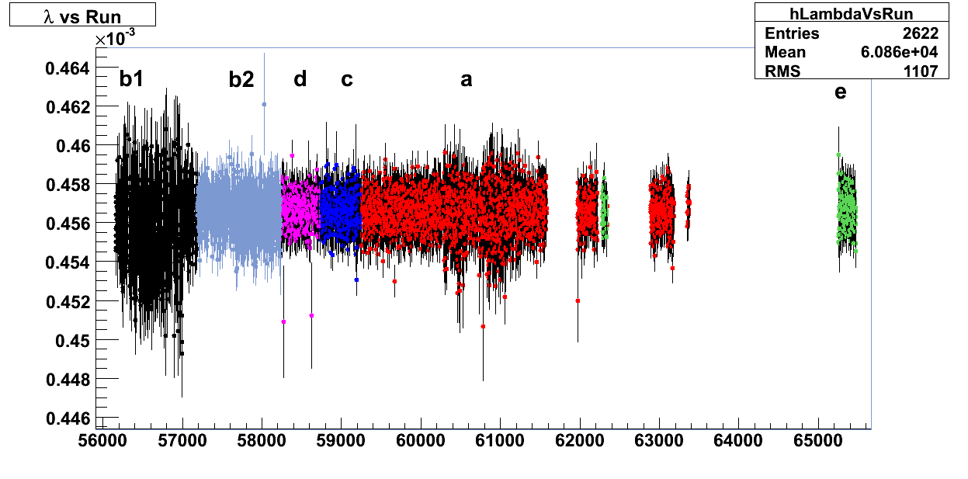
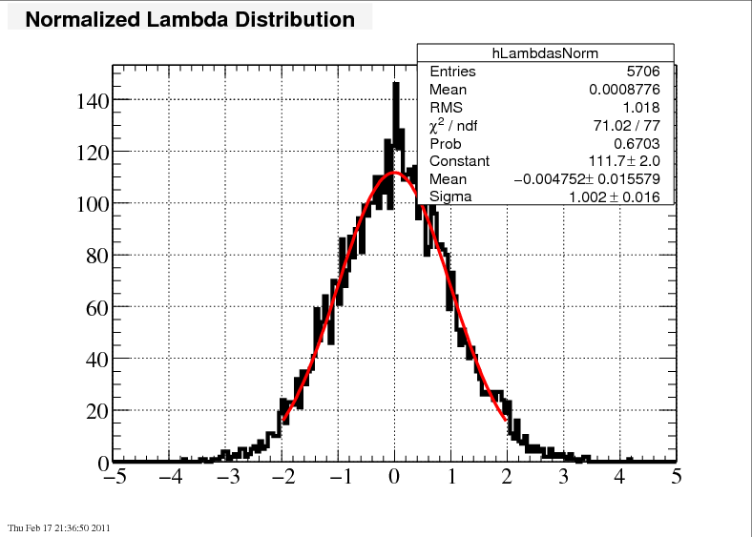
Start- and stop-time-scans
$${ τ}_{μ^{−}}$$
Rate versus run duration
Data run number (~3 minutes per run)

Slide 27
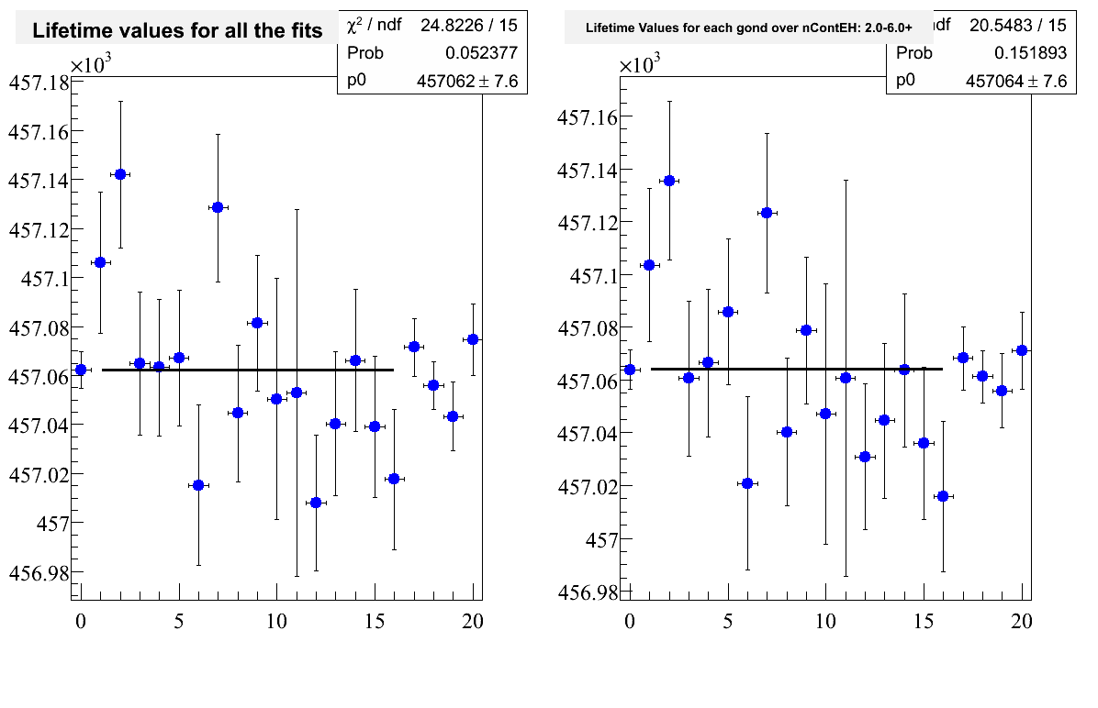
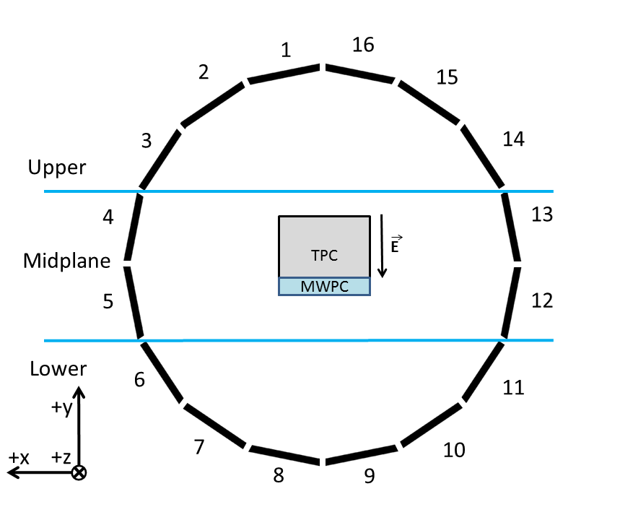
The disappearance rate is independent of azimuth (non trivial since TPC is asymmetric vertically owing to drift direction)
$${ τ}_{μ^{−}}$$
Beam View of MuCap Detector
Fit Rate (s⁻¹)
Azimuthal Element

Slide 28
MuCap systematic corrections, uncertainties and final capture rate
$${ τ}_{μ^{−}}$$
Systematic errors | Run 2006 |  | Run 2007 |  | Comment
 | Λ (s⁻¹) | δΛ (s⁻¹) | Λ (s⁻¹) | δΛ(s⁻¹)
High-Z impurities | -7.8 | 1.87 | -4.54 | 0.93
μp scatter | -12.4 | 3.22* | -7.20 | 1.25* | * = prelim.
μp diffusion | -3.1 | 0.1 | -3.0 | 0.1
Fiducial volume cut |  | 3.0 |  | 3.0
Entrance counter inefficiencies |  | 0.5 |  | 0.5
Choice of electron detector def. |  | 1.8* |  | 1.8* | * =prelim.
Total | -23.3 | 5.14§ | -14.74 | 3.88§ | § = correlated
Λ₀(06) = 455,857.3 ± 7.7 ± 5.2 s⁻¹ Λ₀(07) = 455,853.1 ± 8.3 ± 3.9 s⁻¹
Apply μp atomic correction
Subtract μ+ decay rate: Λ_{μ+} = 455170.05 ± 0.46 s⁻¹
3.2% increase in the uncertainty because of ppμ correction
Λ_{S}(06) = 717.5 ± 8.0 ± 5.7 s⁻¹
Λ_{S}(07) = 713.1 ± 8.6 ± 4.5 s⁻¹
Measured disappearance rates
ΔΛ_{S}(06 – 07) = 4.4 s⁻¹

Slide 29
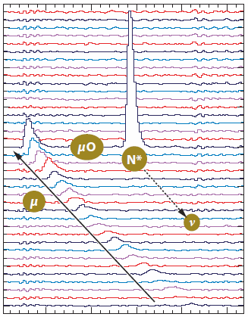
Gas impurities are monitored directly. Correction is based on measurement. Calibration done at high concentation
$${ τ}_{μ^{−}}$$
Production Data
Calibration Data
(nitrogen added to production gas)
Λ
Extrapolated
Result
0
Observed capture yield Y_{Z}
Imp. Capture: μ⁻ Z → (Z-1) n ν
2004 run: c_{N} < 7 ppb, c_{H2O}~30 ppb
2006 / 2007 runs: c_{N} < 7 ppb, c_{H2O}~10 ppb
Notes:
Different techniques, plot with more and more results

Slide 30

External corrections to Λ
$${ τ}_{μ^{−}}$$
MuCap
$$Λ_{obs disappearance }=Λ_{μ^{−}decay }+Λ_{S}+∆Λ_{ppμ}$$
molecular formation
MuLan
$$Λ_{{free μ}^{+}}+∆Λ_{μp}$$
Atomic bound state effect
Λ_{S} (MuCap prelim.*) = 715.1 ± 5.4_{stat} ± 5.0_{syst} s⁻¹
* Small revision of molecular correction might affect Λ_{S} < 0.5 s⁻¹ and syst. error
Λ_{S} (theory) = 711.5 ± 3.5 ± 3 s⁻¹

Slide 31

Precise and unambiguous MuCap result solves longstanding puzzle
$${ τ}_{μ^{−}}$$
g_{P}(MuCap prelim.) = 8.0 ± 0.5
g_{P}(theory) = 8.26 ± 0.23

Slide 32

Compare Lifetimes ! (If you believe χPT more than CPT ☺ )
$${ τ}_{μ^{+}}$$
$${ τ}_{μ^{−}}$$
Free μ+
τ_{MuLan} = 2 196 980.3 ± 2.2 ps
Effective* μ-
τ_{MuCap} = 2 196 963 +/- 42 ps
$$\frac{τ^{+}−τ^{−}}{τ_{avg}}=\left(7±19 \right) ppm$$
Difference:
*Important assumptions
Assume χPT prediction is exact
Correct for μp atomic shift (easy)
Correct for impurity distortion (expt. errors are included)

Slide 33

Summary
MuLan has finished and published
1.0 ppm final error achieved, as proposed
The most precise particle or nuclear lifetime ever measured
Most precise Fermi constant
Modest check of muonium versus free muon
MuCap has finished; publication in progress
First unambiguous determination of g_{P}
Excellent agreement with theory
Method paves way for future MuSun expt on μd capture
MuCap
MuLan
MuCap 2012

Slide 34
Collaborations
MuLan
Boston University, USA
University of Illinois at Urbana-Champaign, Urbana, USA
James Madison University, Harrisonburg, USA
University of Kentucky, Lexington, USA KVI, University of Groningen, Groningen, The Netherlands
Paul Scherrer Institute (PSI), Villigen, Switzerland
Regis University, Denver, USA
University of Washington, Seattle, USA
MuCap
Petersburg Nuclear Physics Institute (PNPI), Gatchina, Russia Paul Scherrer Institute (PSI), Villigen, Switzerland University of California, Berkeley (UCB and LBNL), USA
University of Illinois at Urbana-Champaign, Urbana, USA
University of Washington, Seattle, USA Université Catholique de Louvain, Belgium University of Kentucky, Lexington, USA Boston University, USA
Regis University, Denver, USA

Slide 35
Backups

Slide 36


Varying the fit start and stop time shows good self-consistency.
$${ τ}_{μ^{+}}$$
R
Χ²/NDF
R
Χ²/NDF

Slide 37

Quartz visible μSR. Fit each detector for an “effective lifetime.” Would be correct, except for remnant longitudinal polarization relaxation.
$${ τ}_{μ^{+}}$$
Difference between Top of Ball and Bottom of Ball to Sum, vs time-in-fill
Illustration of free muon precession in top/bottom detector differences

Slide 38
Longitudinal polarization distorts result in predictable manner depending on location. The ensemble of lifetimes is fit to obtain the actual lifetime. (Method robust in MC studies)
$${ τ}_{μ^{+}}$$
Relative effective lifetime (ppm)
(+ blind offset)
Magnet-right data

Slide 39

The pileup corrections were tested with Monte-Carlo.
Monte-Carlo Simulation, 10¹² events
agrees with truth to < 0.2 ppm
1.19 ppm statistical uncertainty

Slide 40

Gain is photomultiplier tube type dependent
Artifact from start signal
Deviation at t=0
1 ADC = 0.004 V
Sag in tube response
0 10 20 μs
Notes:
Figure from elog 667.

Slide 41



The sum cancels muSR effects; the difference accentuates the effect.
counts arb.
B
⊗
μ
counts arb.
Sum
Difference/Sum
counts arb.

Slide 42


Gain variation vs. time is derived from the stability of the peak (MPV) of the fit to pulse distribution
If MPV moves, implies greater or fewer hits will be over threshold
0 10 20 μs
Gain(t) is PMT type dependent. Carefully studied over the summer and reduced to 0.25 ppm uncertainty. Gain correction gives a 0.5 ppm shift in result vs uncorrected
42

Slide 43
Pileup to sub-ppm requires higher-order terms
$${ τ}_{μ^{+}}$$
12 ns deadtime, pileup has a 5 x 10⁻⁴ probability at our rates
Left uncorrected, lifetime wrong by 100’s of ppm
Proof of procedure validated with detailed Monte Carlo simulation
uncorrected
Pileup terms at different orders …
R (ppm)
1 ppm
150 ns deadtime range
Artificial Deadtime (ct)

Slide 44




The decay positron energy and angular distributions are not uniform, resulting in position dependant measurement rates.
Highest Energy Positrons
Lowest Energy Positrons
E_{e} = E_{max} = 52.83 MeV
Positron energy distribution
Lowest energy positron when neutrinos are anti-parallel.
Neutrino helicities add so that they have angular momentum of 2.
Positron spin must compensate to bring total to 1.
Chiral suppression (not well justified at this energy) makes positron most likely right handed.
Most probable positron direction is opposite muon spin
Highest energy positron when neutrinos are parallel.
Neutrino helicities cancel angular momentum.
Positron spin must be in the same direction as muon spin.
Chiral limit dictates right handed positrons.
Most probable positron direction is same as muon spin
θ
E_{e} = 26.4 MeV
E_{e} = 13.2 MeV
e⁺
Detection threshold

Slide 45


μSR rotation results in an oscillation of the measurement probability for a given detector.
B
⊗
μ
B = 34 G
B = 1 G
counts arb.
counts arb.
This oscillation is easily detected
This oscillation is not easily detected and systematic errors may arise

Slide 46


μSR relaxation results in a reduction of the polarization magnitude.
T1 is independent of magnetic field.
T2 is from an inhomogeneous field.

Slide 47


G_{F} & τ_{μ} precision has improved by ~4 orders of magnitude over 60 years.
Achieved!
PRL Jan 2011

