Slide 1
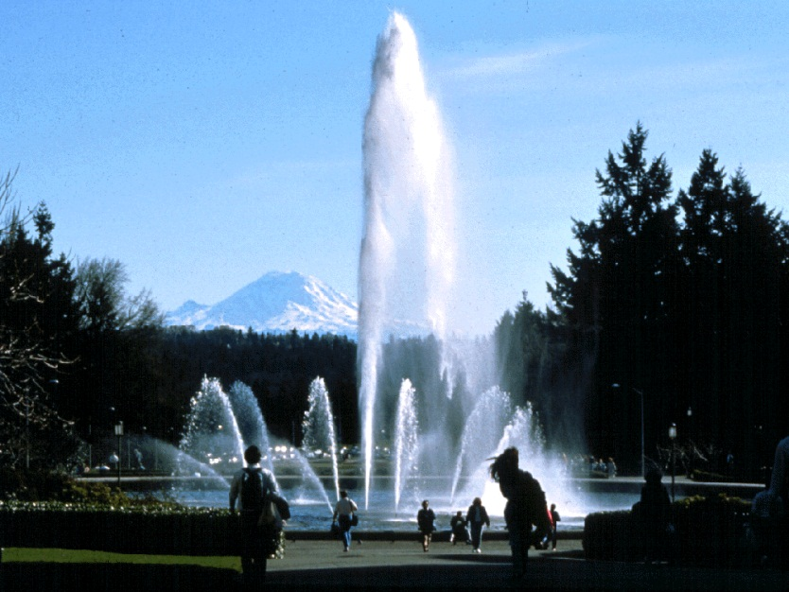
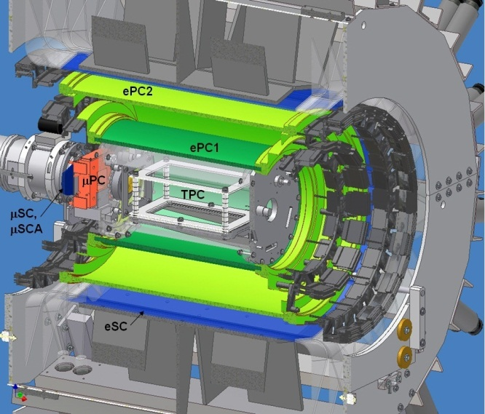
Muon Capture on the Proton
Final results from the MuCap experiment
Peter Winter
University of Washington
− for the MuCap collaboration −
g_{P}

Slide 2
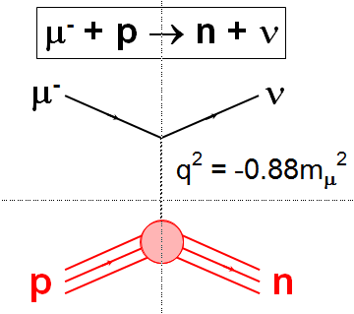
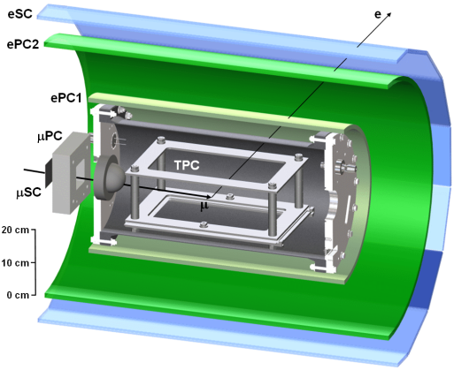
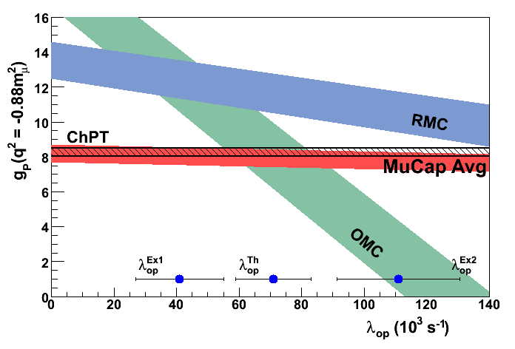
Overview
Brief motivation for MuCap
Experimental overview
Final MuCap result

Slide 3
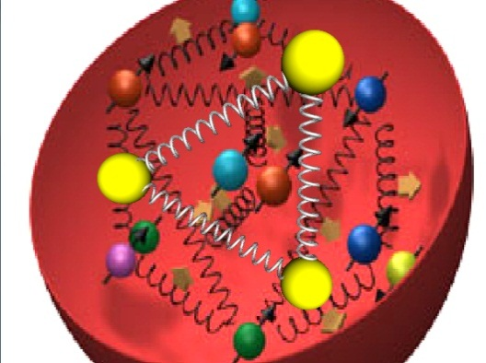
Nucleon form factors
μ⁻ + p → n + ν
μ⁻
ν
q² = -0.88m_{μ}²
u
d
u
u
d
d

Slide 4
Nucleon form factors
μ⁻ + p → n + ν
μ⁻
ν
q² = -0.88m_{μ}²
p
n
M ~ G_{F}V_{ud} · ψ_{ν} γ_{α}(1-γ₅)ψ_{μ} · ψ_{n}(V^{α}-A^{α})ψ_{p}
Observable: Singlet capture rate Λ_{S}

Slide 5
Nucleon form factors
M ~ G_{F}V_{ud} · ψ_{ν} γ_{α}(1-γ₅)ψ_{μ} · ψ_{n}(V^{α}-A^{α})ψ_{p}
V^{α} = g_{V}(q²) γ^{α}
+ i g_{M}(q²) σ^{αβ}q_{β}/2M_{N}
δΛ_{S}
δg_{P}
⇒
Λ_{S}
g_{P}
A^{α} = g_{A}(q²) γ^{α}γ₅
+ g_{P}(q²) q^{α}/m_{μ}γ₅
1.0% 6.1%
Contributes 0.45% uncertainty to Λ_{S}^{theory}
Notes:
Fermi's golden rule – Matrix element – decay rate,
gV and gM from CVC and measurements JLab, Mainz,...
gA from neutron beta decay and nuN scattering and pi electroprod

Slide 6
Pseudoscalar form factor g_{P}
2m_{N}m_{¹}g_{A}(0)
μ
ν
2m_{N}m_{μ}g_{A}(0)
1
f_{π}
g_{P}(q²) = - - g_{A}(0)m_{N}m_{μ}r_{A}²
g_{P}(q²) = -
q²-m_{¼}²
q²-m_{π}²
3
π
PCAC pole term
(Adler, Dothan, Wolfenstein)
NLO (ChPT)
Bernard, Kaiser, Meissner
PR D50, 6899 (1994)
g_{πNN}
p
n
g_{P} = 8.26 ± 0.23
ChPT based on the spontaneous symmetry breaking
solid QCD prediction via ChPT (2-3% level)
basic test of chiral symmetries and low energy QCD
Recent review:
Kammel, P. and Kubodera, K., Annu. Rev. Nucl. Part. Sci. 60 (2010), 327
Notes:
Amplify gP with right momentum transfer

Slide 7
How to access g_{P}?
In principle any process directly involving axial current:
- β decay: Not sensitive since g_{P} term
proportional to q
- ν scattering difficult to measure
⇓
Muon capture most direct source for g_{P}
Notes:
Different techniques, plot with more and more results

Slide 8
Muon capture
- Ordinary muon capture (OMC): μ⁻ p → ν n
- Radiative muon capture (RMC): μ⁻ p → ν n γ
BR = ~10⁻⁸ for E_{γ}>60 MeV
- μ⁻ ³He → ν ³H or other nuclei
Notes:
Different techniques, plot with more and more results

Slide 9
Muon capture
- Ordinary muon capture (OMC): μ⁻ p → ν n
- Radiative muon capture (RMC): μ⁻ p → ν n γ
BR = ~10⁻⁸ for E_{γ}>60 MeV
- μ⁻ ³He → ν ³H or other nuclei
Notes:
Different techniques, plot with more and more results

Slide 10
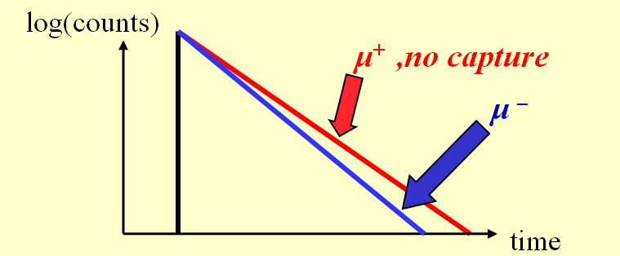
Methods to measure OMC rate
Direct method:
- Measure outgoing neutrons
- Typical experiments ~10% precision in Λ_{S}
Lifetime method:
Λ_{S} ≈ λ⁻ - λ⁺
Λ_{S} = 0.15% λ⁻!
Notes:
Different techniques, plot with more and more results

Slide 11
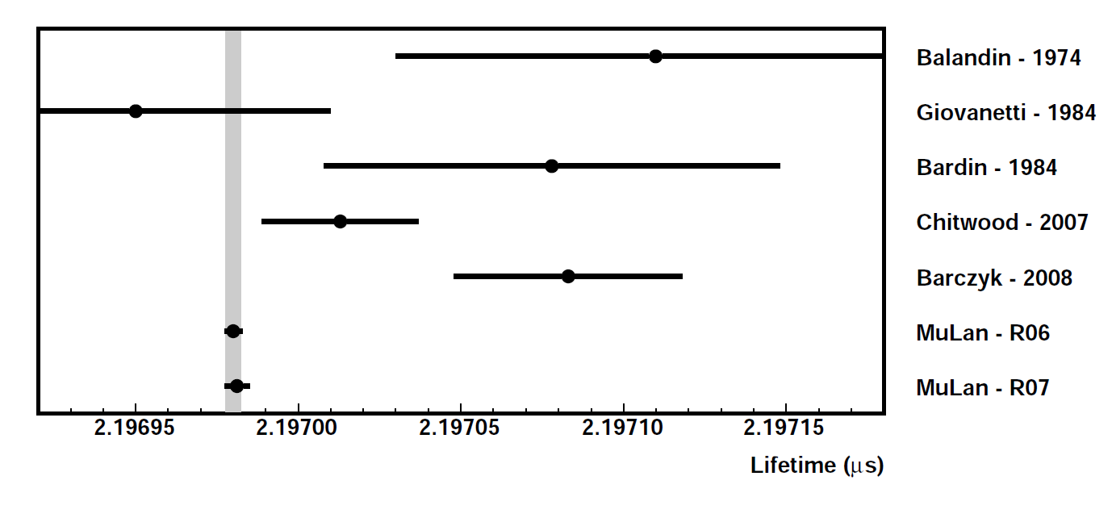
λ⁺ known to 1 ppm!
MuLan 2007 and 2011
G_{F} = 1.1663818(7) x 10⁻⁵ GeV⁻² (0.6 ppm)
D.B. Chitwood et al., Phys. Rev. Lett. 99, 03201 (2007)
D. Webber et al., Phys. Rev. Lett. 106, 041803 (2011)

Slide 12

MuCap key elements
Lifetime method
Low gas density
Active gas target (TPC)
Ultra pure gas system with in-situ monitoring
Isotopically pure hydrogen gas
Notes:
Different techniques, plot with more and more results

Slide 13
Muon kinetics
φ: Hydrogen density, (LH₂: φ=1)
Λ_{T} ~ 12s⁻¹
pμ↑↑
p
φ>0.01
<100ns
μ-
pμ↑↓
Λ_{S} ~ 700s⁻¹
Notes:
Different techniques, plot with more and more results

Slide 14
Muon kinetics
ppμ
Λ_{OM} ~ ¾ Λ_{S}
φλ_{OF}
ortho (J=1)
pμ↑↓
λ_{OP}
φλ_{PF}
Λ_{S} ~ 700s⁻¹
ppμ
Λ_{PM} ~ ¼ Λ_{S}
para (J=0)
ppμ formation depends on density φ
Interpretation requires knowledge of λ_{OF} and λ_{OP}
Notes:
Different techniques, plot with more and more results

Slide 15
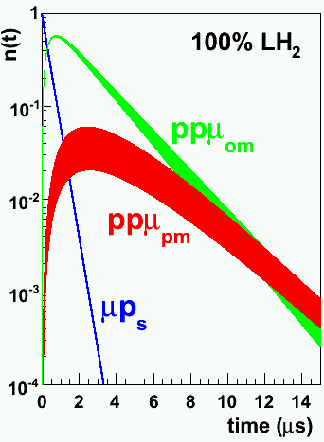
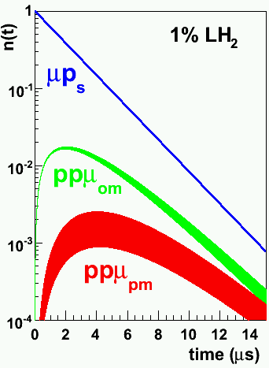
ppμ
Λ_{OM} ~ ¾ Λ_{S}
φλ_{OF}
ortho (J=1)
pμ↑↓
λ_{OP}
φλ_{PF}
Λ_{S} ~ 700s⁻¹
ppμ
Λ_{PM} ~ ¼ Λ_{S}
para (J=0)
Notes:
Different techniques, plot with more and more results

Slide 16
Muon kinetics
ppμ
φλ_{OF}
Λ_{OM} ~ ¾ Λ_{S}
ortho (J=1)
pμ↑↓
λ_{OP}
φλ_{PF}
Λ_{S} ~ 700s⁻¹
ppμ
Λ_{PM} ~ ¼ Λ_{S}
para (J=0)
Lower density dramatically decreases sensitivity to molecular complications
Notes:
Different techniques, plot with more and more results

Slide 17
Previous results
μ p → ν n @ SACLAY
μ p → ν n γ @ TRIUMF
g_{P}
μCap precision goal
ChPT
exp
theory
TRIUMF 2005
λ_{OP} (ms⁻¹)
no overlap theory, OMC & RMC
large uncertainty in λ_{OP} ⇒ g_{P} ± 50%

Slide 18
Requirement of clean target
ppμ
φλ_{OF}
Λ_{OM} ~ ¾ Λ_{S}
ortho (J=1)
c_{d}λ_{pd}
pμ↑↓
λ_{OP}
μd
φλ_{PF}
Λ_{S} ~ 700s⁻¹
ppμ
Λ_{d}
Λ_{PM} ~ ¼ Λ_{S}
diffusion
para (J=0)
Notes:
Different techniques, plot with more and more results

Slide 19
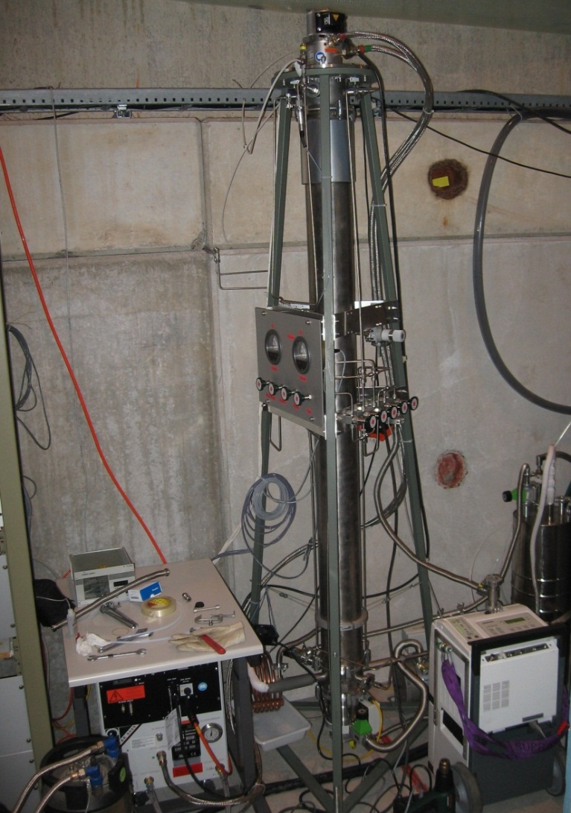
Deuterium removal unit
c_{d} < 6 ppb

Slide 20
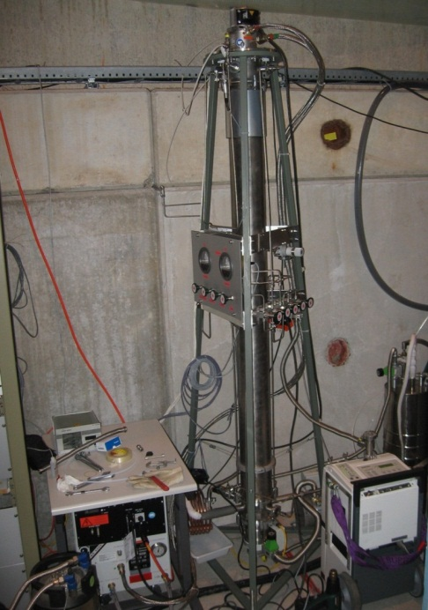
Requirement of clean target
μZ
Λ_{Z} ~ Λ_{S} Z⁴
ppμ
c_{Z}Λ_{Z}
φλ_{OF}
Λ_{OM} ~ ¾ Λ_{S}
ortho (J=1)
c_{d}λ_{pd}
pμ↑↓
λ_{OP}
μd
φλ_{PF}
Λ_{S} ~ 700s⁻¹
ppμ
Λ_{d}
Λ_{PM} ~ ¼ Λ_{S}
diffusion
para (J=0)
Notes:
Different techniques, plot with more and more results

Slide 21
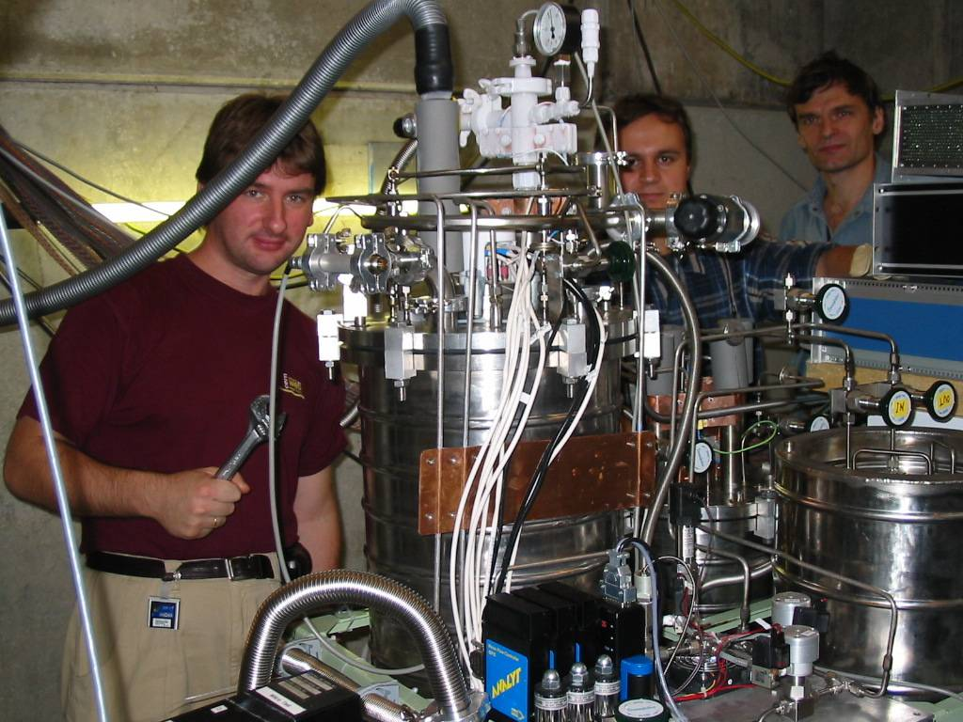
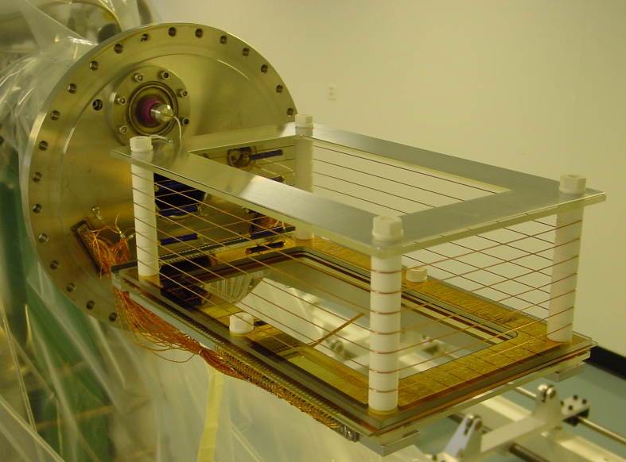
High-Z in MuCap
Circulating H₂ Ultra-Purification System
Active TPC
No materials in fiducial volume
c_{N}, c_{H2O} < 10 ppb
NIM A578 (2007), 485
Notes:
Different techniques, plot with more and more results

Slide 22


Requirement of clean target
μZ
Λ_{Z} ~ Λ_{S} Z⁴
ppμ
c_{Z}Λ_{Z}
φλ_{OF}
Λ_{OM} ~ ¾ Λ_{S}
ortho (J=1)
c_{d}λ_{pd}
pμ↑↓
λ_{OP}
μd
φλ_{PF}
Λ_{S} ~ 700s⁻¹
ppμ
Λ_{d}
Λ_{PM} ~ ¼ Λ_{S}
diffusion
para (J=0)
Notes:
Different techniques, plot with more and more results

Slide 23
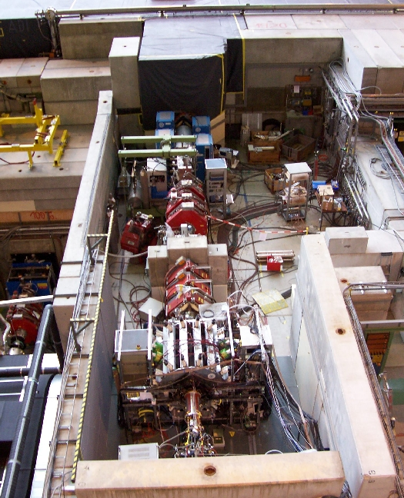
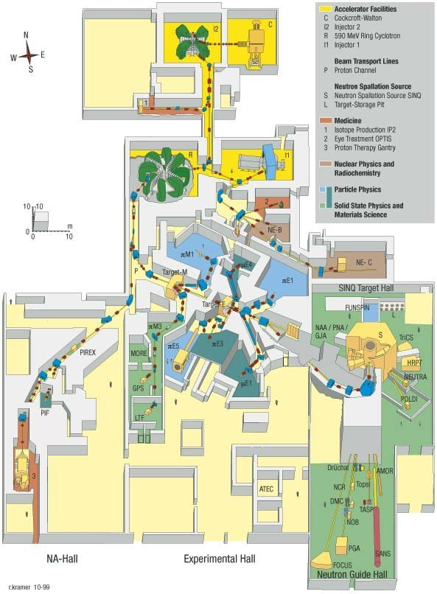
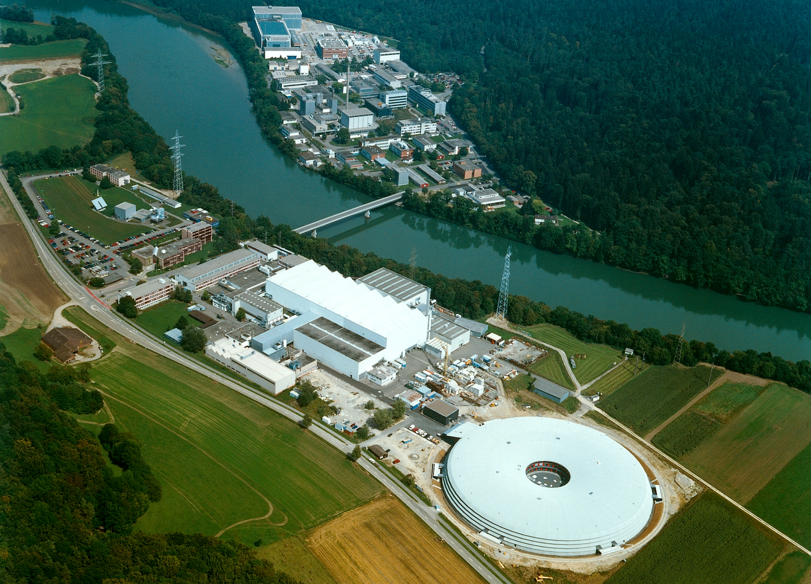

The facility: πE3 beamline at PSI
http://www.psi.ch
Notes:
Different techniques, plot with more and more results

Slide 24

MuCap
e
t
μ
Notes:
Different techniques, plot with more and more results

Slide 25
TPC - the active target
10 bar ultra-pure H₂
bakeable materials
No materials in fiducial volume
Notes:
Different techniques, plot with more and more results

Slide 26
TPC - the active target
10 bar ultra-pure H₂
bakeable materials
No materials in fiducial volume
μ⁻
E
e⁻
μ⁻p
Notes:
Different techniques, plot with more and more results

Slide 27
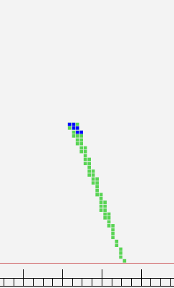
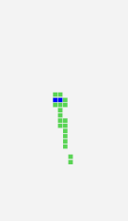
A sample event
TPC side view
Front face view
Fiducial volume
Fiducial volume
vertical direction
vertical direction
TPC active volume
TPC active volume
muon beam direction
transverse direction

Slide 28
10 times increased statistics
Year | Statistics [10¹⁰ muon decays] |  | Comment
 | μ- | μ+
2004 | 0.16 | 0.05 | published *
2006 | 0.55 | 0.16 | This talk
2007 | 0.50 | 0.40 | This talk
Total | ~1.21 | ~0.61
*V.A. Andreev et al., Phys. Rev. Lett. 99, 03202 (2007)
Remember: λ⁺ known to 1 ppm from MuLan!
Notes:
Different techniques, plot with more and more results

Slide 29
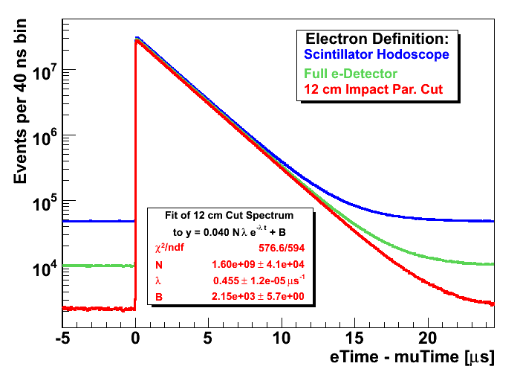
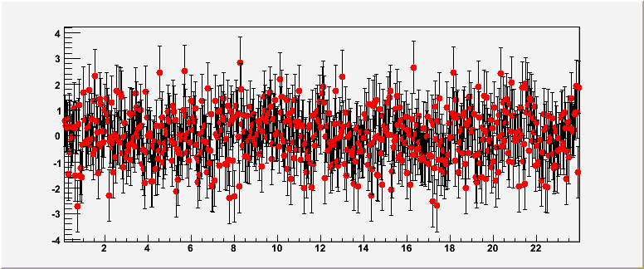
Lifetime spectra
Normalized
residuals
Notes:
Different techniques, plot with more and more results

Slide 30
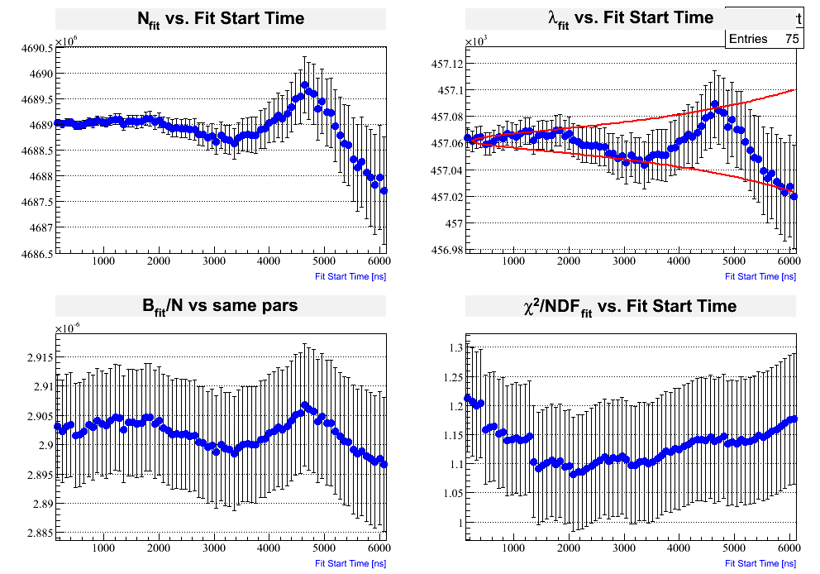
Consistency checks
Notes:
Different techniques, plot with more and more results

Slide 31
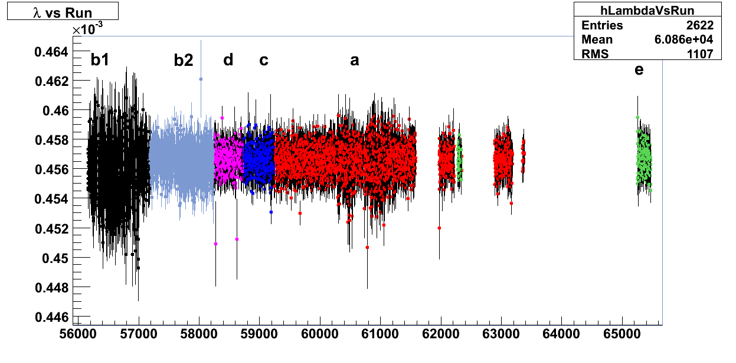
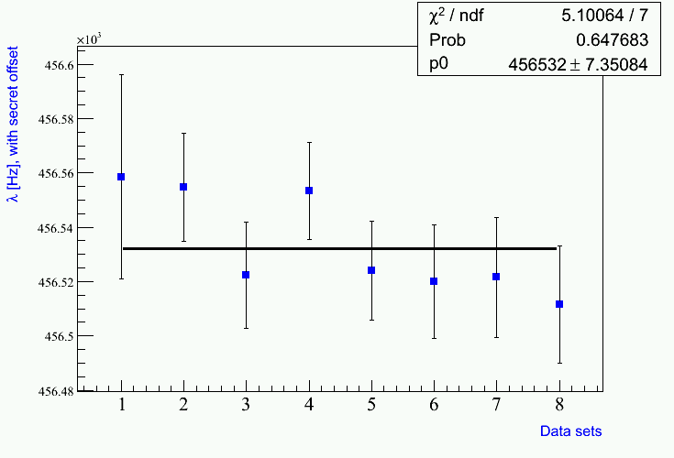
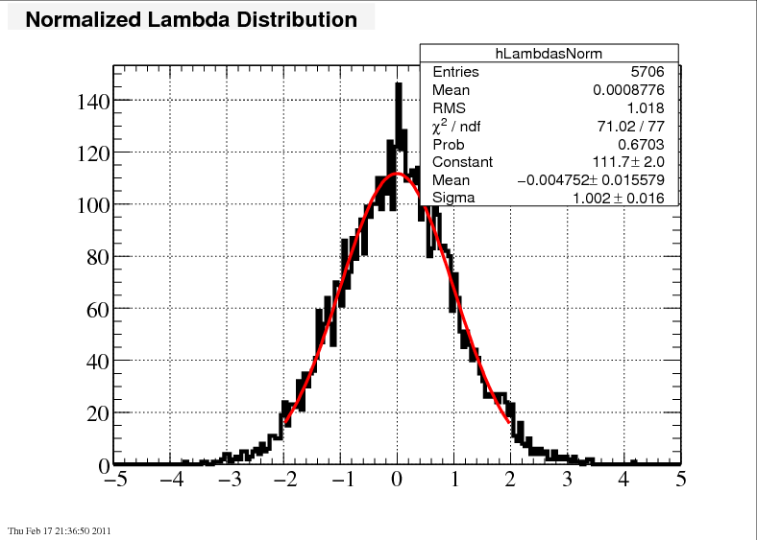
Consistency: Rate versus run
Data run number (~3 minutes per run)
Notes:
Did we go on vacation at the end? No, mu plus data taking interspersed or systematics

Slide 32
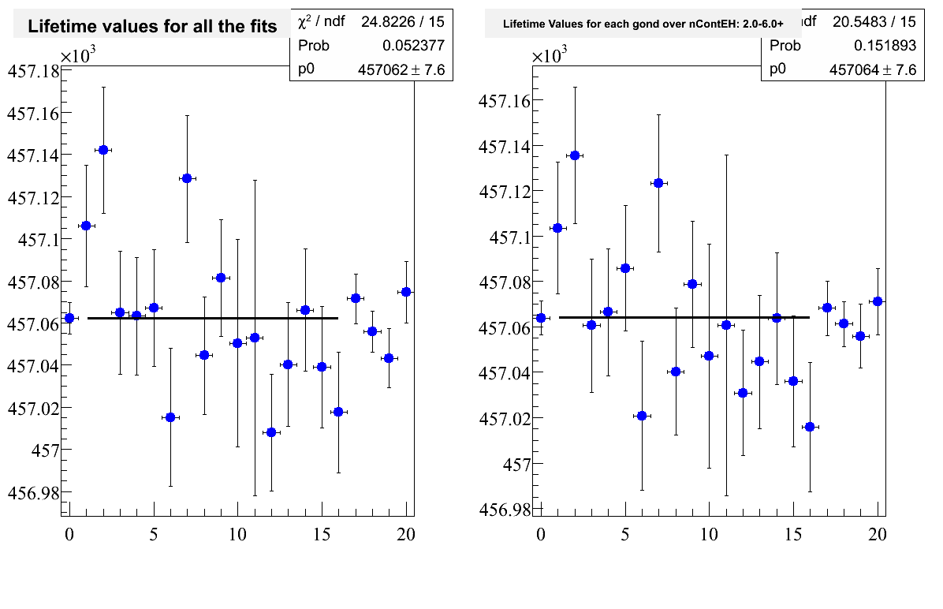
Rate versus azimuth

Slide 33
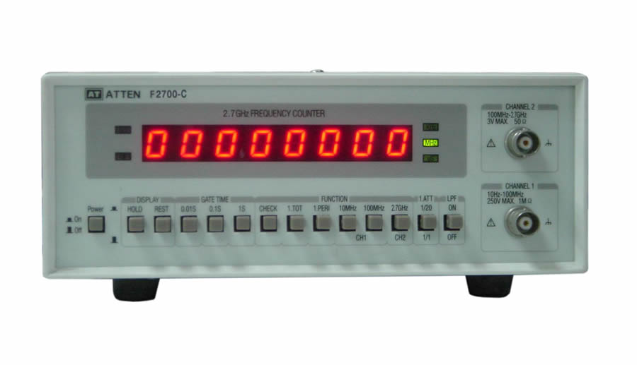



Blinded measurement
500 MHz precise master clock
Detune clock
Hide from analyzers
Double blinded analysis!
Analyzers add secret offset

Slide 34
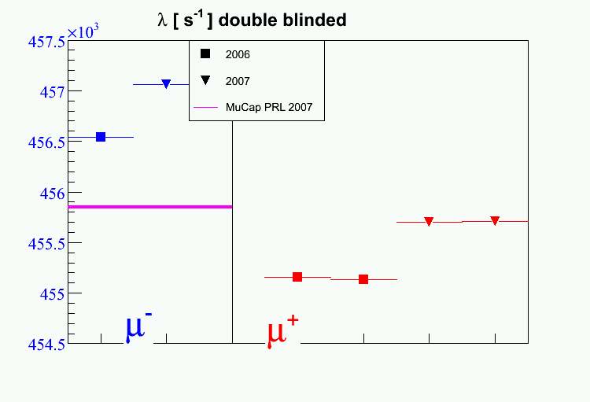
Double blinded
~700 s⁻¹

Slide 35
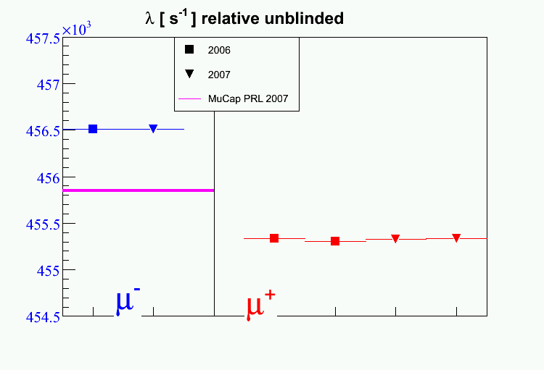
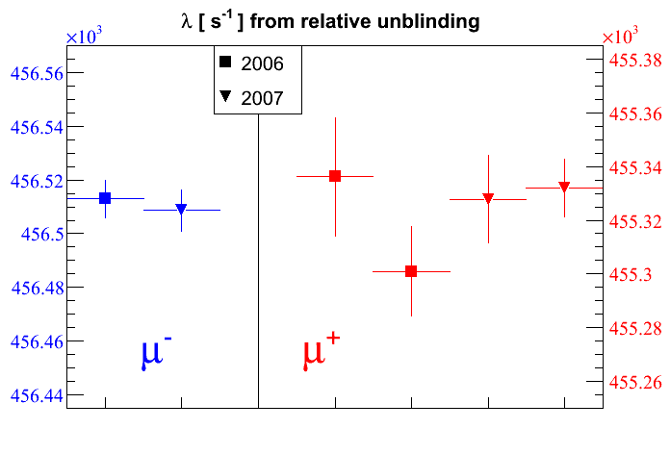
Relative unblinded
~700 s⁻¹
rates with secret offset, stat. errors only

Slide 36
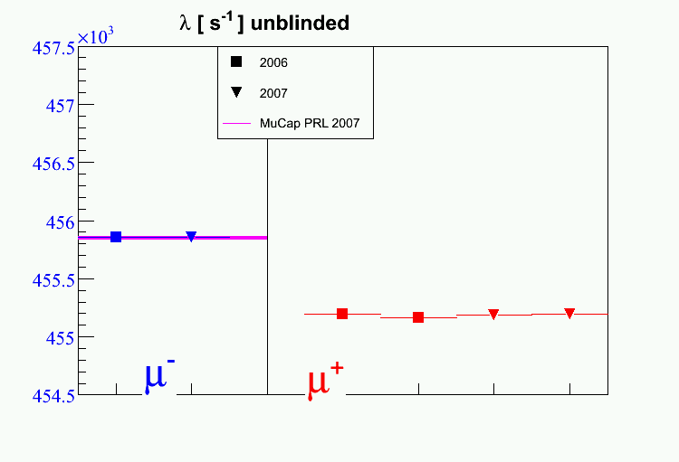
Unblinded
~700 s⁻¹

Slide 37
Systematic corrections and errors
Systematic errors | Run 2006 |  | Run 2007 |  | Comment
 | λ (s⁻¹) | δλ (s⁻¹) | λ (s⁻¹) | δλ (s⁻¹)
High-Z impurities | -7.8 | 1.87 | -4.54 | 0.93
μp scatter | -12.4 | 3.22* | -7.20 | 1.25* | * = prelim.
μp diffusion | -3.1 | 0.1 | -3.0 | 0.1
Fiducial volume cut |  | 3 |  | 3
Entrance counter inefficiencies |  | 0.5 |  | 0.5
Choice of electron detector def. |  | 1.8* |  | 1.8* | * =prelim.
Total | -23.3 | 5.14§ | -14.74 | 3.88§ | § = correlated

Slide 38
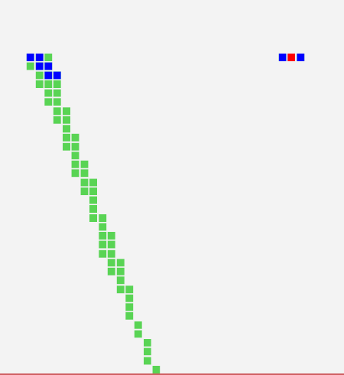
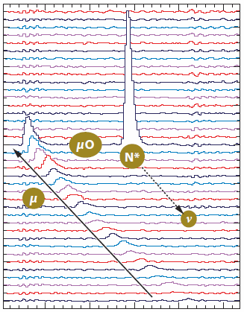
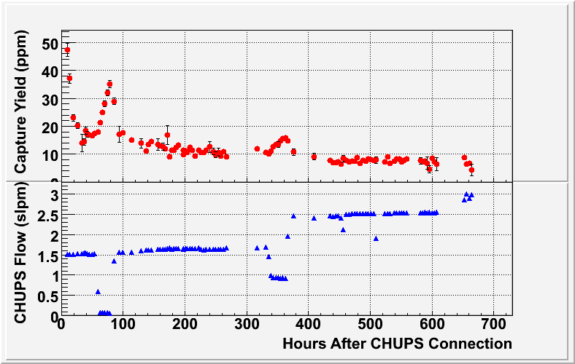
Impurity monitoring
Imp. Capture:
μ⁻ Z → (Z-1) n ν
2004 run: c_{N} < 7 ppb, c_{H2O}~30 ppb
2006 / 2007 runs: c_{N} < 7 ppb, c_{H2O}~10 ppb
Notes:
Different techniques, plot with more and more results

Slide 39
Final high-Z impurity correction
Production Data
Calibration Data
(oxygen added to production gas)
λ
Extrapolated
Result
0
Observed capture yield Y_{Z}
Lifetime deviation is linear with the Z>1 capture yield.
Notes:
Different techniques, plot with more and more results

Slide 40


External corrections to λ₋
molecular formation
bound state effect
Λ_{S} (MuCap prelim.*) = 714.5 ± 5.4_{stat} ± 5.4_{syst} s⁻¹
* Small revision of molecular correction might affect Λ_{S} < 0.5s⁻¹ and syst. error
Λ_{S} (theory) = 711.5 ± 3.5 ± 3 s⁻¹
Notes:
Different techniques, plot with more and more results

Slide 41
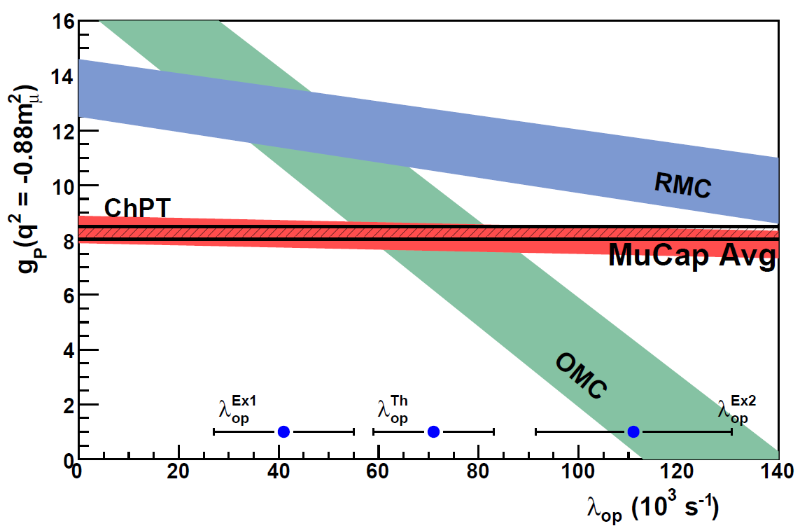
Precise and unambiguous MuCap result solves longstanding puzzle
g_{P}(MuCap prelim.) = 8.07 ± 0.5
g_{P}(theory) = 8.26 ± 0.23
Notes:
Different techniques, plot with more and more results

Slide 42
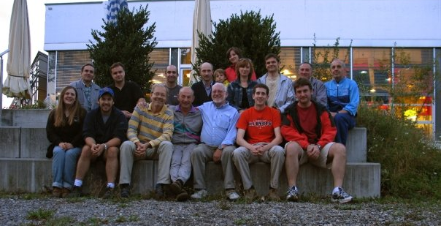




Subset of the MuCap collaboration
Petersburg Nuclear Physics Institute, Gatchina, Russia
Paul Scherrer Institute, CH
University of California
University of Illinois at
Urbana-Champaign
University of Washington
University of Kentucky
Boston University
Regis University, Colorado
Université Catholique de
Louvain, Belgium
James Madison University
Supported by NSF, DOE, Teragrid, PSI and Russian Acad. Science and CRDF
Notes:
Different techniques, plot with more and more results

Slide 43
Precise and unambiguous MuCap result solves longstanding puzzle
g_{P}(MuCap prelim.) = 8.07 ± 0.5
g_{P}(theory) = 8.26 ± 0.23
Notes:
Different techniques, plot with more and more results

