Slide 1
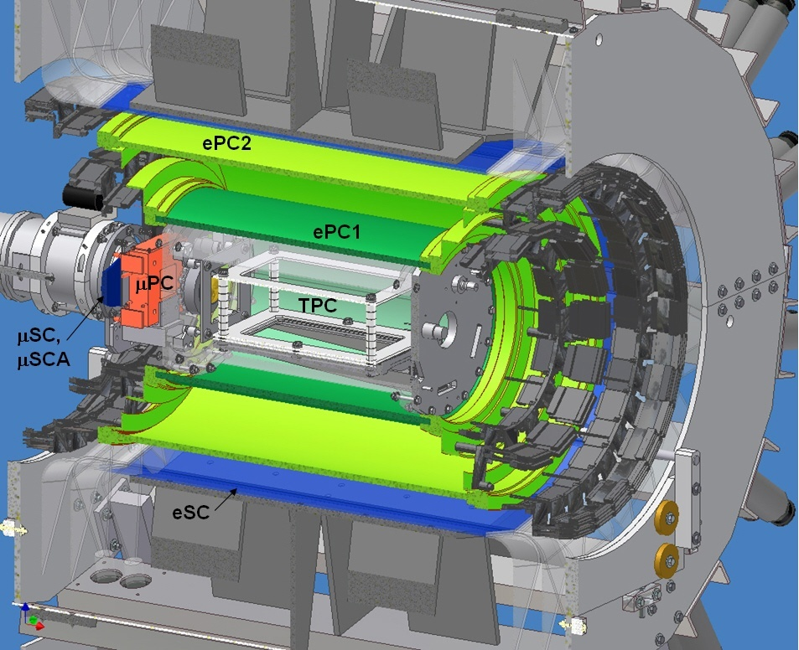
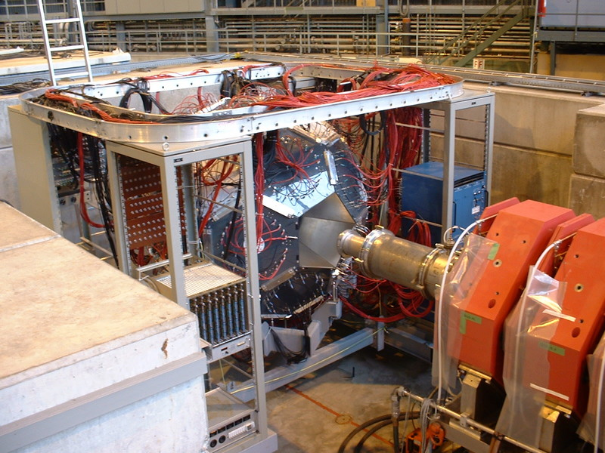
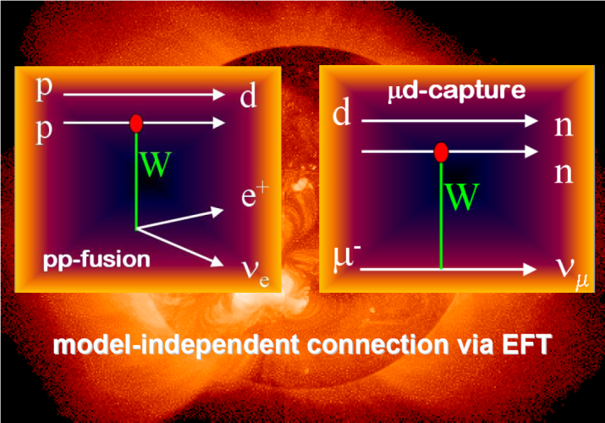
In a muon's lifetime: From Fermi's constant to calibrating the sun
Peter Winter
University of Washington
g_{P}
τ_{μ}
L_{1A} / d_{R}

Slide 2
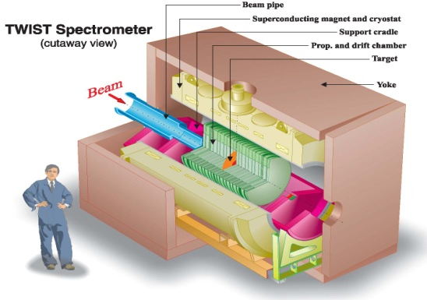
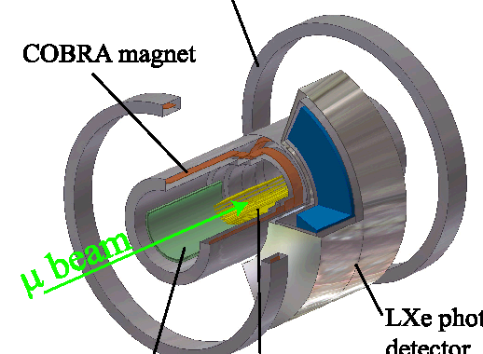
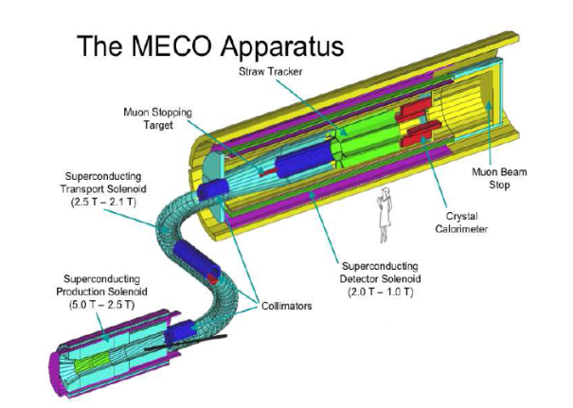
Muon physics efforts worldwide
Lifetime – Fermi constant
2 “precision” experiments: MuLan & FAST
Decay parameters
Michel – TWIST ρ, δ, η, P_{μ}ξ
Transverse polarization (η) – PSI
Capture
MuCap: g_{P}, pseudoscalar coupling
MuSun: basic EW interaction in 2N system
Anomalous magnetic moment (g-2)
New g-2 experiment in planning
Lepton Flavor Violation
μ◊eγ – MEG at PSI taking data now
μe conversion – μA→eA Mu2e at FNAL new high-priority project
EDM
E821 PRD in prep ~10⁻²¹ e.cm
Modest efforts toward small dedicated ring at PSI
Lorentz / CPT violation tests
E821 g-2 PRL 2007; precession vs. sidereal day
Muonic Lamb shift (QED)
Finite size effects aids to hydrogen Lamb shift effort
TWIST
MEG
Mu2e

Slide 3
Outline
Muon Lifetime Analysis (MuLan)
Motivation
MuLan experiment
Main systematics and result
μ⁺
Muon capture on the proton (MuCap)
Motivation and general overview
MuCap experiment
Systematics and results
μ⁻p
Muon capture on the deuteron (MuSun)
Motivation and outlook
μ⁻d

Slide 4
Three electro-weak input parameters
Fine structure constant
Δα / α ≈ 0.37 ppb [Gabrielse et al, 2008]
Neutral weak boson mass
ΔM_{Z} / M_{Z} ≈ 23 ppm [LEP EWWG 2005]
Fermi constant
ΔG_{F} / G_{F} ≈ 9 ppm [Giovanetti et al, 1984,
Bardin et al., 1984]

Slide 5
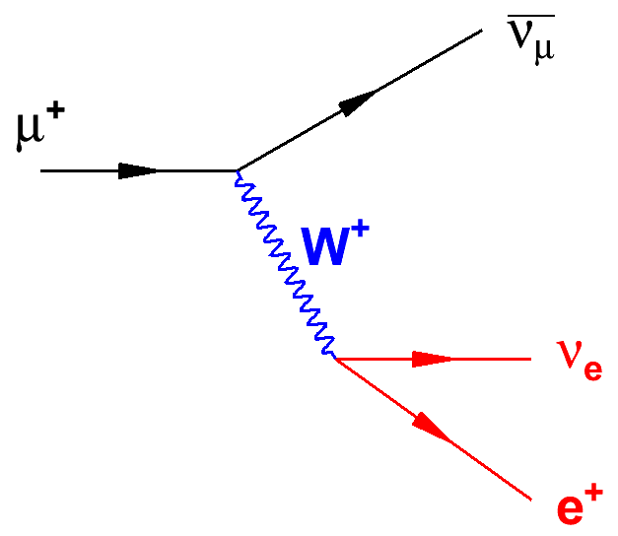
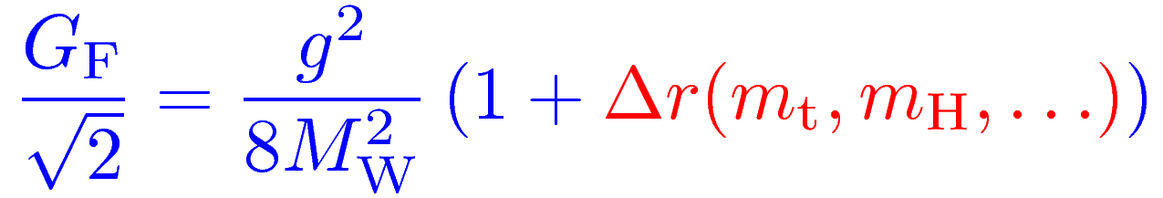
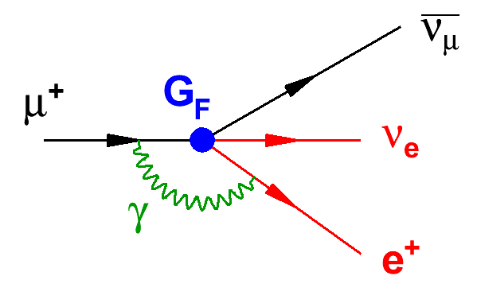
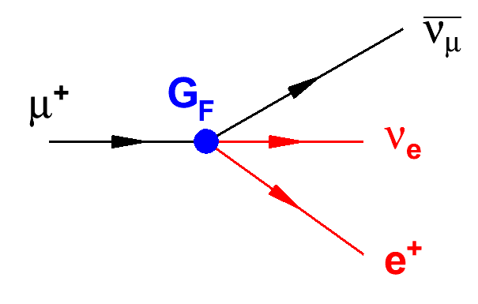
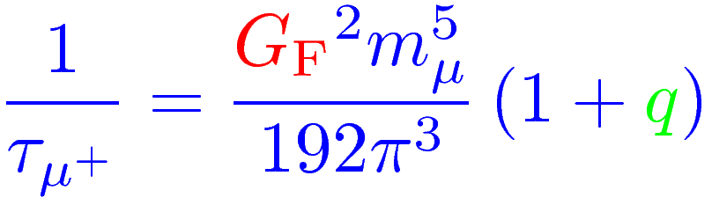
Fermi constant G_{F}
Implicit to all EW precision physics
Most precisely determined by muon decay
q
PS, QED and hadr. rad.

Slide 6
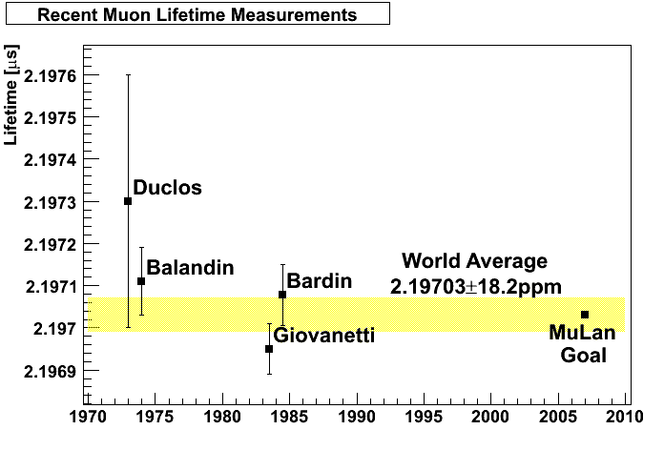
Brief history of τ_{μ}
Before 2007, the best measurements
were over 20 years old,
and until 1999 G_{F} was theory limited.
G. Bardin et al., Phys. Lett. B 137, 135 (1984)
K. Giovanetti et al., Phys. Rev. D 29, 343 (1984)

Slide 7
Extraction of G_{F} no longer theory limited
Mid 90s:
<0.3 ppm
1999:
Future:
17 ppm
9 ppm
0.5 ppm
18 ppm
1 ppm
0.09 ppm
30 ppm
Lifetime error is
the limit
2 loop QED corrections
T. van Ritbergen and R. G. Stuart, Nucl. Phys. B564, 343 (2000)
A. Pak and A. Czarnecki, PRL 100, 241807 (2008)

Slide 8
Outline
Muon Lifetime Analysis (MuLan)
Motivation
MuLan experiment
Main systematics and result
μ⁺
Muon capture on the proton (MuCap)
Motivation and general overview
MuCap experiment
Systematics and results
μ⁻p
Muon capture on the deuteron (MuSun)
Motivation and outlook
μ⁻d

Slide 9
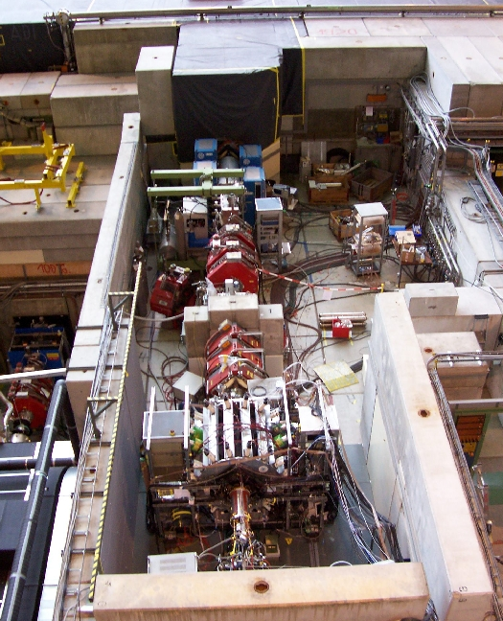
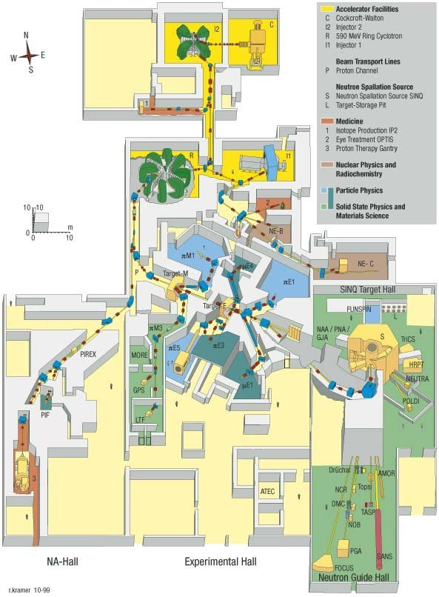
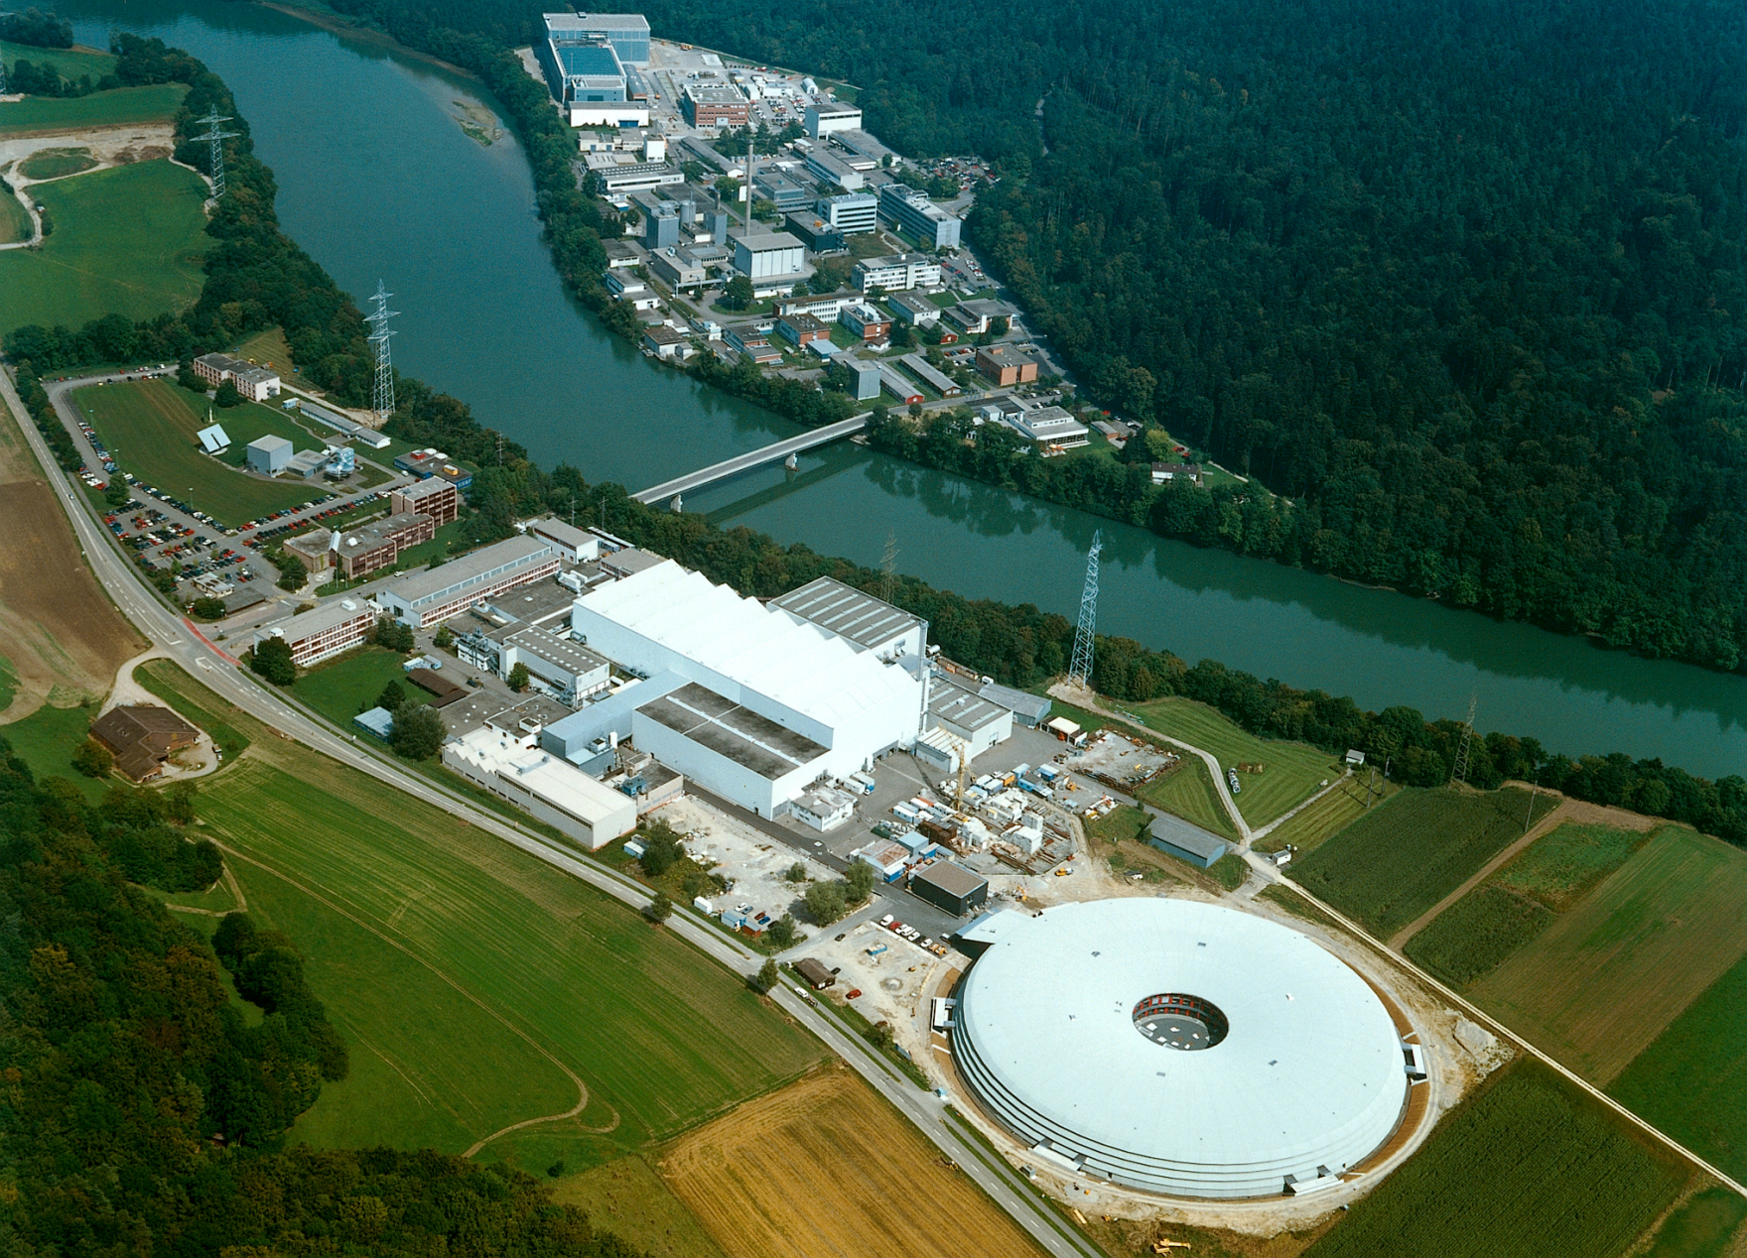

The facility: πE3 beamline at PSI
http://www.psi.ch
Notes:
Different techniques, plot with more and more results

Slide 10
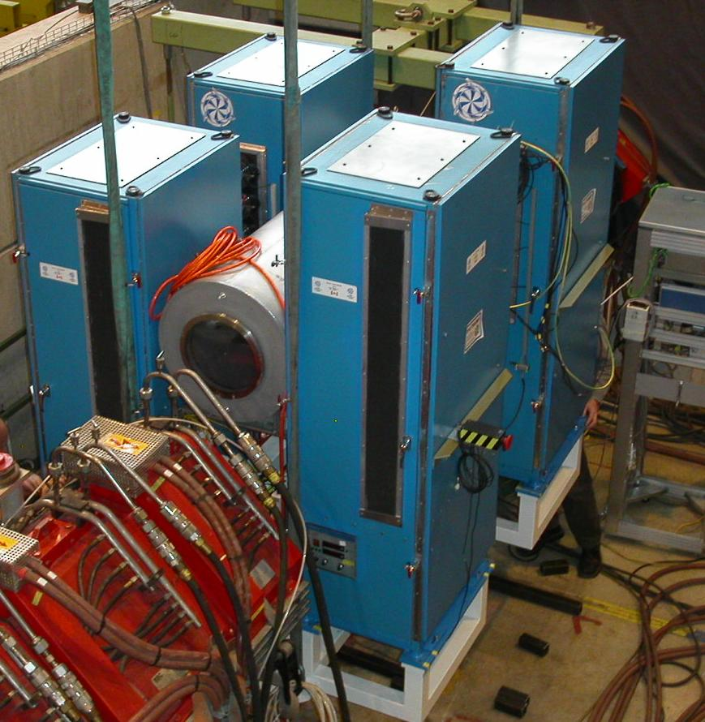
The Kicker
Design at TRIUMF
MOSFET based
50 ns switching time
Kicker
Notes:
Different techniques, plot with more and more results

Slide 11
Other elements
Separator: Suppression of e⁺ or e⁻ in beam
Separator
Quadrupoles
Detector
Notes:
Different techniques, plot with more and more results

Slide 12
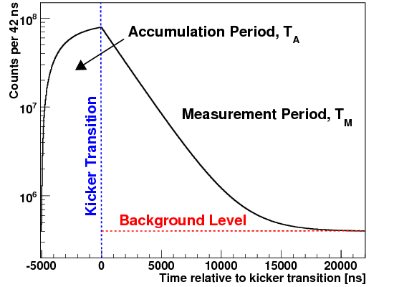
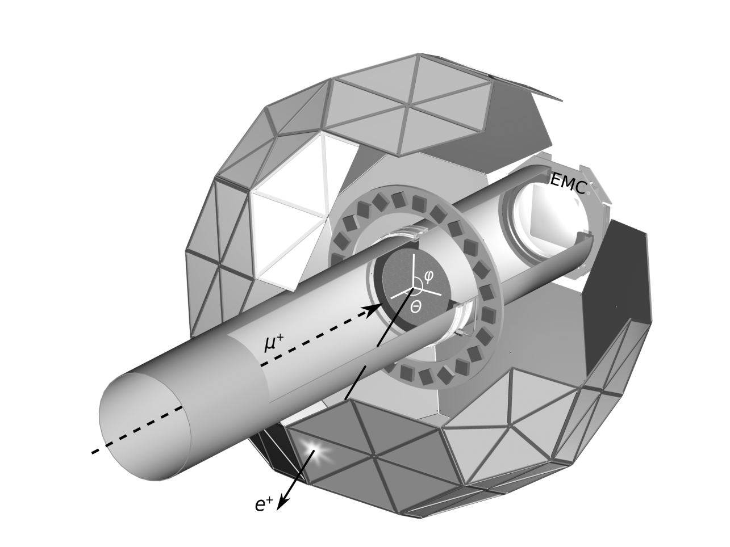
The experimental concept…
Inner/Outer
tile pair
Real data
Kicker On
450 Mhz
waveform
digitization
Measurement Period
MHTDC
(2004)
Number (log scale)
time
Fill Period
-12.5 kV
12.5 kV

Slide 13
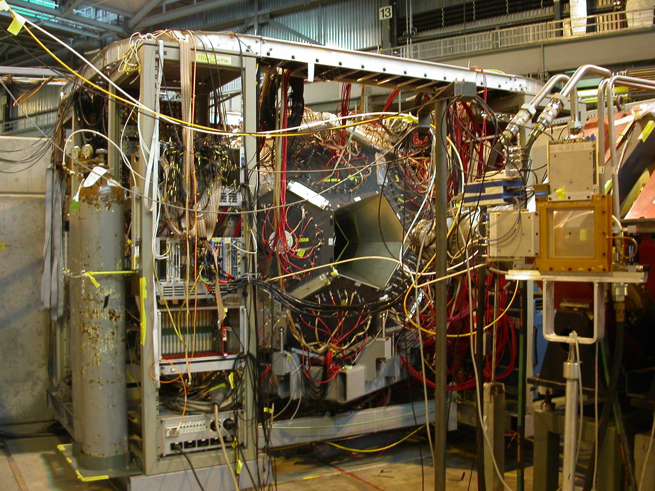
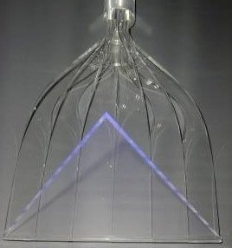
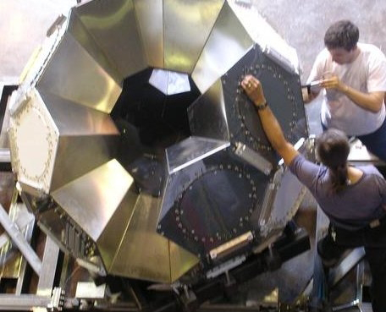
a tile ...
a house ...
the ball ...

Slide 14
Outline
Muon Lifetime Analysis (MuLan)
Motivation
MuLan experiment
Main systematics and result
Muon capture on the proton (MuCap)
Motivation and general overview
MuCap experiment
Systematics and results
Muon capture on the deuteron (MuSun)
Motivation and outlook

Slide 15
Main systematics
Any early-to-late effect:
Instrumental issues
Pileup pulses
Non-flat background
PMT gain change
....
Physics issues
Polarization
Longitudinal relaxation
....

Slide 16
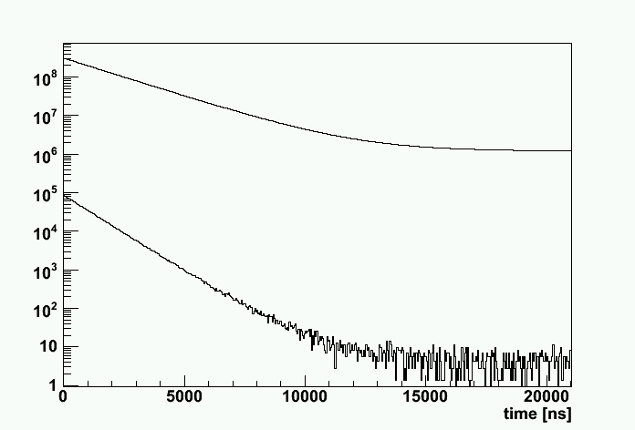
Pileup corrected from the data
A MuLan
detector
tile pair
Pileup pulses measurably distort the lifetime
Shadow and pileup pulses have the same probability distribution!
Normal Time
Distribution
1/τ − 2/τ
time
2/τ
Pileup Time
Distribution
Pulse
Resolving
Time
Shadow
window

Slide 17
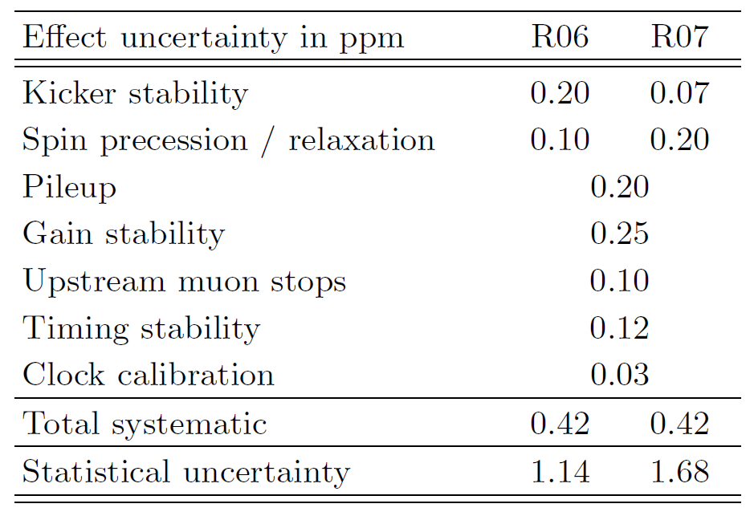
Results final statistics
τ_{μ}(R06) = 2196979.9 ± 2.5 ± 0.9 ps
τ_{μ}(R07) = 2196981.2 ± 3.7 ± 0.9 ps

Slide 18
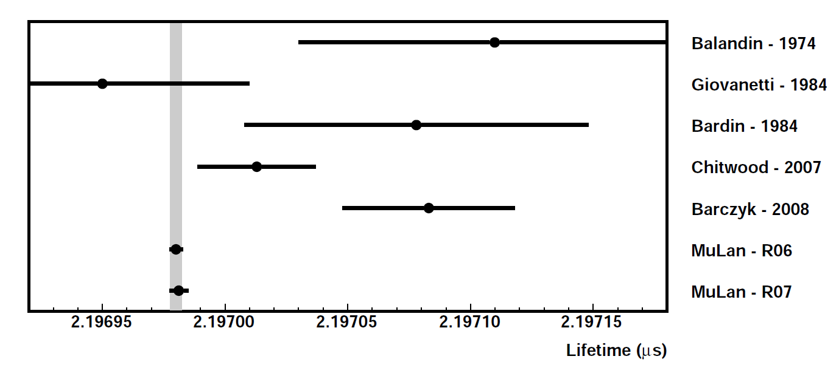
G_{F} = 1.1663818(7) x 10⁻⁵ GeV⁻² (0.6 ppm)
D.B. Chitwood et al., Phys. Rev. Lett. 99, 03201 (2007)
D. Webber et al., in preparation for publication (2010)

Slide 19
Outline
Muon Lifetime Analysis (MuLan)
Motivation
MuLan experiment
Main systematics and result
μ⁺
Muon capture on the proton (MuCap)
Motivation and general overview
MuCap experiment
Systematics and results
μ⁻p
Muon capture on the deuteron (MuSun)
Motivation and outlook
μ⁻d

Slide 20
Nucleon form factors
μ⁻ + p → n + ν
μ⁻
ν
q² = -0.88m_{μ}²
p
n
M ~ G_{F}V_{ud} · ψ_{ν} γ_{α}(1-γ₅)ψ_{μ} · ψ_{n}(V^{α}-A^{α})ψ_{p}

Slide 21
Nucleon form factors
M ~ G_{F}V_{ud} · ψ_{ν} γ_{α}(1-γ₅)ψ_{μ} · ψ_{n}(V^{α}-A^{α})ψ_{p}
V^{α} = g_{V}(q²) γ^{α}
+ i g_{M}(q²) σ^{αβ}q_{β}/2M_{N}
+ g_{S}(q²) q^{α}/m_{μ}
Conserved Vector Current and isospin symmetry
g_{S}(q²) = 0
g_{V}, g_{M}: strong program JLab, Mainz, ...

Slide 22
Nucleon form factors
M ~ G_{F}V_{ud} · ψ_{ν} γ_{α}(1-γ₅)ψ_{μ} · ψ_{n}(V^{α}-A^{α})ψ_{p}
A^{α} = g_{A}(q²) γ^{α}γ₅
+ i g_{T}(q²) σ^{αβ}q_{β}/2M_{N}γ₅
+ g_{P}(q²) q^{α}/m_{μ}γ₅
Second class current suppressed by isospin ⇒ g_{T}(q²) = 0
g_{A}(q²) measured in neutron decay

Slide 23
Pseudoscalar form factor g_{P}
2m_{N}m_{¹}g_{A}(0)
μ
ν
2m_{N}m_{μ}g_{A}(0)
1
g_{P}(q²) = - - g_{A}(0)m_{N}m_{μ}r_{A}²
g_{P}(q²) = -
q²-m_{¼}²
q²-m_{π}²
3
W
f_{π}
PCAC pole term
(Adler, Dothan, Wolfenstein)
NLO (ChPT)
Bernard, Kaiser, Meissner PR D50, 6899 (1994)
π
g_{P} = 8.26 ± 0.23
g_{πNN}
p
n
solid QCD prediction via ChPT (2-3% level)
NNLO < 1%: N. Kaiser, PRC67 (2003)
basic test of chiral symmetries and low energy QCD
Recent reviews: T. Gorringe, H. Fearing, Rev. Mod. Physics 76 (2004) 31 V. Bernard et al., Nucl. Part. Phys. 28 (2002), R1

Slide 24
How to access g_{P}?
In principle any process directly involving axial current:
- β decay: Not sensitive since g_{P} term ~ q
- ν scattering difficult to measure
⇓
Muon capture most direct source for g_{P}
Notes:
Different techniques, plot with more and more results

Slide 25
Experiments: Observed Processes
- Ordinary muon capture (OMC): μ⁻ p → ν n
- Radiative muon capture (RMC): μ⁻ p → ν n γ
- μ⁻ ³He → ν ³H or other nuclei
Notes:
Different techniques, plot with more and more results

Slide 26
Experiments: Observed Processes
- Ordinary muon capture (OMC): μ⁻ p → ν n
- Radiative muon capture (RMC): μ⁻ p → ν n γ
- μ⁻ ³He → ν ³H or other nuclei
Notes:
Different techniques, plot with more and more results

Slide 27
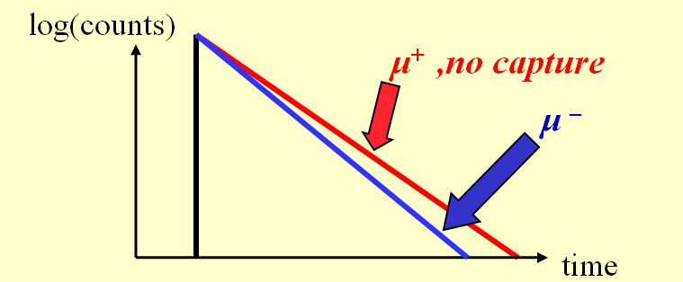
OMC: Methods to measure
Neutron experiments:
- Measure outgoing neutrons N_{N}
- Requires knowledge of neutron efficiency
- Separation of decay γ's from neutrons
- Typical experiments 8-13% precision in Λ_{S}
Lifetime method:
- Λ_{S} ≈ 1/τ₋ - 1/τ₊
Notes:
Different techniques, plot with more and more results

Slide 28
Muon kinetics
φ: Hydrogen density, (LH₂: φ=1)
Λ_{T} ~ 12s⁻¹
pμ↑↑
p
φ>0.01
<100ns
μ
pμ↑↓
Λ_{S} ~ 700s⁻¹
Notes:
Different techniques, plot with more and more results

Slide 29
Muon kinetics
ppμ
Λ_{OM} ~ ¾ Λ_{S}
φλ_{OF}
ortho (J=1)
pμ↑↓
λ_{OP}
φλ_{PF}
Λ_{S} ~ 700s⁻¹
ppμ
Λ_{PM} ~ ¼ Λ_{S}
para (J=0)
ppμ formation depends on density φ
Interpretation requires knowledge of Λ_{OM}, Λ_{PM} and λ_{OP}
Notes:
Different techniques, plot with more and more results

Slide 30
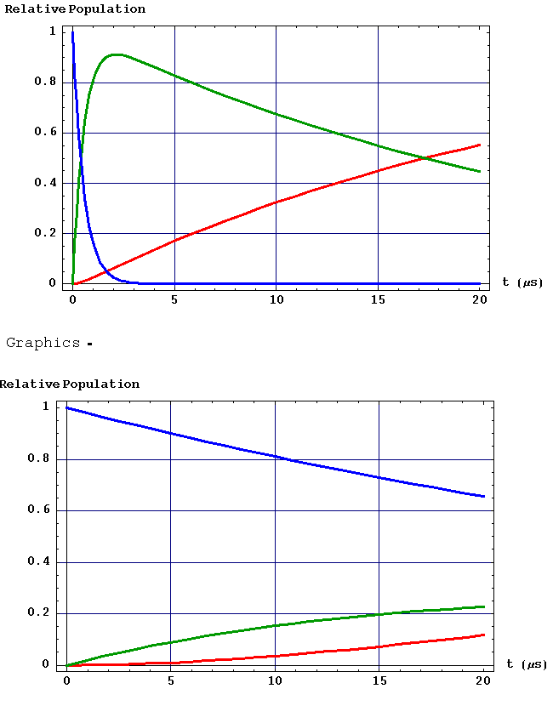
ppμ
Λ_{OM} ~ ¾ Λ_{S}
φλ_{OF}
ortho (J=1)
pμ↑↓
λ_{OP}
φλ_{PF}
Λ_{S} ~ 700s⁻¹
ppμ
Λ_{PM} ~ ¼ Λ_{S}
para (J=0)
φ = 1 (Liquid)
φ = 0.01 (~10 bar gas)
Rel. Population
Rel. Population
Time after μp Formation
Time after μp Formation
Notes:
Different techniques, plot with more and more results

Slide 31
Previous results
μ p → ν n @ SACLAY
μ p → ν n γ @ TRIUMF
g_{P}
μCap precision goal
ChPT
exp
theory
TRIUMF 2005
λ_{OP} (ms⁻¹)
no overlap theory, OMC & RMC
large uncertainty in λ_{OP} ⇒ g_{P} ± 50%

Slide 32
Requirement of clean target
μZ
Λ_{Z} ~ Λ_{S} Z⁴
ppμ
Λ_{OM} ~ ¾ Λ_{S}
c_{Z}Λ_{Z}
φλ_{OF}
ortho (J=1)
c_{d}λ_{pd}
pμ↑↓
λ_{OP}
μd
φλ_{PF}
Λ_{S} ~ 700s⁻¹
ppμ
Λ_{PM} ~ ¼ Λ_{S}
Λ_{d}
diffusion
para (J=0)
Isotopically and chemically pure H₂, ideally:
c_{d}<1 ppm, c_{Z}<10 ppb
Notes:
Different techniques, plot with more and more results

Slide 33
Outline
Muon Lifetime Analysis (MuLan)
Motivation
MuLan experiment
Main systematics and result
μ⁺
Muon capture on the proton (MuCap)
Motivation and general overview
MuCap experiment
Systematics and results
μ⁻p
Muon capture on the deuteron (MuSun)
Motivation and outlook
μ⁻d

Slide 34

e
μ
Notes:
Different techniques, plot with more and more results

Slide 35
One muon at a time
Muon
entrance
counter
Target
0 kV
μ beam
μ
0 kV

Slide 36
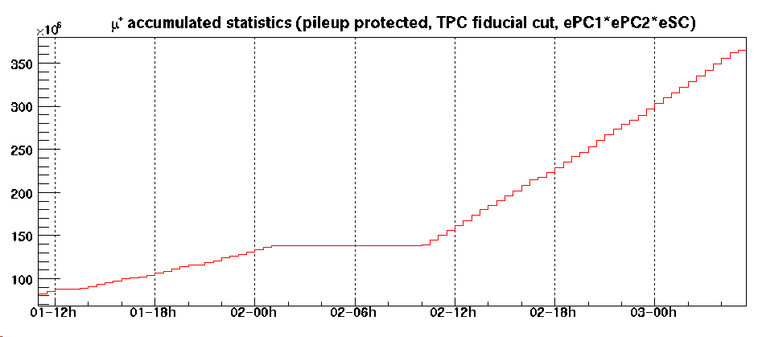
One muon at a time
Muon
entrance
counter
Target
kicked
Fig will be improved
+12.5 kV
μ beam
μ
-12.5 kV
DC
~3 times higher rate
Pileup protection for 25 μs

Slide 37
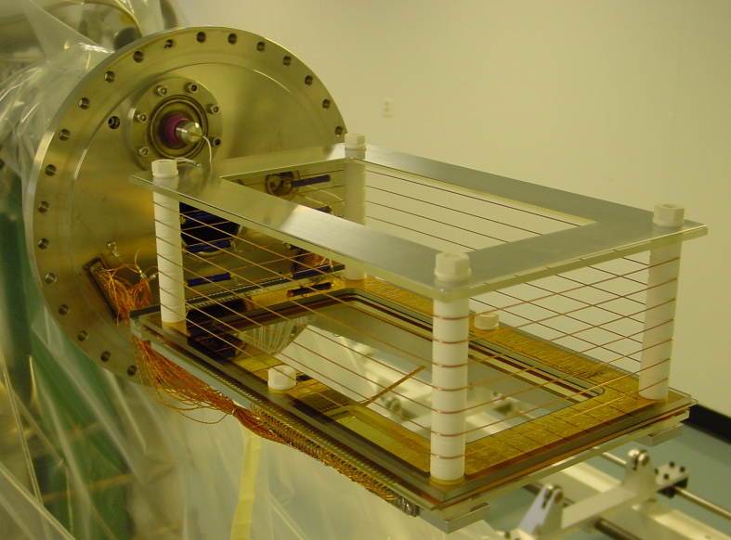
TPC - the active target
10 bar ultra-pure H₂
2.0 kV/cm drift field
~ 5.4 kV on 3.5 mm anode half gap
bakeable glass/ceramic materials
Operation with pure H₂ challenging, R&D @ PNPI, PSI
Notes:
Different techniques, plot with more and more results

Slide 38
TPC - the active target
μ entrance: lower energy loss
μ stop: Bragg peak
μ⁻
E
y
e⁻
x
μp
z
xz projection
from anodes
and strips
zy projection
from anodes
and drift time
xy projection
from strips
and drift time
3d tracking without material in fiducial volume
Clean muon stop definition away from high-Z
Notes:
Different techniques, plot with more and more results

Slide 39
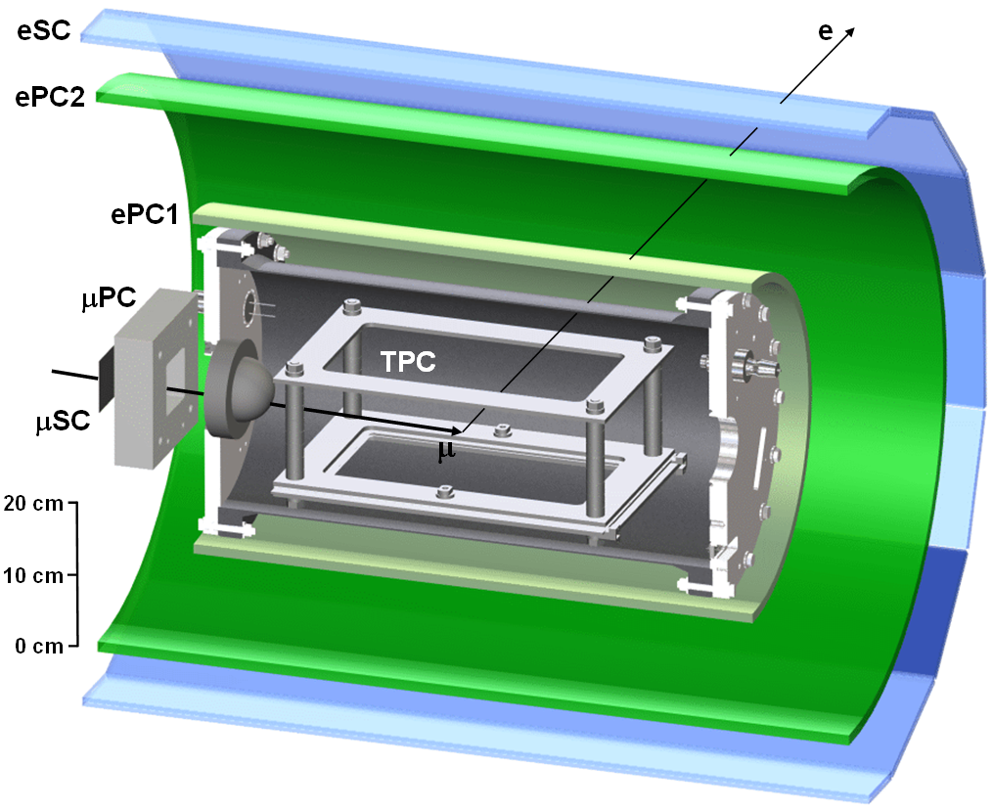
Electron detectors
Timing from scintillator (eSC)
Full 3d tracking with wire chamber (ePC1 and ePC2)
Notes:
Different techniques, plot with more and more results

Slide 40
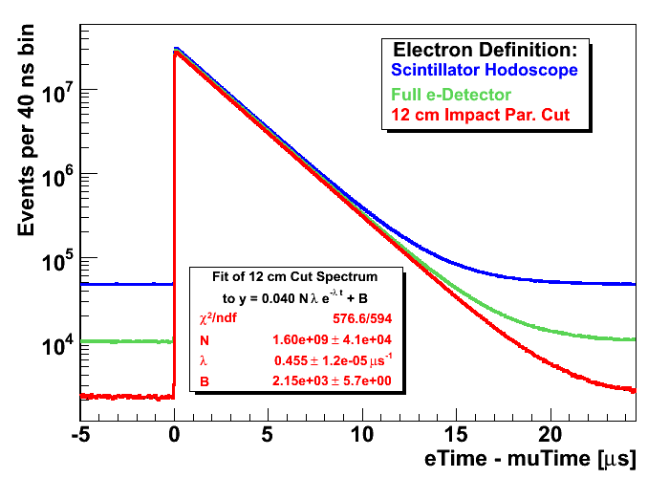
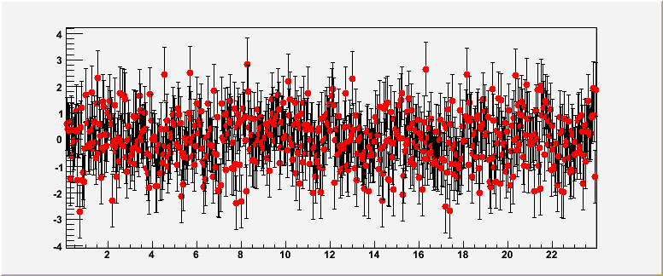
Lifetime spectra
Normalized
residuals
Notes:
Different techniques, plot with more and more results

Slide 41
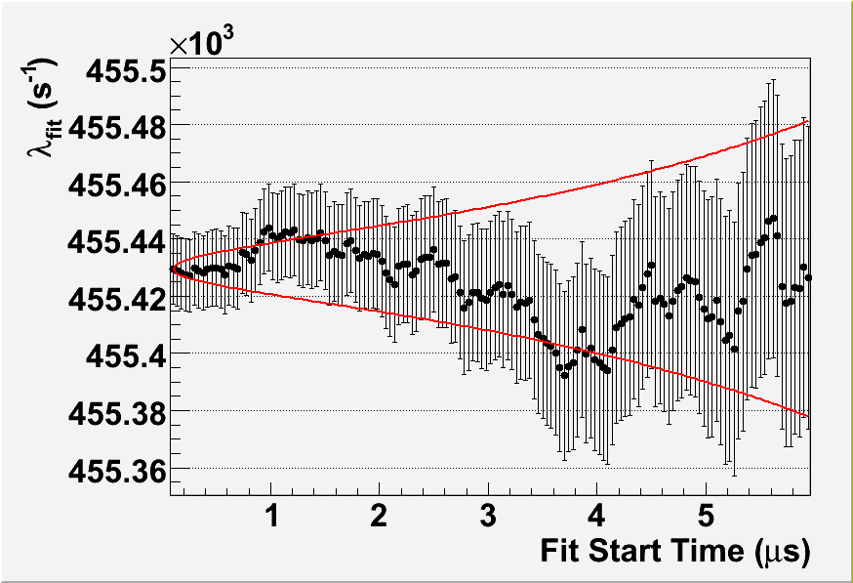
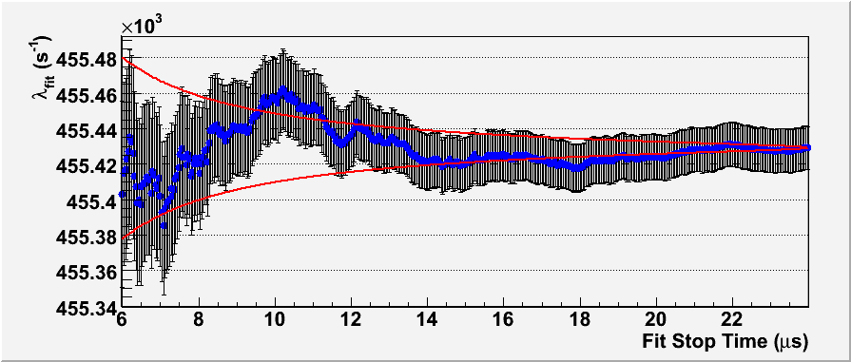
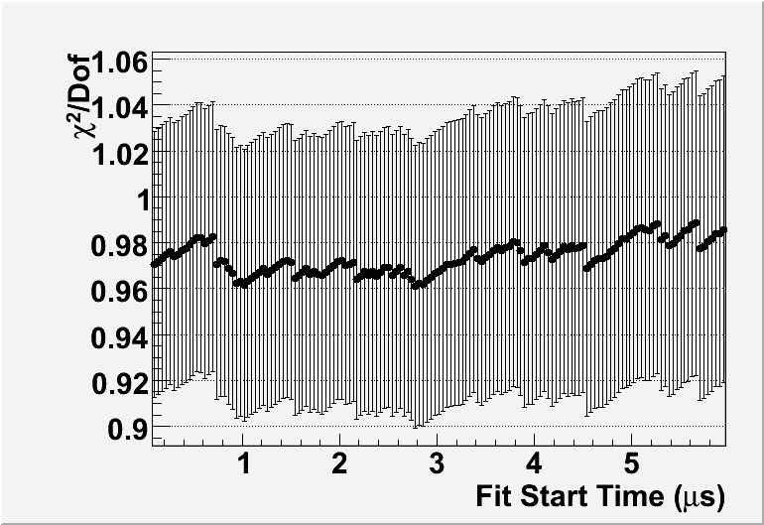
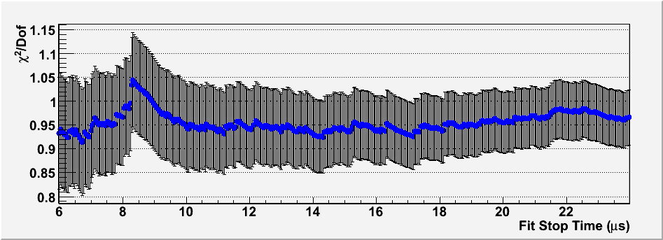
Consistency checks
Notes:
Different techniques, plot with more and more results

Slide 42
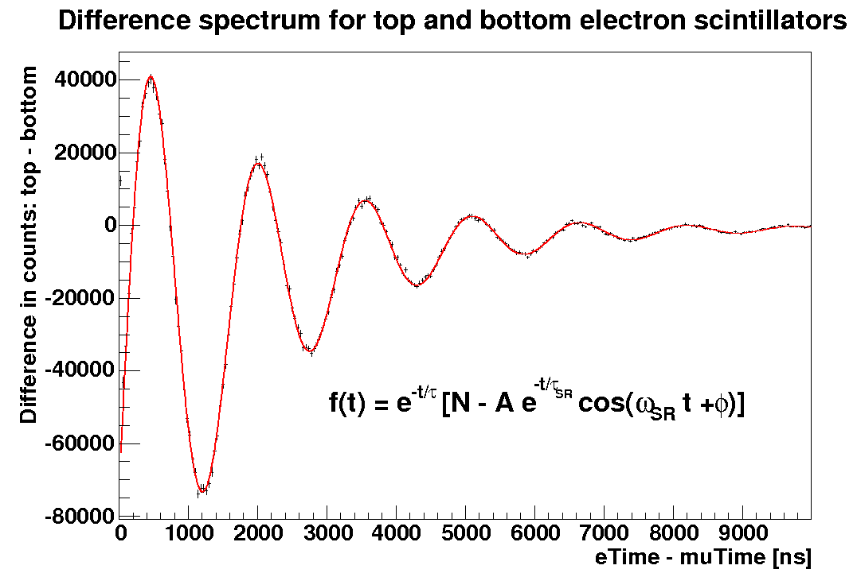
μ⁺ as reference
μSR in 50G
Measurement with μ⁺ has identical detector systematics
Cross check with world average τ₊: ~1ppm precision in the future (MuLan and FAST @ PSI)
Notes:
Different techniques, plot with more and more results

Slide 43
Outline
Muon Lifetime Analysis (MuLan)
Motivation
MuLan experiment
Main systematics and result
μ⁺
Muon capture on the proton (MuCap)
Motivation and general overview
MuCap experiment
Systematics and results
μ⁻p
Muon capture on the deuteron (MuSun)
Motivation and outlook
μ⁻d

Slide 44
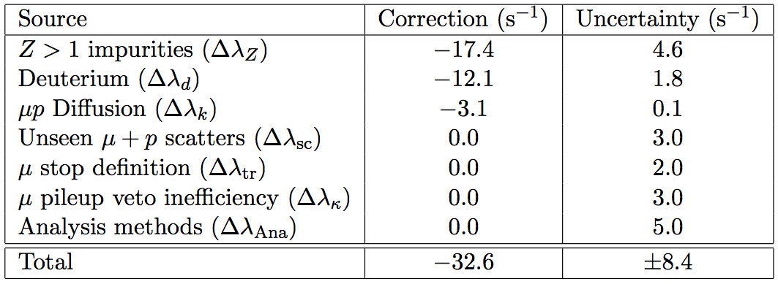
Internal corrections to λ₋
(statistical uncertainty of λ₋: 13.7 s⁻¹)
Notes:
Different techniques, plot with more and more results

Slide 45
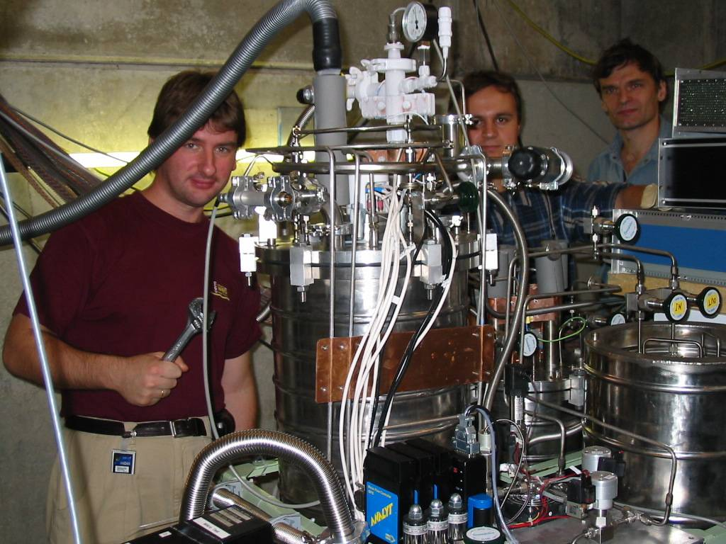
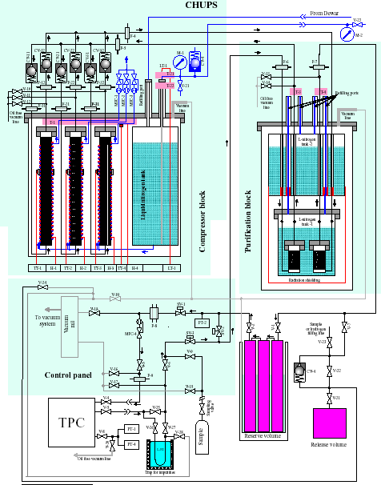
CHUPS
Continous H₂ Ultra-Purification System
c_{N2}, c_{O2} < 10 ppb
NIM A578 (2007), 485
Notes:
Different techniques, plot with more and more results

Slide 46
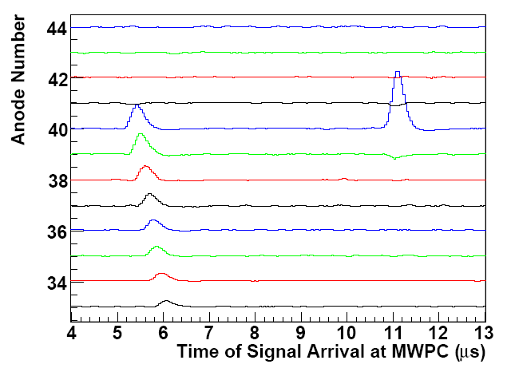
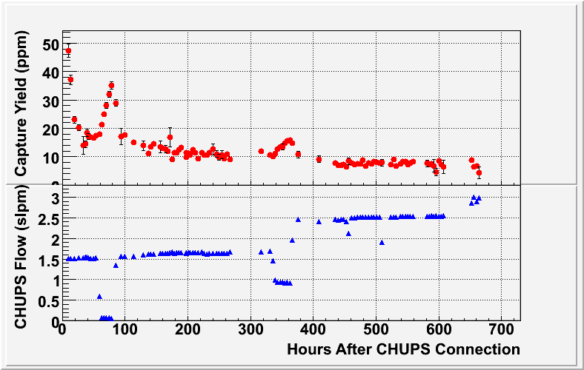
Impurity monitoring
Imp. Capture: μ⁻ Z → (Z-1) n ν
2004 run: c_{N}, c_{O} < 7 ppb, c_{H2O}~30 ppb
2006/2007 runs: c_{N}, c_{O} < 7 ppb, c_{H2O}~10 ppb
Notes:
Different techniques, plot with more and more results

Slide 47
Final high-Z impurity correction
Production Data
Calibration Data
(oxygen added to production gas)
λ
Extrapolated
Result
0
Observed capture yield Y_{Z}
Lifetime deviation is linear with the Z>1 capture yield.
Notes:
Different techniques, plot with more and more results

Slide 48
Internal corrections to λ₋
(statistical uncertainty of λ₋: 13.7 s⁻¹)
Notes:
Different techniques, plot with more and more results

Slide 49
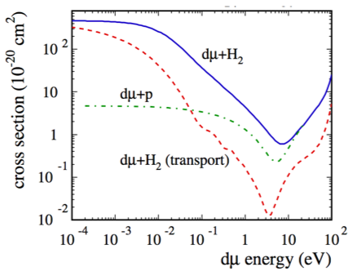
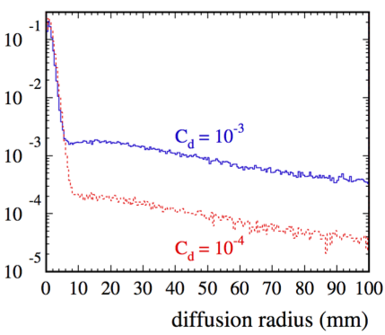
μd diffusion
(Monte Carlo)
Ramsauer-Townsend minimum in the scattering cross section
μd can diffuse ~10 cm before muon decay, possibly into walls
Notes:
Different techniques, plot with more and more results

Slide 50
Deuterium correction
Again zero extrapolation procedure
Production Data
(d-depleted Hydrogen)
Calibration Data
(Natural Hydrogen)
λ from fits to data
(f = Nλe^{-λt} + B)
λ
Extrapolated
Result
0
d Concentration (c_{d})
This must be determined.
Notes:
Different techniques, plot with more and more results

Slide 51
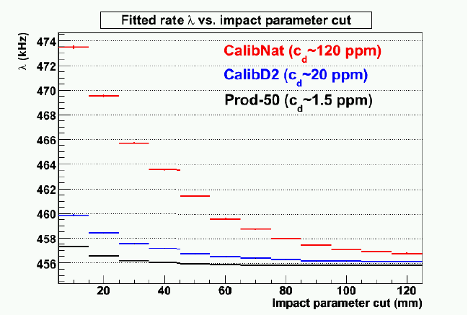
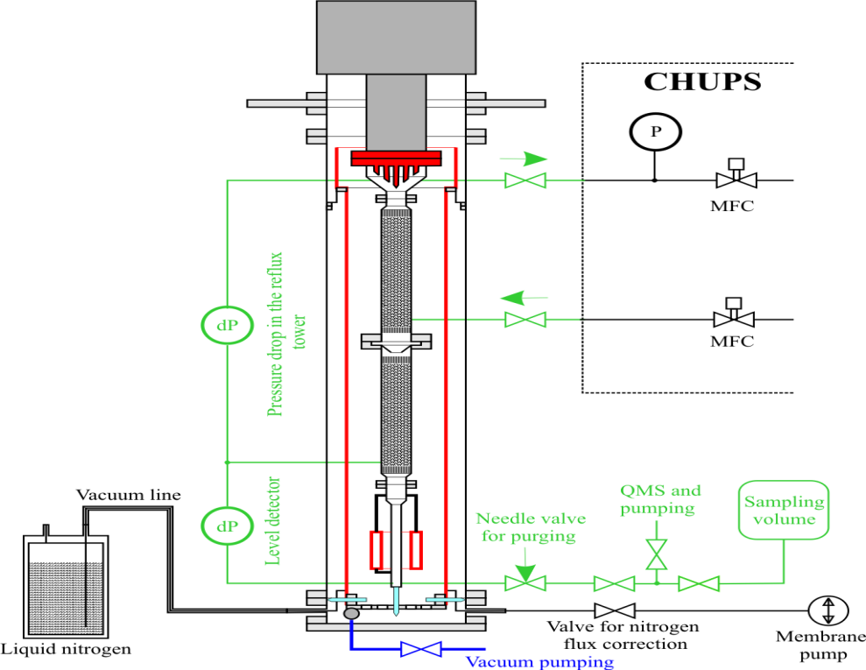
μd: MuCap's unique capability
Data: λ versus impact parameter cut
On site purification since 2006
c_{d} = 1.49 ± 0.12 ppm
AMS, ETH Zurich
World Record: c_{d} < 100 ppb
c_{d} = 1.44 ± 0.15 ppm
Notes:
Different techniques, plot with more and more results

Slide 52
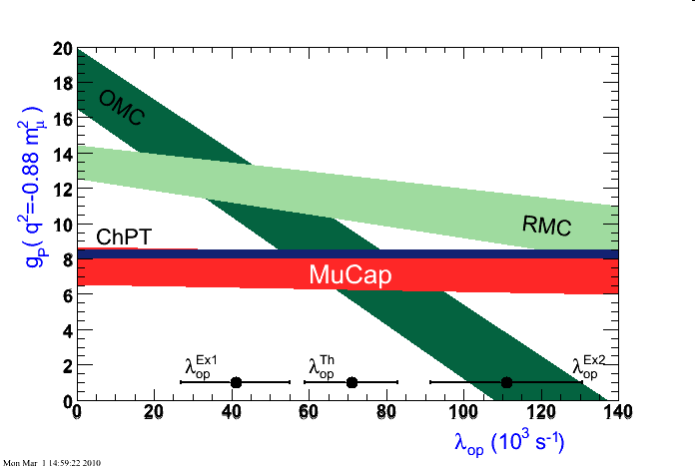
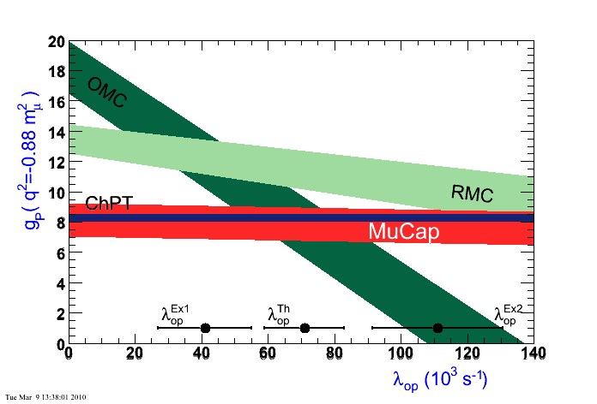
Precise and unambiguous MuCap result
Using previous τ_{μ} world average
Using new MuLan τ_{μ} average
V.A. Andreev et al., Phys. Rev. Lett. 99, 03202 (2007)
Notes:
Different techniques, plot with more and more results

Slide 53
Outline
Muon Lifetime Analysis (MuLan)
Motivation
MuLan experiment
Main systematics and result
μ⁺
Muon capture on the proton (MuCap)
Motivation and general overview
MuCap experiment
Systematics and results
μ⁻p
Muon capture on the deuteron (MuSun)
Motivation and outlook
μ⁻d

Slide 54
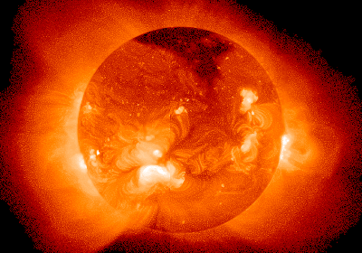
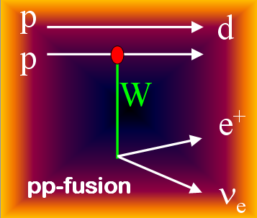
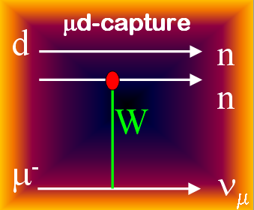
MuSun: "Calibrating" the sun
μ + d → n + n + ν
model-independent connection via EFT & L_{1A}
Aim: Measure rate Λ_{d} from μd(↑↓) to < 1.5 %

Slide 55
Theory
One body currents well defined
Two body currents not well constrained by theory (short dist.)
Methods:
Potential model + MEC π−less or hybrid EFT (L_{1A} / d_{R})
Muon capture soft enough to relate to solar reactions
MEC EFT
L_{1A,} d_{R}

Slide 56

Precise experiment needed
hybrid EFT
Potential Model + MEC
consistent ChPT
pionless, needs L_{1A}

Slide 57
μd kinetics
μd↑↑
μ
+ t + p
μ
dμd
μ
+ ³He + n
μ³He
+ n
μd↑↓
μZ
Λ_{D}
n + n + ν

Slide 58



Approved proposal by PSI
Stage 1:
MuCap setup with 1% LD₂ and 300 K
Prove excellent energy resol.
Understand fusion and impurity events
Measure nitrogen transfer rate
Run finished end of 2008
μd(↑↓)
1% LD₂ 300 K
μd(↑↑)
μ³He
time (μs)
30K, 5%
10% LD₂ 30 K
Stage 2:
Measure Λ_{D} at >5% LD₂ and 30 K
Cryo TPC development

Slide 59

Cryo-TPC development
Cold head
Vibration-free
support
Neon condensor
Cryo-TPC
Neon heat
pipe
Vacuum vessel

Slide 60


Slide 61


Overall summary
MuLan:
Factor ~25 improvement on G_{F} is final
MuCap:
First precise g_{P} with clear interpretation
Consistent with ChPT expectation, clarifies long-standing puzzle
Factor 3 additional improvement on the way (unblinding in first half of 2011)
MuSun
Muon-deuteron capture with 10x higher precision
Calibrates basic astrophysics reactions and provides new benchmark in axial 2N reactions

Slide 62


Parts of the MuLan collaboration
Petersburg Nuclear Physics Institute, Gatchina, Russia
Paul Scherrer Institute, CH
University of California, Berkeley, USA
University of Illinois at Urbana-Champaign, USA
Université Catholique de Louvain, Belgium
University of Kentucky, Lexington, USA
Boston University, USA
James Madison University, USA
Regis University, Colorado, USA
Parts of the MuCap collaboration
Notes:
Different techniques, plot with more and more results

