Slide 1
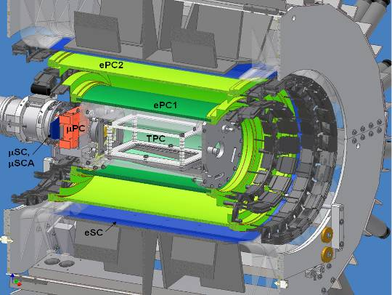
Data Analysis and Present Status of the MuCap Experiment
Steven Clayton*
University of Illinois
Outline:
Experimental overview
Data analysis challenges
Some systematics and consistency checks
First physics results and context
MuCap improvements since first physics results
*Present address: LANL

Slide 2
Experimental Challenges
1) Unambiguous interpretation requires low-density hydrogen target to reduce μ-molecular formation.
μp diffusion into Z > 1 material.
broad μ stop distribution
μ
μ stop
distribution
container wall
gas (1% LH₂ density)
liquid (LH₂)
2) H₂ must be pure chemically (c_{O},c_{N} < 10 ppb) and isotopically (c_{d} < 1 ppm). 3) All neutral final state of muon capture is difficult to detect (would require absolute calibration of neutron detectors, accurate subtraction of backgrounds).
Notes:
Saclay expt. used liquid target and High-Z walls: narrow stopping distribution, small diffusion into boundaries. Gas target required because of lambda_OP, but then broad stopping distribution and diffusion into Z>1 over measurement interval. Lifetime technique: look at the shape of the decay spectrum instead of the absolute scale.

Slide 3
μCap Method: Lifetime Technique
μCap measures the lifetime of μ⁻ in 10 bar Hydrogen.
e⁻
Data Acquisition
H₂
T_{electron}
μ⁻
T_{zero}
ΔT
Repeat 10¹⁰ times for a 10 ppm precision lifetime measurement.
slope = λ_{μ}⁻ ≡ 1/τ_{μ}⁻
Compare to μ⁺ lifetime:
Log N_{events}
slope = λ_{μ}⁺ ≡ 1/τ_{μ}⁺
λ_{μ}⁻ ≈ λ_{μ}⁺ + Λ_{S}
⇒ Λ_{S} to 1% precision
ΔT
Notes:
Actual muCap detector has:
full tracking of the muon to its stop position;
electron direction tracking, with ~70% of 4*pi coverage;
etc.

Slide 4

μCap Detailed Diagram
Tracking of Muon to Stop Position in Ultrapure H₂ Gas
Tracking of Decay Electron
Notes:
Also, in 2005, neutron detectors were installed in effort to constrain lambda_op. Development of readout continues.
Spectra are from 2004 data.

Slide 5
MuCap Exptl./Data analysis considerations
Precision muon lifetime experiment
Avoid unintended mu-e correlations,
“early-to-late” effects.
Avoid distortions to lifetime spectrum
Avoid detector dead time effects
Avoid analyzer bias
Capture on Z>1 materials must be avoided
Fiducial cut
μ+p scatters vs. “delta electrons”
Diffusion (μp and μd)
Z>1 impurities in the protium gas
Identify impurity concentration, effect on lifetime
Separate μ/e detectors;
Dead-time-free DAQ
Pileup protection (1 muon at a time)
Blinded time base
Robust “muon” definition
Impact parameter cut studies
Z>1 captures within TPC have unique signature.
Calibration data → Z>1 capture detection efficiency

Slide 6
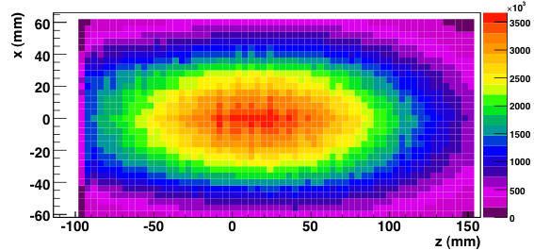
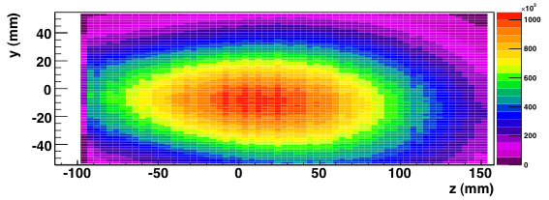
Tracking in the Time Projection Chamber
1) μ entrance, Bragg peak at stop.
2) ionization electrons drift to MWPC.
μ⁻
E
e⁻
p
y
x
z
3) projection onto zx plane from anodes and strips.
4) projection onto zy plane from anodes and drift time.
5) projection onto zy plane from strips and drift time.
Notes:
TPC tracking in Y needs time of mu entrance and drift time. For unambiguous tracking, 1 muon at a time is preferred; 25 microsecond drift time sets optimal beam rate. With DC beam at optimal ~20 kHz, ~65% of events rejected due to pileup. Use of kicked beam therefore improves good data rate by ~3 times.

Slide 7
Impact Parameter Cuts
(also known as μ-e vertex cuts)
Scatter
in wall
e
(electron view)
interpolated
e-track
point of closest approach
stop
position
μ-e Vertex Cut
b
μ Stop Position
aluminum
pressure vessel
The impact parameter b is the distance of closest approach of the e-track to the μ stop position.

Slide 8
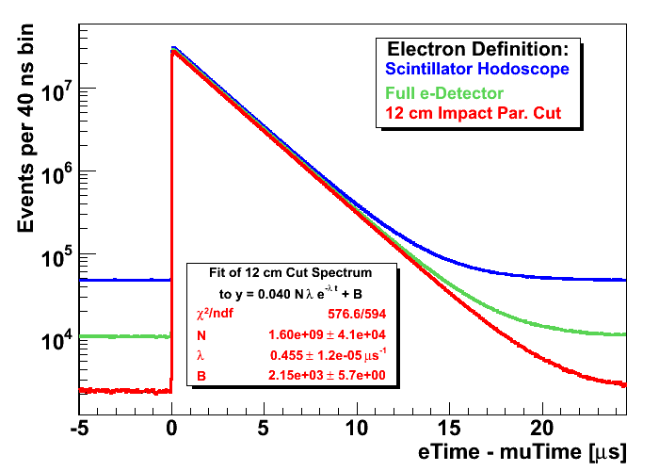
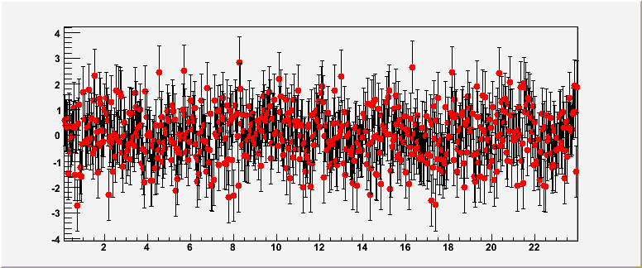
Lifetime Spectra
Normalized
residuals (“pull”)

Slide 9
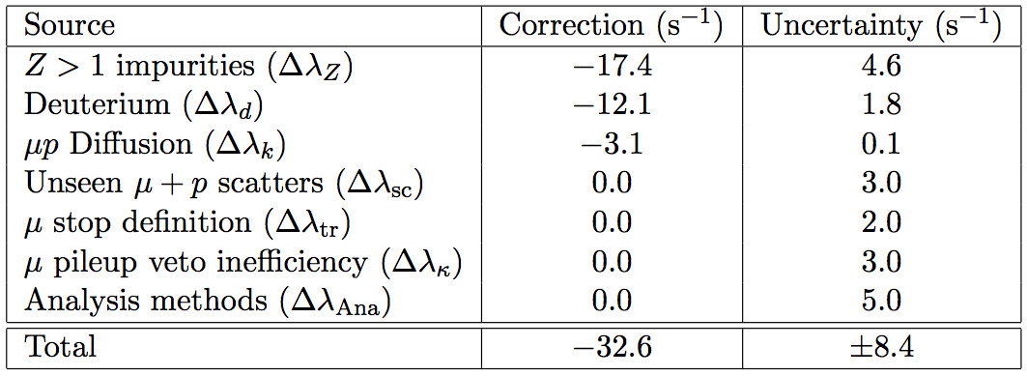
Internal corrections to λ_{μ}⁻
(statistical uncertainty of λ_{μ}⁻: 12 s⁻¹)

Slide 10
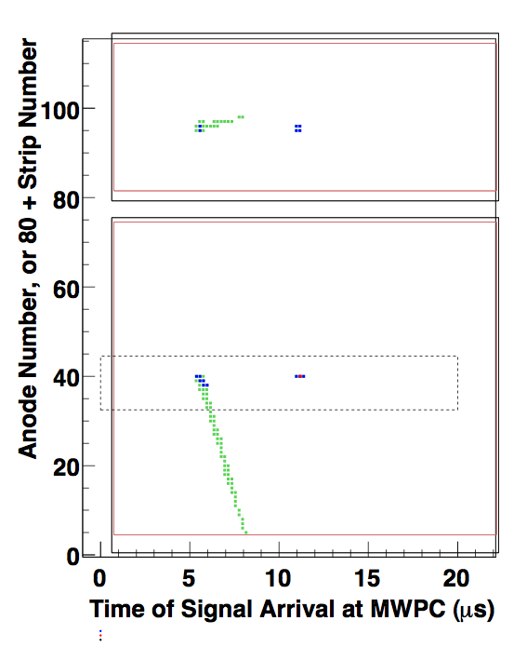
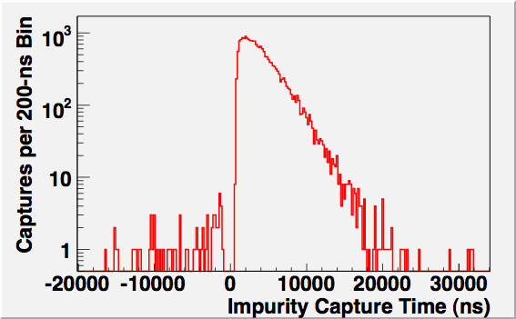
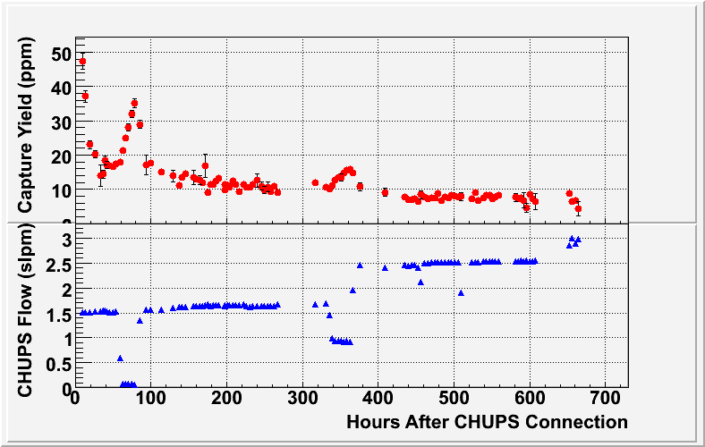
In situ detection of Z > 1 captures
TPC (side view)
Z>1 Capture
(recoil nucleus)
μ Beam
Capture Time
μ Stop

Slide 11
The final Z > 1 correction Δλ_{Z} is based on impurity-doped calibration data.
Production Data
Calibration Data
(oxygen added to production gas)
λ
Extrapolated
Result
0
Observed capture yield Y_{Z}
Lifetime deviation is linear with the Z>1 capture yield.
Some adjustments were made because calibration data with the main contaminant, oxygen (H₂O), were taken in a later running period (2006).

Slide 12
Internal corrections to λ_{μ}⁻
(statistical uncertainty of λ_{μ}⁻: 12 s⁻¹)

Slide 13
Residual deuterium content is accounted for by a zero-extrapolation procedure.
Production Data
(d-depleted Hydrogen)
Calibration Data
(Natural Hydrogen)
λ from fits to data
(f = Nλe^{-λt} + B)
λ
Extrapolated
Result
0
d Concentration (c_{d})
This must be determined.

Slide 14
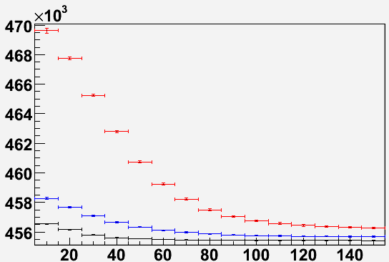
c_{d} Determination: Data Analysis Approach
μd can diffuse out of acceptance region:
signal proportional to number of μd, and therefore to c_{d}.
(electron view)
μ Decay Position
μd Diffusion Path
Fits to Lifetime Spectra
μ-e Vertex Cut
natural hydrogen (c_{d} ≈ 120 ppm)
d-doped target (c_{d} ≈ 17 ppm)
production target (c_{d} ~ 2 ppm)
λ [s⁻¹]
μ Stop Position
diffusion “signal” for 40-mm cut
c_{d}(Production)
c_{d}(Natural H2)
= 0.0125 ± 0.0010
*after accounting for μp diffusion
Impact Parameter Cut b_{cut} [mm]
Agrees with atomic mass spectrometry measurement of c_{D}
Notes:
Decay-Time-dependent acceptance → different lambda.
Complication: we also see mu-p diffusion (~1 mm), common to all D concentrations, that must be subtracted off.

Slide 15
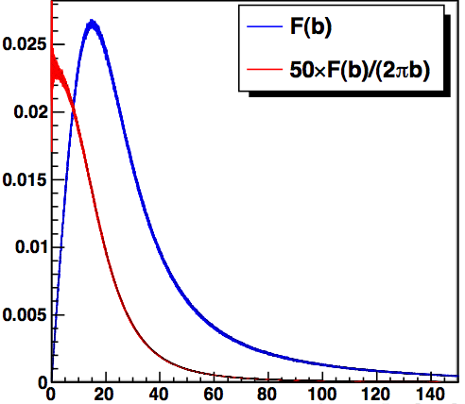
μp Diffusion Effect
(electron view)
Impact Parameter Distribution F(b)
μp Diffusion Path
μ Decay Position
early decays
later decays
b (obs.)
b_{cut}
μ-e Vertex Cut
(b_{cut})
b (ideal)
μ Stop Position
b (mm)
Later decays are less likely than early decays to pass the impact parameter cut.
The effect is calculated based on:
1) the observed F(b),
2) a thermal diffusion model,
3) the requirement of consistency
of the c_{d} ratio vs. b_{cut} (prev. slide).

Slide 16
Consistency Checks
lifetime vs. variations in parameters not expected to change the results

Slide 17
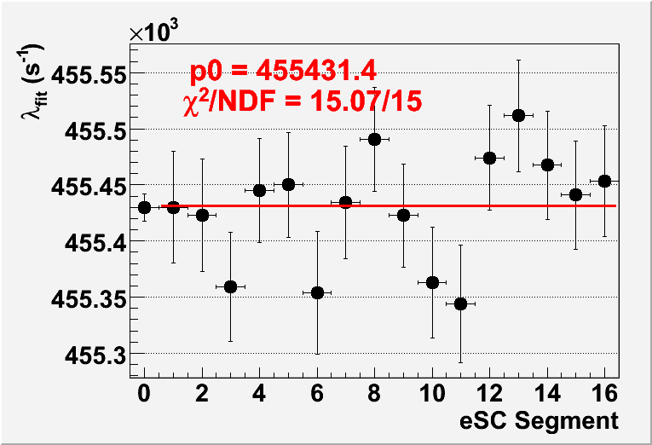
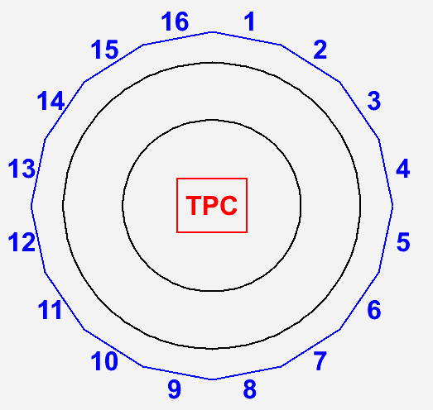
Lifetime vs eSC segment
eSC
Beam view
of MuCap
detector
Sum over all segments

Slide 18
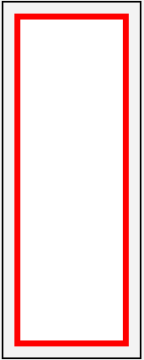
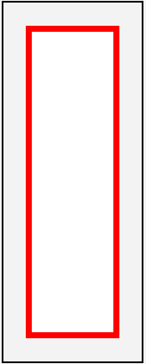
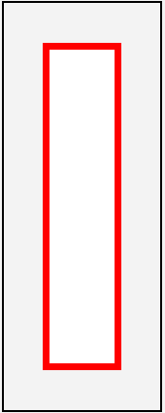
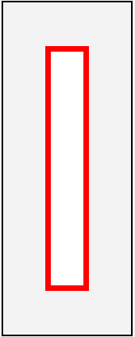
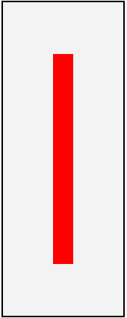
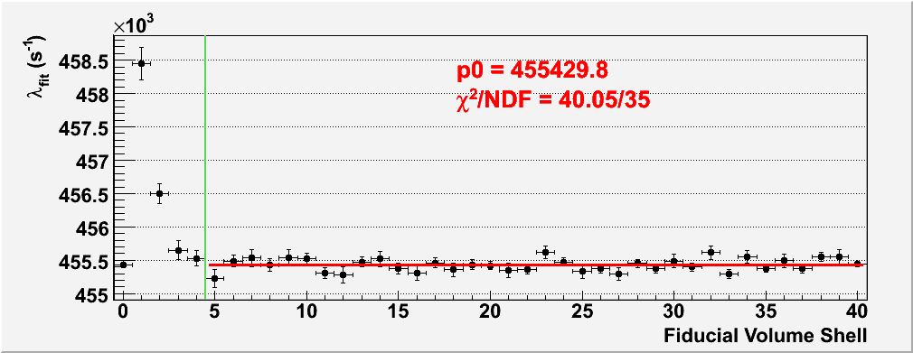
Lifetime vs. Non-Overlapping Fiducial Volume Shell
outer
inner
z
outside the standard fiducial cut
y
Example TPC fiducial volume shells (red areas)
Included in standard fiducial cut
outer
inner

Slide 19
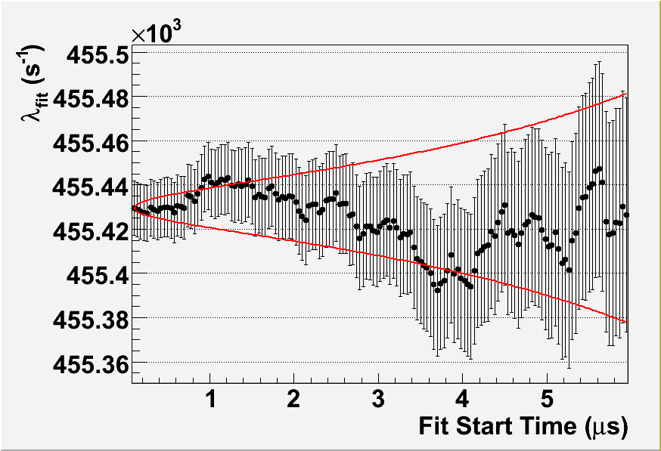
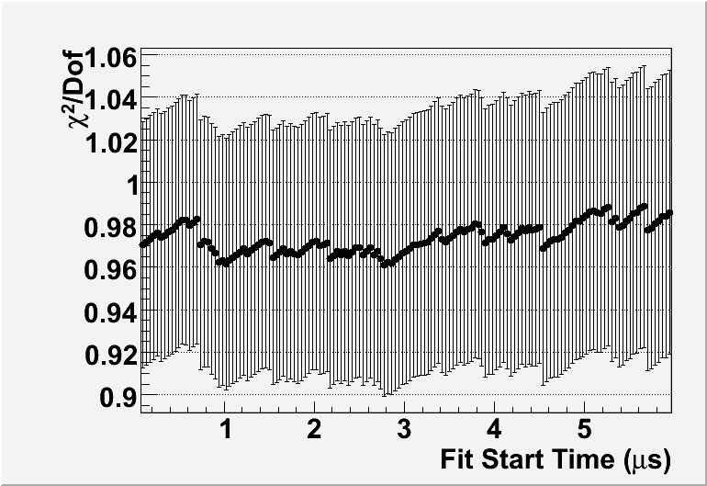
Fit Start Time Scan

Slide 20
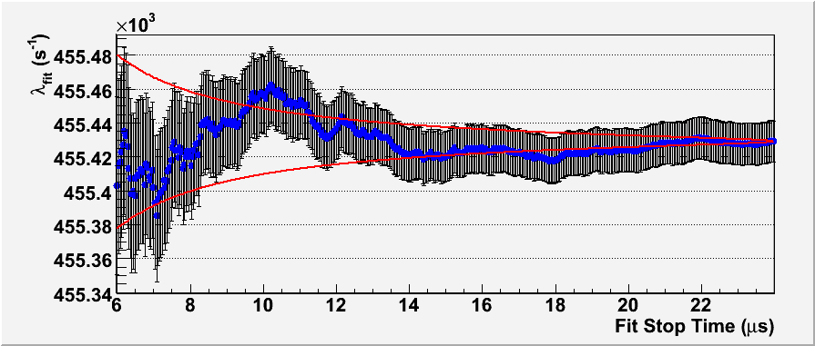
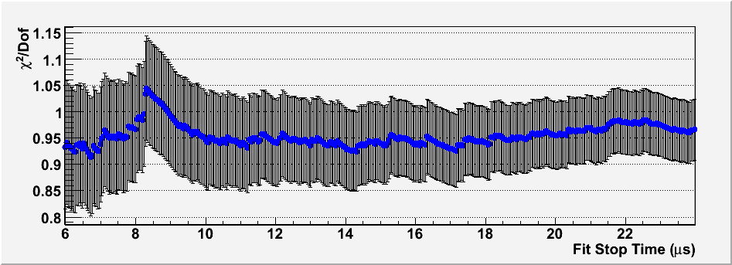
Fit Stop Time Scan

Slide 21
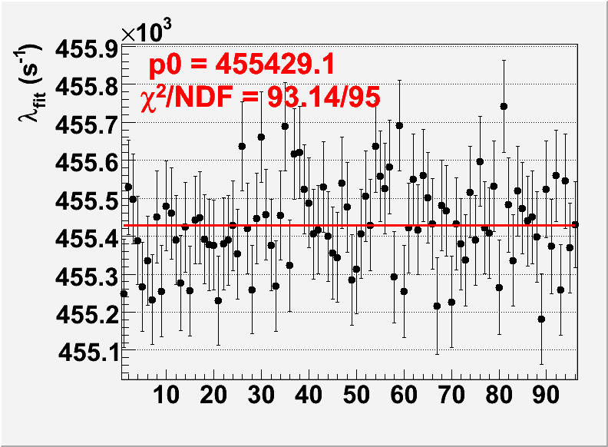
Lifetime vs. Chronological Subdivisions
Oct. 9, 2004
Nov. 4, 2004

Slide 22
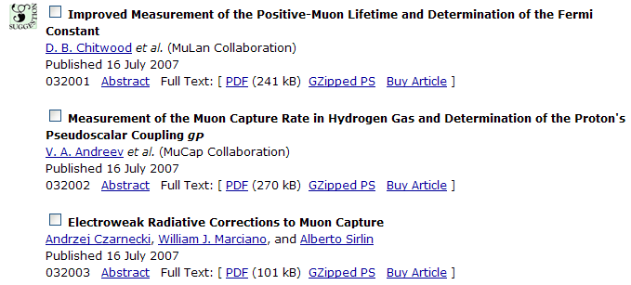
Λ_{s} and g_{P} Results 07
MuCap Result 07
Theory 07
Pseudoscalar coupling from MuCap 07
with τ_{μ}+ from PDG and MuLan
PRL 99, 032001 (2007)
Λ_{S}^{MuCap} = 725.0 ± 13.7_{stat} ± 10.7_{sys} s⁻¹
Average of HBChPT calculations of Λ_{S}:
further sub percent theory required
Λ_{S}^{Theory} = 710.6 s⁻¹
Apply new rad. correction (2.8%):
Czarnecki, Marciano,Sirlin , PRL 99 (2007)
g_{P} = 7.3 ± 1.1

Slide 23
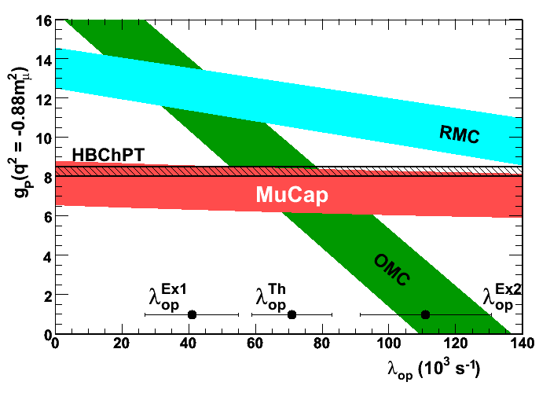
Updated g_{P} vs. λ_{op}
(contributes 3% uncertainty to g_{p}^{MuCap})
MuCap 2007 result (with g_{P} to 15%) is consistent with theory.
This is the first precise, unambiguous experimental determination of g_{P}

Slide 24
Several upgrades should lead to a 3-fold improved precision in 2006-2007 runs
Source | 2007 Uncertainty (s⁻¹) | Projected Final Uncertainty (s⁻¹)
Statistical | 13.7 | 3.7
Z > 1 impurities | 5.0 | 2
µd diffusion | 1.6 | 0.5
µp diffusion | 0.5 | 0.5
µ + p scattering | 3 | 1
µ pileup veto eff. | 3 | 1
Analysis Methods | 5 | 2
Muon kinetics | 5.8 | 2
Systematic | 10.7 | 3.8
Total | 17.4 | 5.3

Slide 25
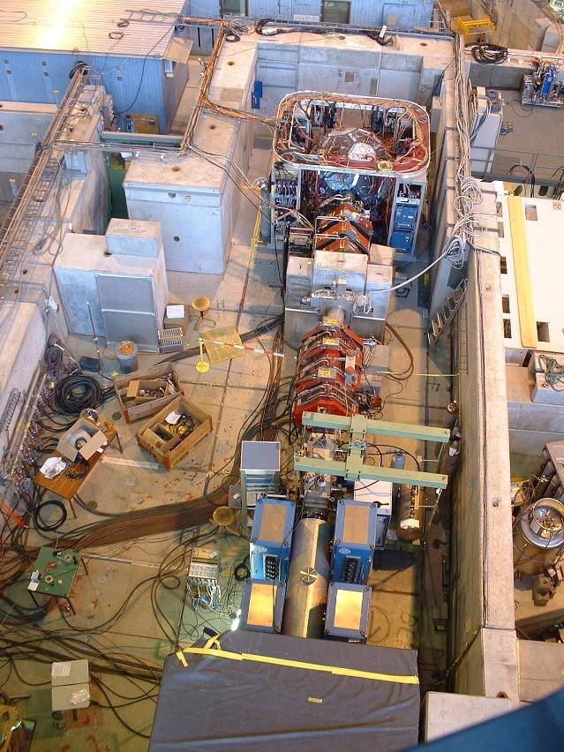
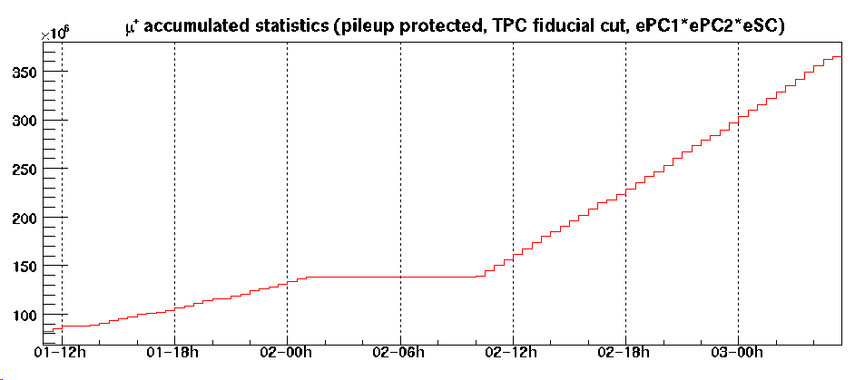
Muon-On-Demand
Single muon requirement (to prevent systematics from pile-up) limits accepted μ rate to ~ 7 kHz, while PSI beam can provide ~ 70 kHz
Muon-On-Demand concept
Muon-On-Demand concept
Beamline
Kicker Plates
μ detector
μ⁻
TPC
+12.5 kV
-12.5 kV
50 ns switching time
μLan kicker TRIUMF rf design
2-Dec-2005
kicked
Fig will be improved
dc
~3 times higher rate

Slide 26
Several upgrades should lead to a 3-fold improved precision in 2006-2007 runs
Source | 2007 Uncertainty (s⁻¹) | Projected Final Uncertainty (s⁻¹)
Statistical | 13.7 | 3.7
Z > 1 impurities | 5.0 | 2
µd diffusion | 1.6 | 0.5
µp diffusion | 0.5 | 0.5
µ + p scattering | 3 | 1
µ pileup veto eff. | 3 | 1
Analysis Methods | 5 | 2
Muon kinetics | 5.8 | 2
Systematic | 10.7 | 3.8
Total | 17.4 | 5.3

Slide 27
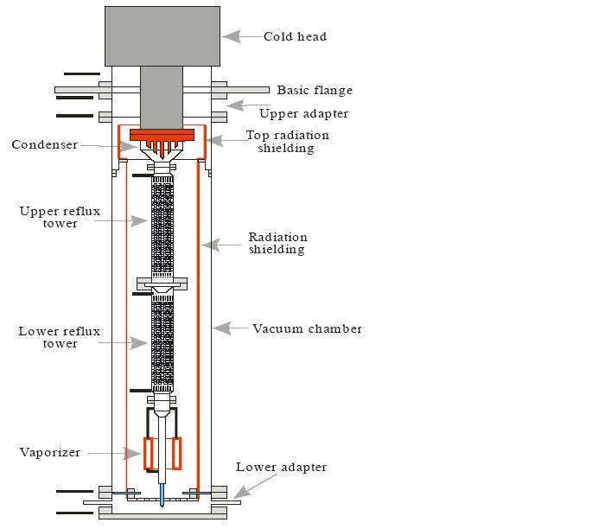
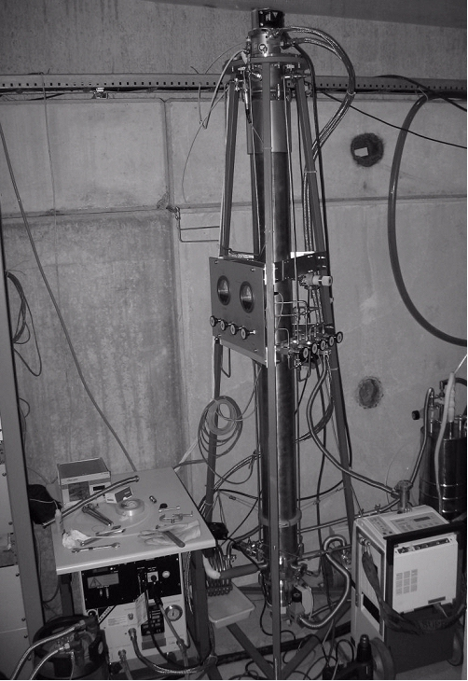
HD separation column
constructed in Gatchina & PSI, tested & operated in March/April 2006
principle: - H₂ gas circulates from bottom to top & gets liquified at the cold head
- liquid droplets fall down & vaporize → gas phase depleted from D
- the D-enriched liquid H₂ at the bottom is slowly removed
results of AMD analysis at ETHZ:
protium in 2004/5:
c_{d} = (1.45±0.15)10⁻⁶
protium used in 2006 after HD separation:
c_{d} < 6*10⁻⁹ (6 ppb)

Slide 28
Several upgrades should lead to a 3-fold improved precision in 2006-2007 runs
Source | 2007 Uncertainty (s⁻¹) | Projected Final Uncertainty (s⁻¹)
Statistical | 13.7 | 3.7
Z > 1 impurities | 5.0 | 2
µd diffusion | 1.6 | 0.5
µp diffusion | 0.5 | 0.5
µ + p scattering | 3 | 1
µ pileup veto eff. | 3 | 1
Analysis Methods | 5 | 2
Muon kinetics | 5.8 | 2
Systematic | 10.7 | 3.8
Total | 17.4 | 5.3

Slide 29
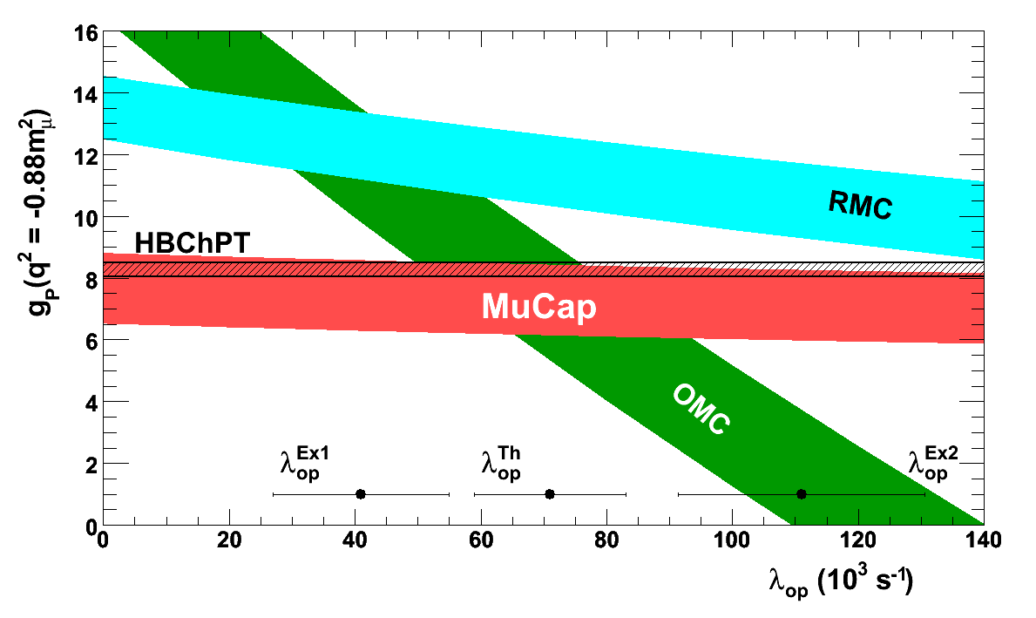
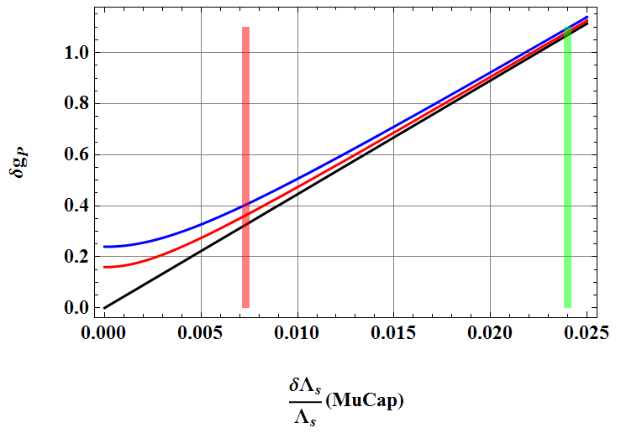
Summary and Outlook
Synergy with MuLan
MuCap
First precise g_{P} with clear interpretation
Consistent with ChPT expectation, clarifies long-standing QCD puzzle
Factor 3 additional improvement on the way
Final Precision of g_{P} determination
Watch new τ_{n} experiments:
g_{A} to explain Serebrov et al. would shift predicted Λ_{S} by ~ 0.7 %
MuCap final 09?
δg_{P}
MuCap 07
+ δRC
+ δg_{A}
exp
δΛ_{S}/Λ_{S}

Slide 30

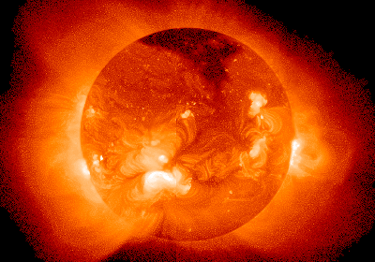
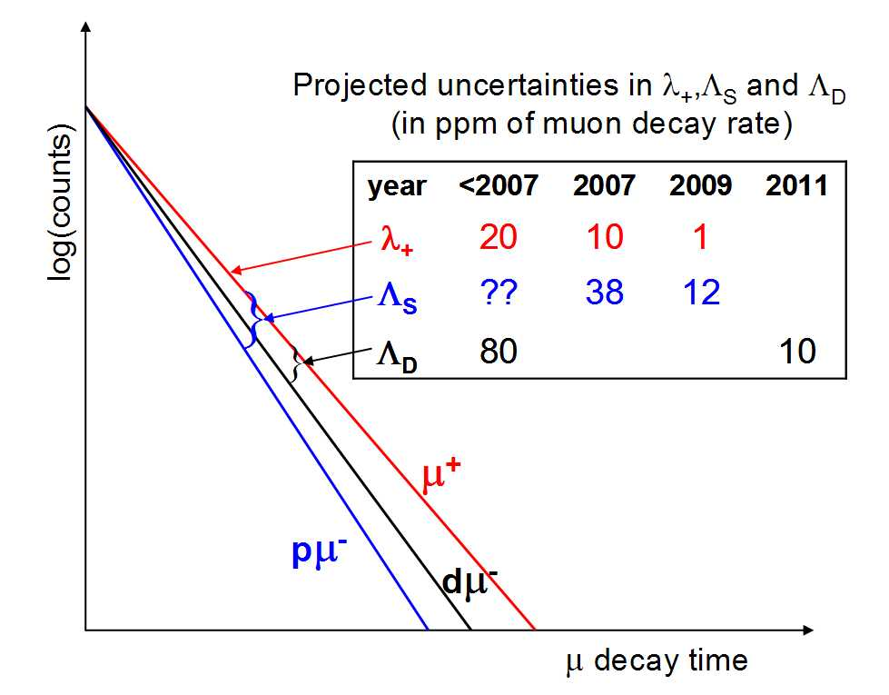
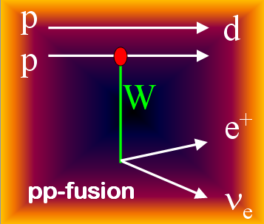
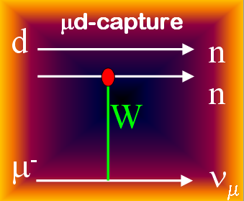
“Calibrating the Sun” via Muon Capture on the Deuteron
μ⁻ + d → n + n + ν
NEW PROJECT
Motivation for the MuSun Experiment:
First precise measurement of basic Electroweak reaction in 2N system,
Impact on fundamental astrophysics reactions (ν’s in SNO, pp fusion)
Comparison to modern high-precision calculations

Slide 31
MuCap Collaboration
V.A. Andreev, T.I. Banks, B. Besymjannykh, L. Bonnet, R.M. Carey, T.A. Case, D. Chitwood, S.M. Clayton, K.M. Crowe, P. Debevec, J. Deutsch, P.U. Dick, A. Dijksman, J. Egger, D. Fahrni, O. Fedorchenko, A.A. Fetisov, S.J. Freedman, V.A. Ganzha, T. Gorringe, J. Govaerts, F.E. Gray, F.J. Hartmann, D.W. Hertzog, M. Hildebrandt, A. Hofer, V.I. Jatsoura, P. Kammel, B. Kiburg, S. Knaak, P. Kravtsov, A.G. Krivshich, B. Lauss, M. Levchenko, E.M. Maev, O.E. Maev, R. McNabb, L. Meier, D. Michotte, F. Mulhauser, C.J.G. Onderwater, C.S. Özben, C. Petitjean, G.E. Petrov, R. Prieels, S. Sadetsky, G.N. Schapkin, R. Schmidt, G.G. Semenchuk, M. Soroka, V. Tichenko, V. Trofimov, A. Vasilyev, A.A. Vorobyov, M. Vznuzdaev, D. Webber, P. Winter, P. Zolnierzcuk
Petersburg Nuclear Physics Institute (PNPI), Gatchina, Russia Paul Scherrer Institute (PSI), Villigen, Switzerland University of California, Berkeley (UCB and LBNL), USA University of Illinois at Urbana-Champaign (UIUC), USA Université Catholique de Louvain, Belgium TU München, Garching, Germany University of Kentucky, Lexington, USA Boston University, USA

Slide 32
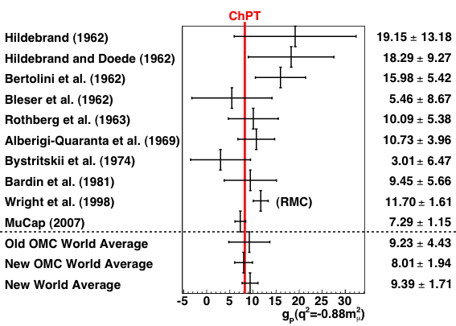
World data on g_{P}

Slide 33
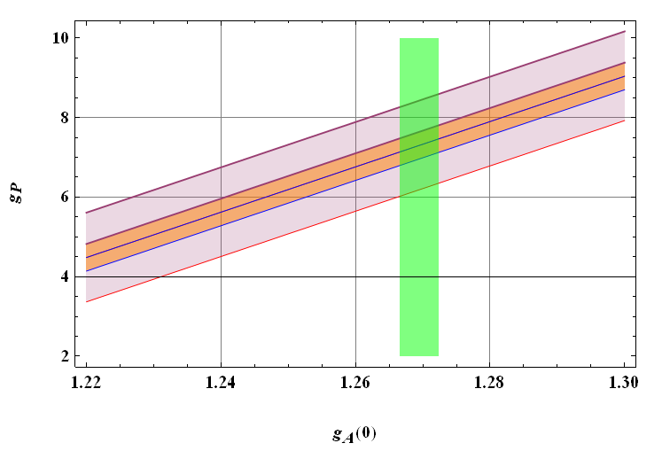
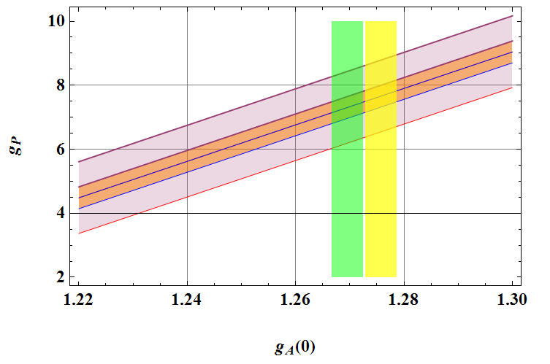

Expectations for Final MuCap Precision
δg_{P} vs δΛ_{S}/Λ_{S}
Allowed g_{P} vs g_{A}
“g_{a} to explain Serebrov et al”
MuCap final 09?
MuCap 07
g_{a} PDG
MuCap 07
MuCap 09?
big exp. improvement 0.7 %
sub-percent theory needed ?
PDG g_{a} contributes 0.36 %
Rad. corr. 0.4 %

Slide 34
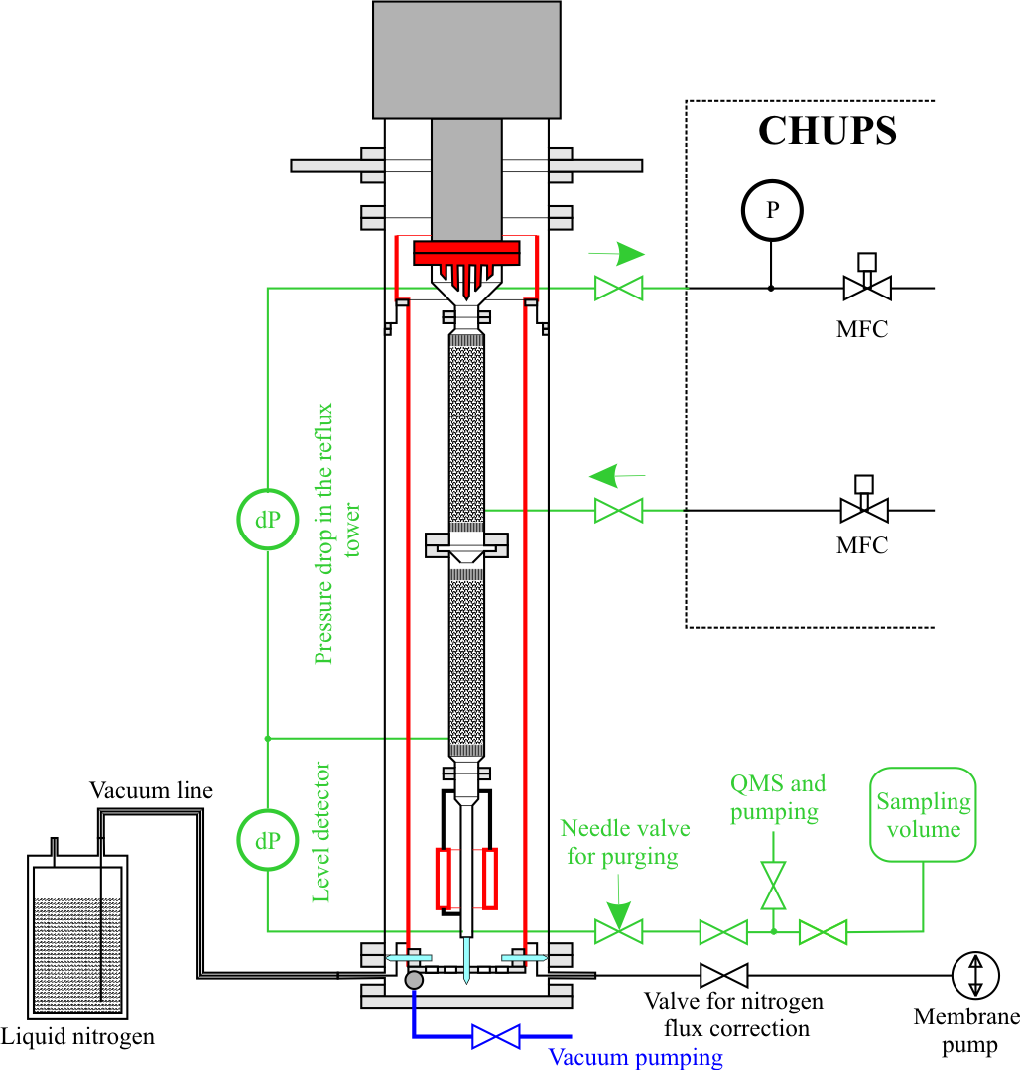
Record Isotopic Purity Achieved
µp + d → μd + p (134 eV)
large diffusion range of μd
< 1 ppm isotopic purity required
μ-e impact par cut
μp
μp→ μd
e⁻
e⁻
or to wall
Diagnostic:
λ vs. μ-e vertex cut
2007 Result
Data: c_{d}= 1.49 ± 0.12 ppm
AMS: c_{d}= 1.44 ± 0.15 ppm
On-site isotopic separator
c_{d} < 0.010 ppm !
World record
AMS, ETH Zurich
AMS, ETH Zurich

Slide 35
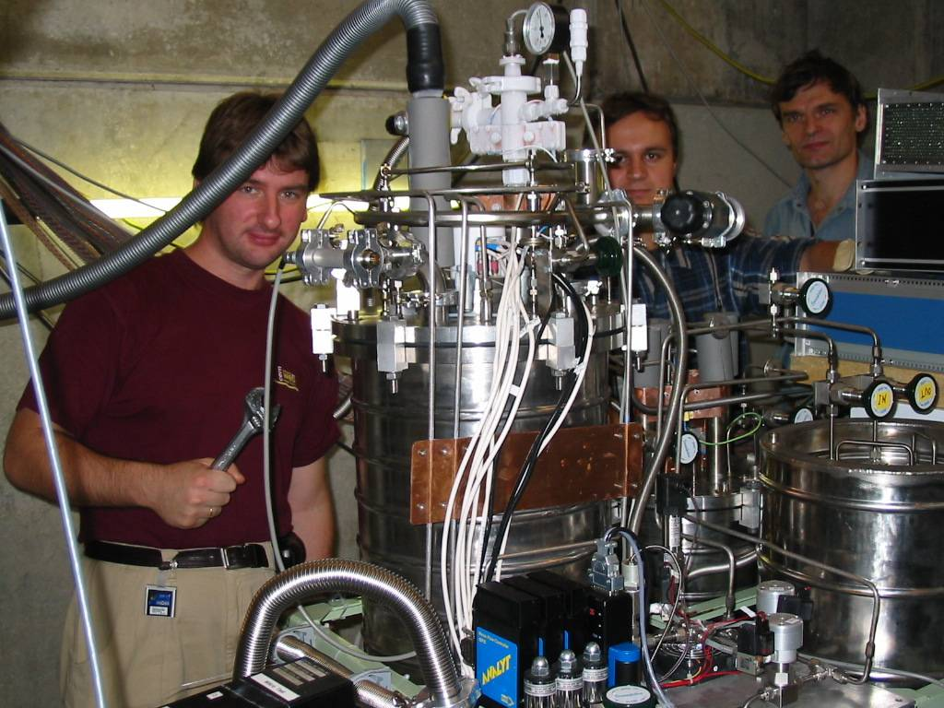
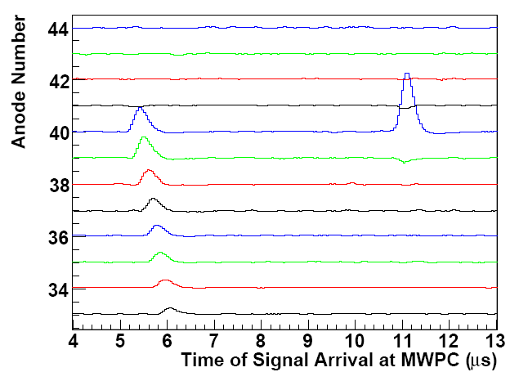
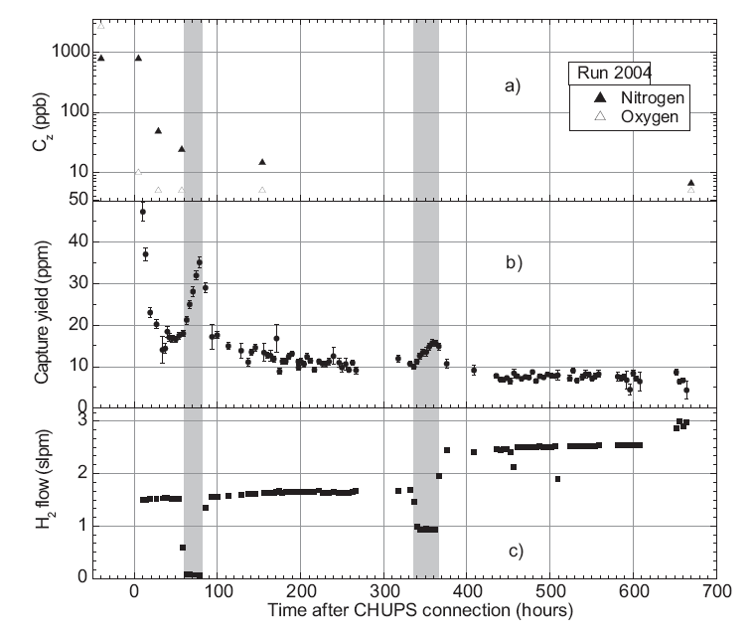
Z>1 Impurities Reduced and Measured
CHUPS
FADC upgrade on all TPC channels
Circulating Hydrogen Ultrahigh Purification System (CHUPS)
Gas chromatography
c_{N}, c_{O} < 5 ppb, c_{H2O} <10 ppb
CRDF support
Diagnostic in TPC
x
t
z
Imp. Capture

Slide 36
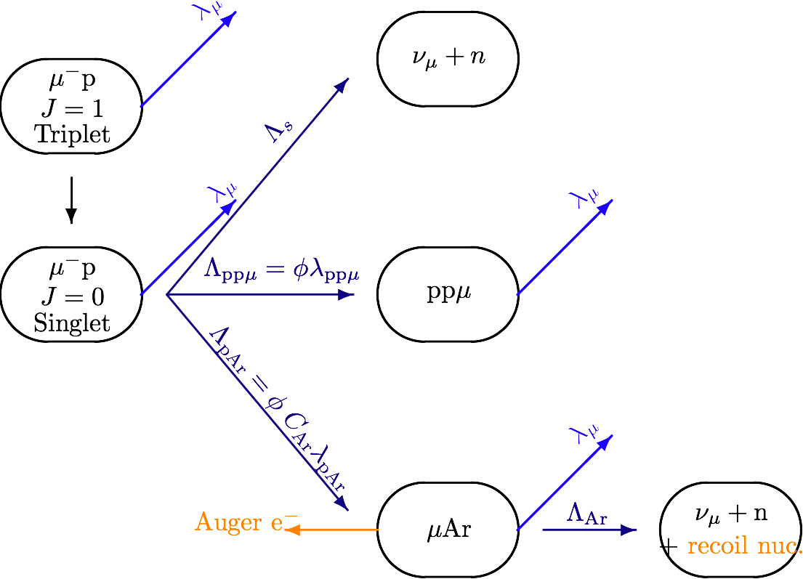
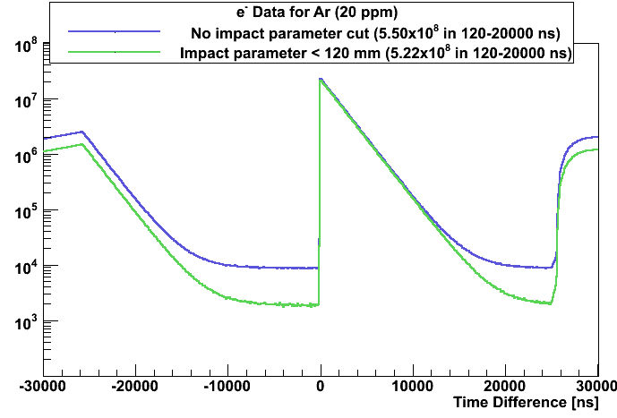
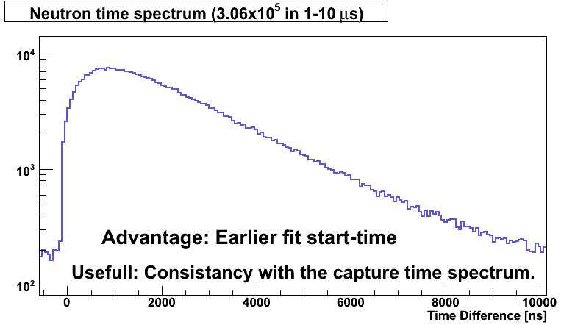
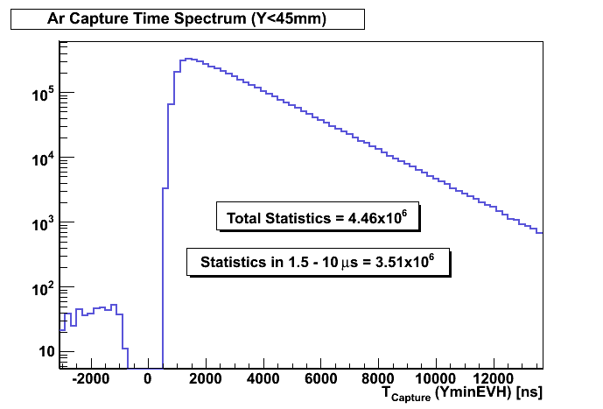
Argon doped run for Λ_{ppμ} measurement
- protium run with 20 ppm Argon doping
- electron spectrum 5.5*10⁸ events
- neutrons from μAr capture 3*10⁵ events
- tpc data from μ-Ar capture 4*10⁶ evts
combined analysis of time spectra yields
λ^{capt}_{Ar} , λ^{transfer}_{pAr} , λ_{ppμ} to ~2%
reduces error of Λ_{S} to 0.5 s⁻¹ !
(analysis in progress at Urbana)
e⁻ time spectrum yields λ_{e} neutron time spectrum Ar capture time spectrum

Slide 37
μCap Method: Lifetime Technique
μCap measures the lifetime of μ⁻ in 10 bar Hydrogen.
e⁻
Data Acquisition
H₂
T_{electron}
μ⁻
T_{zero}
ΔT
Repeat 10¹⁰ times for a 10 ppm precision lifetime measurement.
slope = λ_{μ}⁻ ≡ 1/τ_{μ}⁻
Compare to μ⁺ lifetime:
Log N_{events}
slope = λ_{μ}⁺ ≡ 1/τ_{μ}⁺
λ_{μ}⁻ ≈ λ_{μ}⁺ + Λ_{S}
⇒ Λ_{S} to 1% precision
ΔT
Notes:
Actual muCap detector has:
full tracking of the muon to its stop position;
electron direction tracking, with ~70% of 4*pi coverage;
etc.

Slide 38
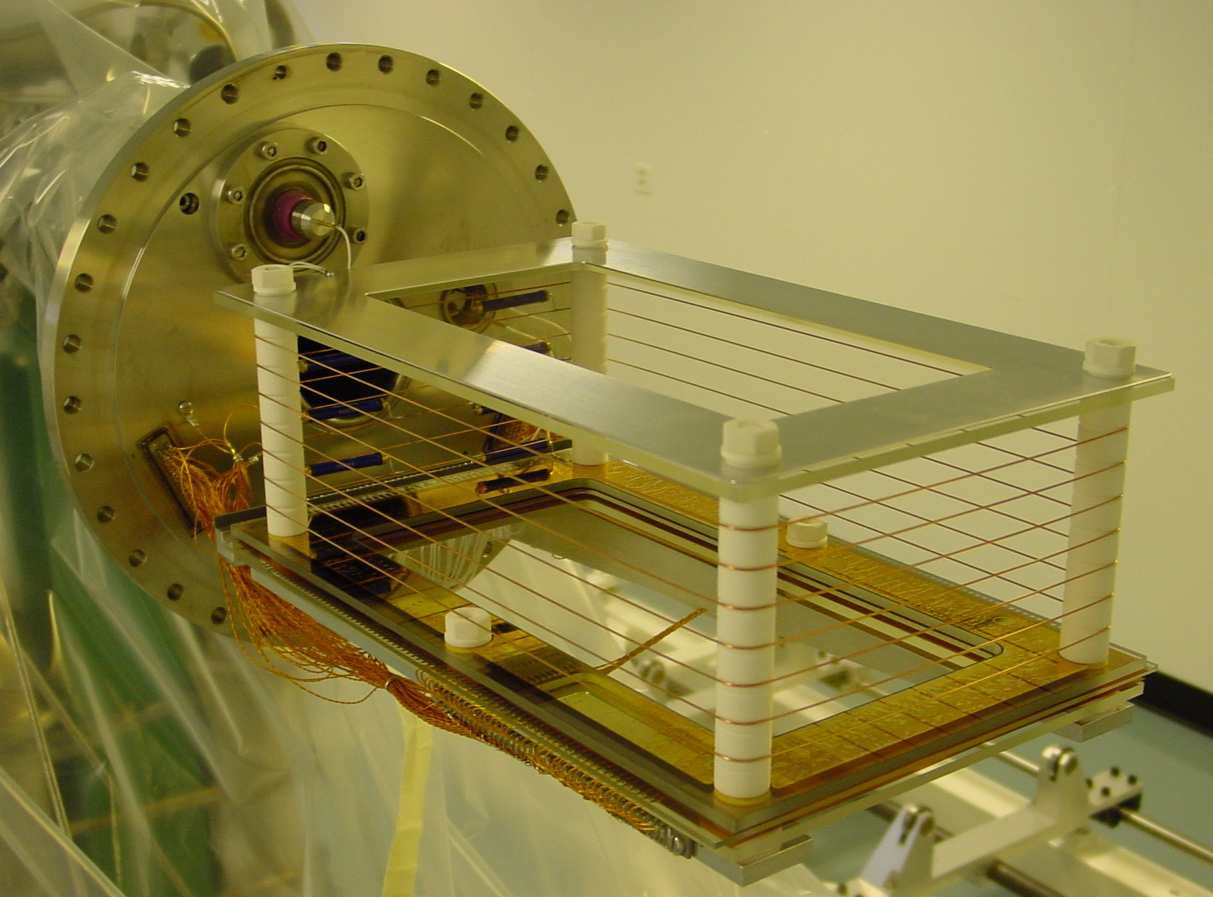
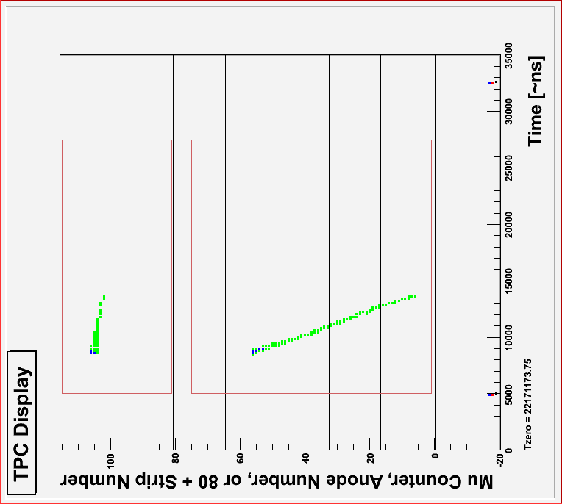
3D tracking w/o material in fiducial volume
Time Projection Chamber (TPC)
10 bar ultra-pure hydrogen, 1% LH₂
2.0 kV/cm drift field
>5 kV on 3.5 mm anode half gap
bakable glass/ceramic materials
μ Stop
Side View
Beam View
y
y
μ Beam
z
x
Notes:
TPC tracking in Y needs time of mu entrance and drift time. For unambiguous tracking, 1 muon at a time is preferred; 25 microsecond drift time sets optimal beam rate. With DC beam at optimal ~20 kHz, ~65% of events rejected due to pileup. Use of kicked beam therefore improves good data rate by ~3 times.

Slide 39
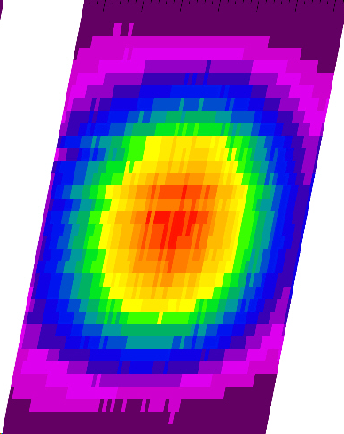

3D tracking w/o material in fiducial volume
Time Projection Chamber (TPC)
10 bar ultra-pure hydrogen, 1% LH₂
2.0 kV/cm drift field
>5 kV on 3.5 mm anode half gap
bakable glass/ceramic materials
Observed muon stopping distribution
μ⁻
E
e⁻
p

Slide 40

μCap Method: Clean μ Stop Definition
Each muon is tracked in a time projection chamber.
Data Acquisition
e⁻
T_{electron}
strips
H₂
μ⁻
anodes
Only muons stopped well-away from non-hydrogen are accepted.
T_{zero}
ΔT
Notes:
Actual muCap detector has:
full tracking of the muon to its stop position;
electron direction tracking, with ~70% of 4*pi coverage;
etc.

Slide 41
μCap Detailed Diagram
Tracking of Muon to Stop Position in Ultrapure H₂ Gas
Tracking of Decay Electron
Notes:
Also, in 2005, neutron detectors were installed in effort to constrain lambda_op. Development of readout continues.
Spectra are from 2004 data.

Slide 42

Commissioning and First Physics Data in 2004
(Target Pressure Vessel, Pulled Back)

Slide 43


μd Diffusion into Z > 1 Materials
displacement (from μ⁻ stop
position) at time of decay
μd scattering in H₂
(Monte Carlo)
Ramsauer-Townsend minimum in the scattering cross section
μd can diffuse ~10 cm before muon decay, possibly into walls.
MuCap uses deuterium-depleted hydrogen (c_{d} ≈ 1.5 ppm).
Residual effects are accounted for by a zero-extrapolation.

Slide 44

Lifetime vs. e-definition
CathOR
(treatment of
detector planes)
CathAND
eSC Only
CathOR
CathAND
CathAND
CathAND
CathOR
CathOR
eSC Only
b<12cm
no b-cut
b<12cm
no b-cut
(impact par. cut)
All e accepted
One e gated
(e-multiplicity)

Slide 45


Impurity correction scales with Z > 1 capture yield.
β_{Z} = Δλ_{Z}/Y_{Z} is similar for C, N, and O.
We can correct for impurities based on the observed Z > 1 capture yield, if we know the detection efficiency ε_{Z}.

Slide 46



MuCap Λ_{S} from the μ⁻ lifetime λ_{μ}⁻
molecular formation
μ⁺ decay rate
bound-state effect
Averaged with UCB result gives

Slide 47

μCap Experimental Strategy
Unambiguous interpretation
capture mostly from F=0 μp state at 1% LH₂ density
Lifetime method
10¹⁰ μ⁻→eνν decays
measure τ_{μ−} to 10ppm
→ Λ_{S} = 1/τ_{μ−} - 1/τ_{μ+} to 1%
Clean μ stop definition in active target (TPC)
to avoid μZ capture, 10 ppm level
Ultra-pure gas system and purity monitoring
to avoid: μp + Z → μZ + p, ~10 ppb impurities
Isotopically pure “protium” to avoid
μp + d → μd + p, ~1 ppm deuterium
diffusion range ~cm
fulfill all requirements simultaneously unique μCap capabilities

Slide 48
c_{D} Monitoring: External Measurement
Measurements with ETH Zürich Tandem Accelerator:
2004 Production Gas,
c_{D} = 1.44 ± 0.13 ppm D
2005 Production Gas,
c_{D} = 1.45 ± 0.14 ppm D
2006 Production Gas (isotope separation column),
c_{D} < 0.06 ppm D
The “Data Analysis Approach” gives a consistent result:
2004 Production Gas,
c_{D} = (0.0125 ± 0.0010) × (122 ppm D)
= 1.53 ± 0.12 ppm
Notes:
Reducing cD to nearly 0 with the separation column is of course another solution to deuterium diffusion.

